Slide 1
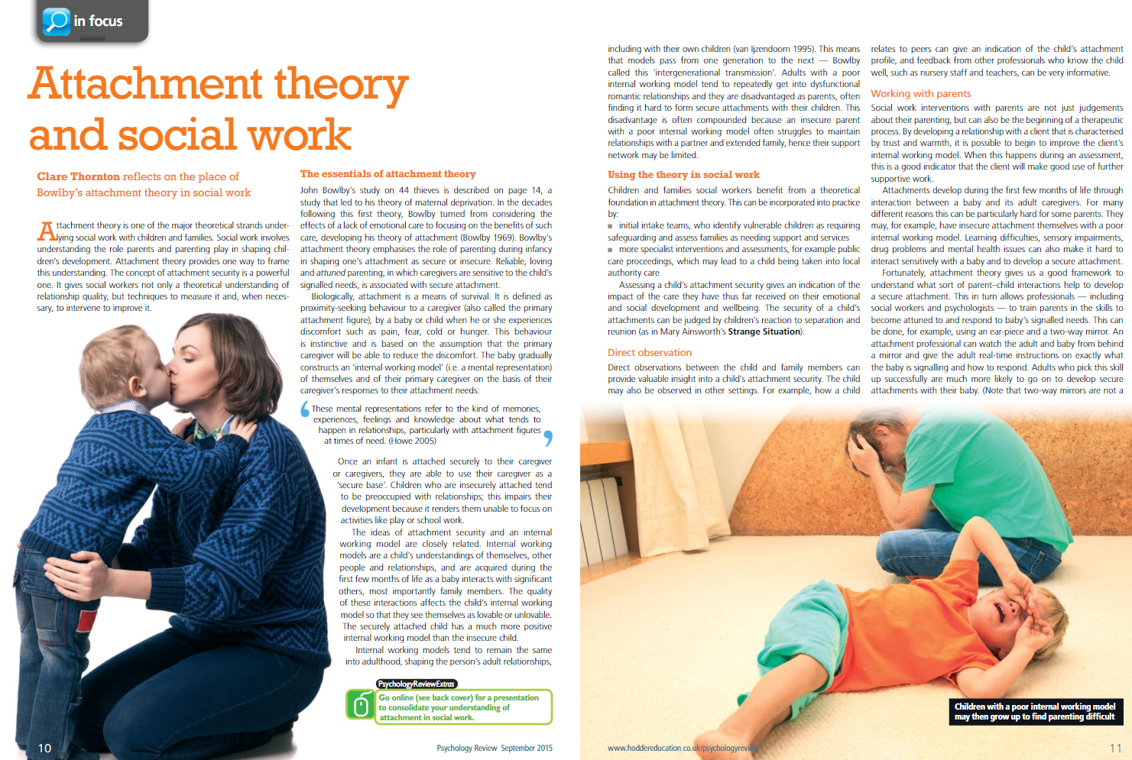
Task – read and complete the challenge yourself questions. You can either type your questions and responses on the PowerPoint or copy the article and type up answers on a word document

Slide 2
