Slide 1
Transition and Summer Project
A-Level

Slide 2
3D Design
Reflect
What is Design?
What are the main design stages?
Name one skill a designer needs.
https://www.youtube.com/watch?v=MS8p-CgTJIg

Slide 3
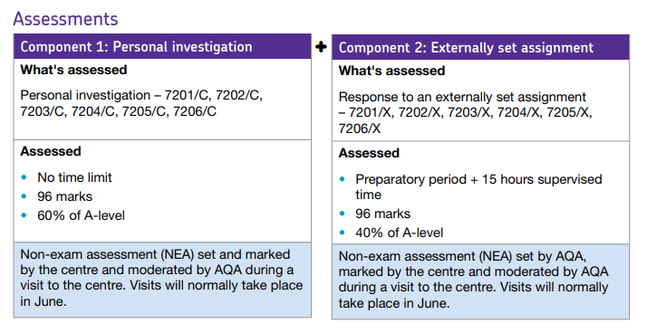
3D Design - Assessment
Big Picture
One thing to remember that this is an Art and Design course. There is no written exam, but there is a 15 hour practical exam. During this exam you have to produce an outcome, on your own.

Slide 4
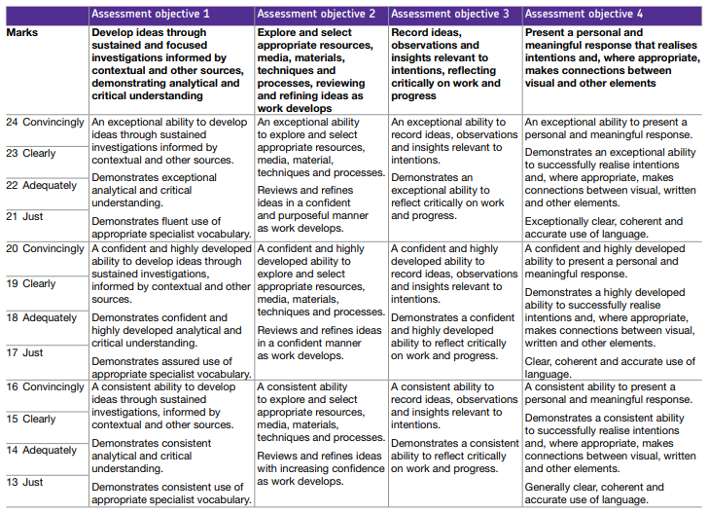
3D Design - Assessment
Big Picture
Areas of study Students are required to work in one or more area(s) of three-dimensional design, such as those listed below.
They may explore overlapping areas and combinations of areas:
Ceramics, sculpture, exhibition design, design for theatre, television and film, interior design, product design, environmental and architectural design, jewellery/body ornament, 3D digital design.

Slide 5
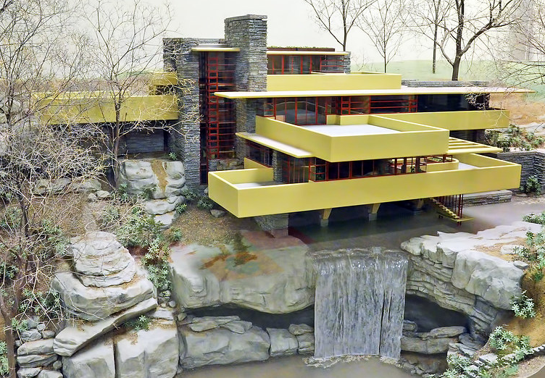
Quick analysis…
Activate
What are the key features of Frank Lloyds Wrights Falling Water Building?
https://www.youtube.com/watch?reload=9&v=kAYU2VkMnRU

Slide 6
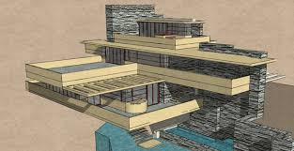
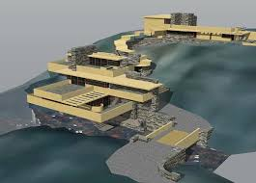
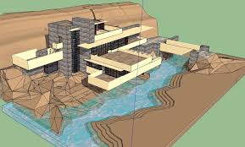
Summer Task – Critical Analysis & Design
Demonstrate
You summer task is to critical analyse Frank Lloyd Wrights Falling Water building. Discuss the key features of the design, and explain why he has designed the building in this way (500 words).
(Joe / Kia / Charles) Learn how to use SketchUp before September!
Design a building based on FLW’s Falling Water building, in SketchUp. The design needs to be as detailed as possible.

Slide 7
Demonstrate
What does critical analysis mean?
A critical analysis is subjective writing. It expresses the writer's opinion or evaluation of a piece of text / image / deign. Analysis means to break down and study the parts.
The rocks from the landscape appear inside the house.
A Stream going into the house.
Canter leaver design taken from the rock formation
Limited colour palette to link with nature.
What's next after this?
Locally source sand stone to reflect the resources from the area
Red steel work to mirror the trees in the surrounding woodland.

Slide 8
Answer these questions about Frank Lloyd Wright
Knowledge What is the designers name? Where/when were they born? What do you know about the designers background background? (Life events/education/career/company) Can you describe the designers work? Is it part of a Design period/movement? Is their a theme/style? | Understanding What is their style of the designer? What materials does the designer use? What manufacturing skills are used? Where are the products sold and what are they used for?
Beyond What are your opinions of the work and why? What skills will you develop looking at this designer? Could you change their designs in any way? how? | The Big Question Have you critically evaluated the designer? What are the key features of this designer? How will this designer influence your own work?
Demonstrate

Slide 9
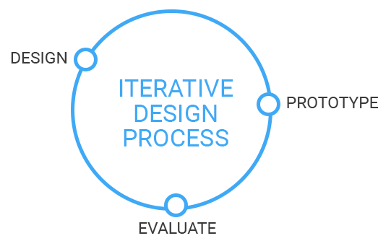
3D Design
Consolidate
Design is changing or improving peoples life.
.
Good designers ask good questions.
What is Design?
What are the main design stages?
Name one skill a designer needs.

