Slide 1
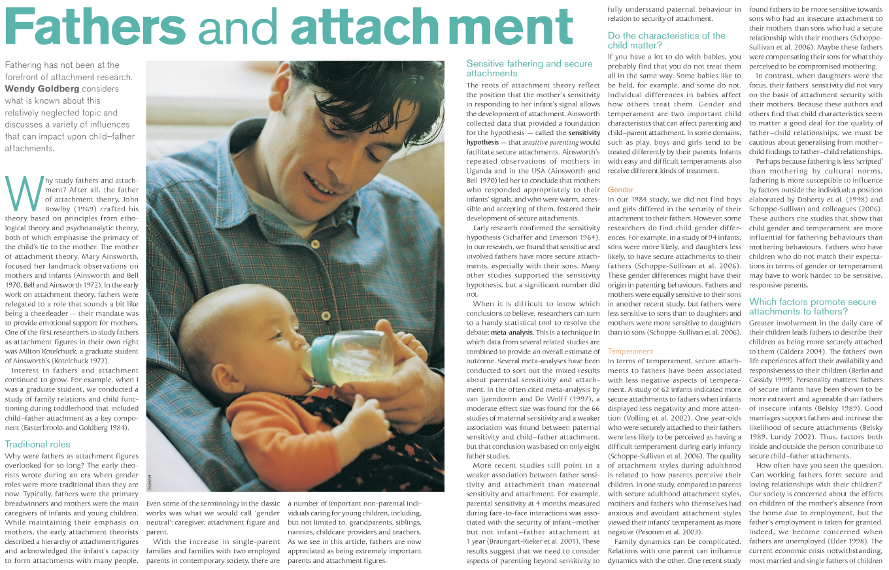

Slide 2
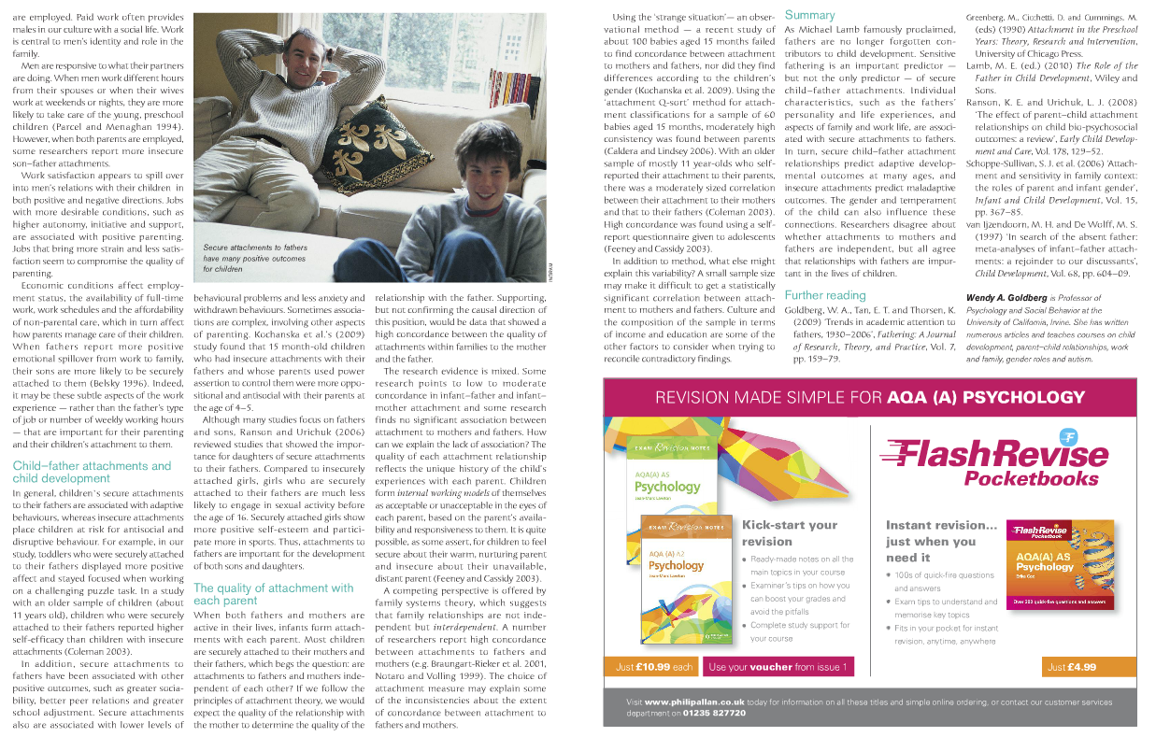

Slide 3
Outline the early work of attachment theory in relation to fathers
Why were fathers as attachment figures are overlooked for so long?
Outline what is meant by the sensitivity hypothesis.
What was the key to secure attachment according to Schafer and Emerson?
Define what is meant by a meta analysis
What do recent studies appear to suggest about father sensitivity and attachment?
Identify 2 child characteristics they can impact on parenting and child –parent attachment
Bullet point 2 points relating to gender and attachment
Define what is meant by temperament
Bullet 2 points relating to temperament and attachment
Why can family dynamics complicated?
Doherty and Schoppe suggest?
Describe the factors that promote secure attachments to fathers? (Bullet at least 3 points)
How is men's work satisfaction related to relationships with their children?
Describe the associations between secure attachment with fathers and child development. (Bullet at least 3 points).
Briefly explain Ransom and Urichuk findings on father daughter attachment.
How are mixed results in concordance rates explained
Explain the arguments of the family systems theory
What are the limitations of using self report to study attachment?
Other than sensitivity what other factors are associated with secure father child attachment?
Task - Please copy and past the questions into a word document and complete with as much detail as you can.

