Slide 1
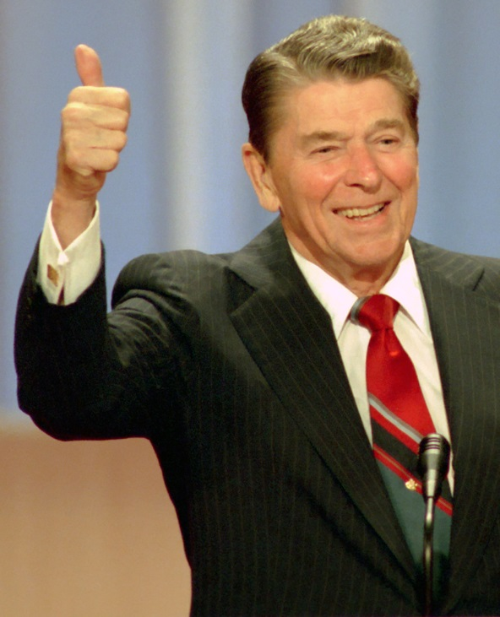
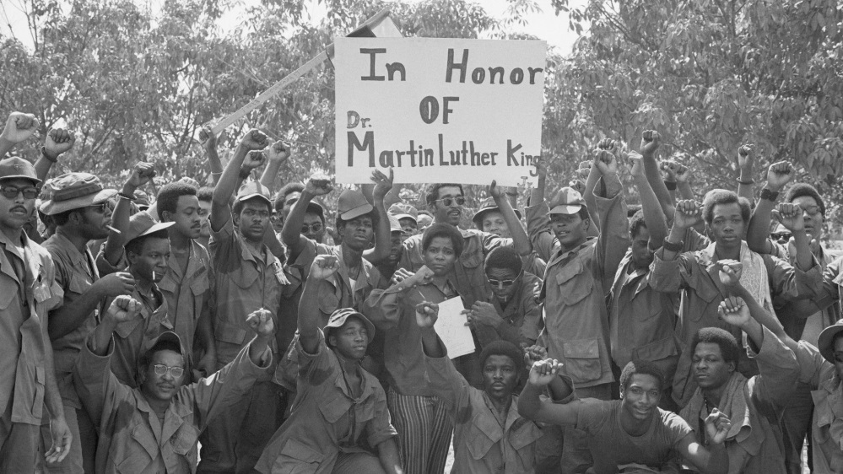
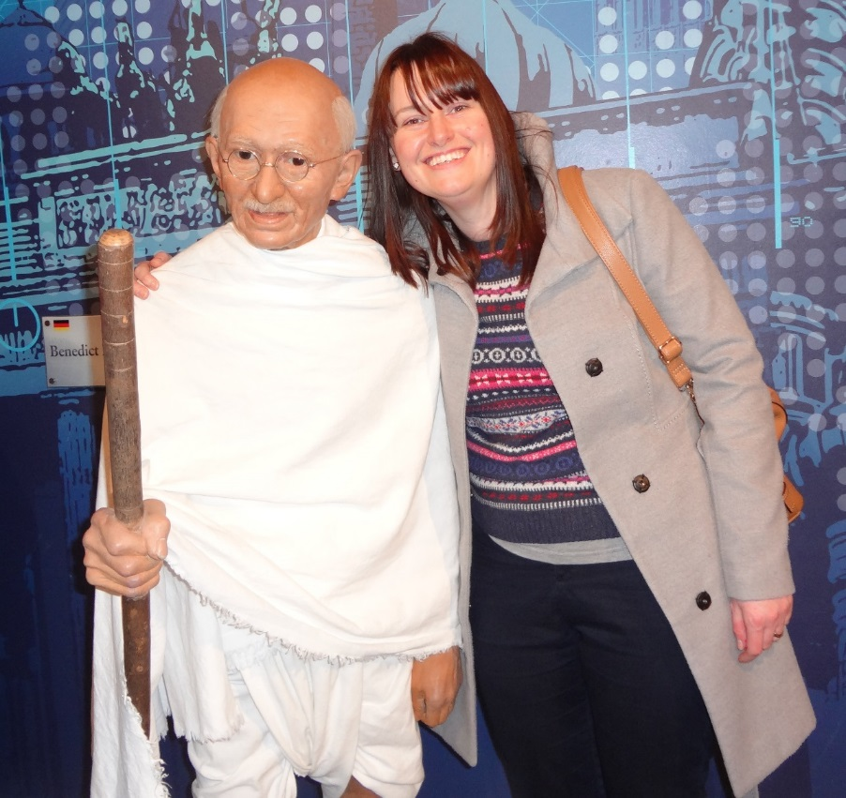
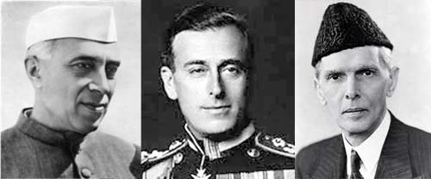
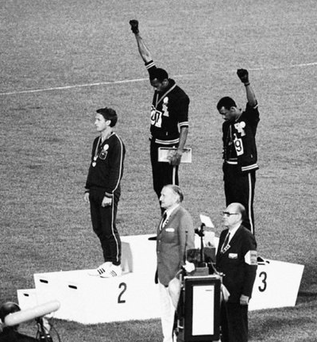
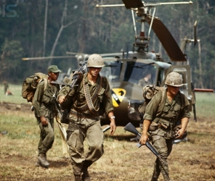
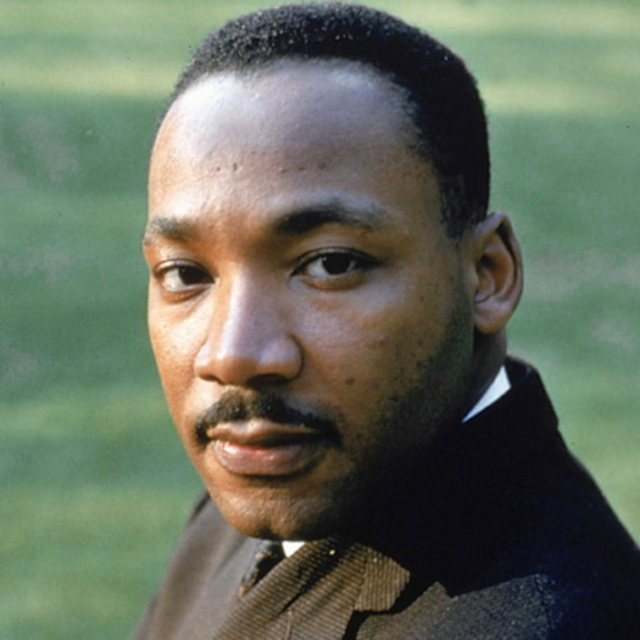
Welcome to A Level History at
The Ripley Academy

Slide 2

One key theme of A Level is racism
What do we mean by the term ‘racism’?
The belief that all members of each race possess characteristics, abilities, or qualities specific to that race, especially so as to distinguish it as inferior or superior to another race or races.

Slide 3
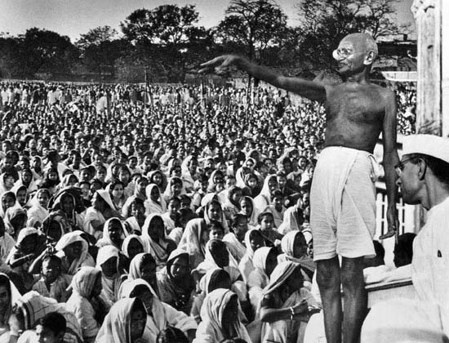
A Level History – two units of study
In Search of the American Dream
The USA 1917-96
India c1914-47
The Road to Independence
Inequality in how black, Hispanic and Native Americans were treated
Inequality of Indians ruled by the British with no say in government

Slide 4
Your task
You have been allocated one source that highlights racism and inequality in either the USA or India
In pairs, talk through the ‘discussion points’ about the source – be prepared to feedback to the group

Slide 5
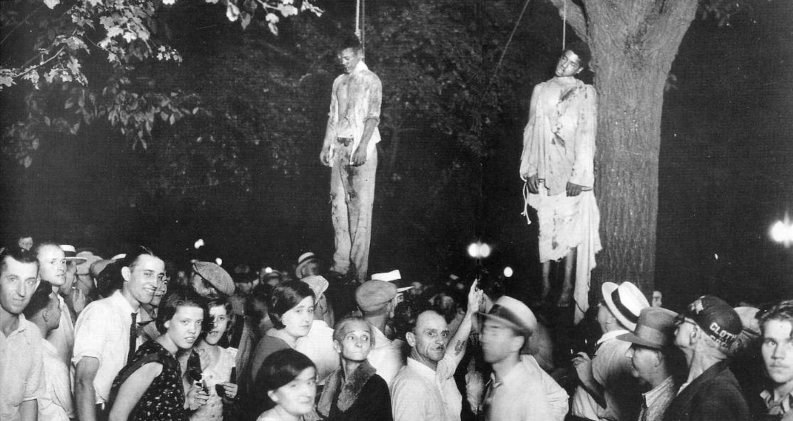
What conclusions can we make?
Elvis was a hero to most
But he never meant s*** to me you see
Straight up racist that sucker was
Simple and plain
Mother f***** him and John Wayne
Cause I'm black and I'm proud
I'm ready and hyped plus I'm amped
Most of my heroes don't appear on no stamps
Sample a look back you look and find
Nothing but rednecks for 400 years if you check
‘Fight the power’ by Public Enemy (1989)

Slide 6
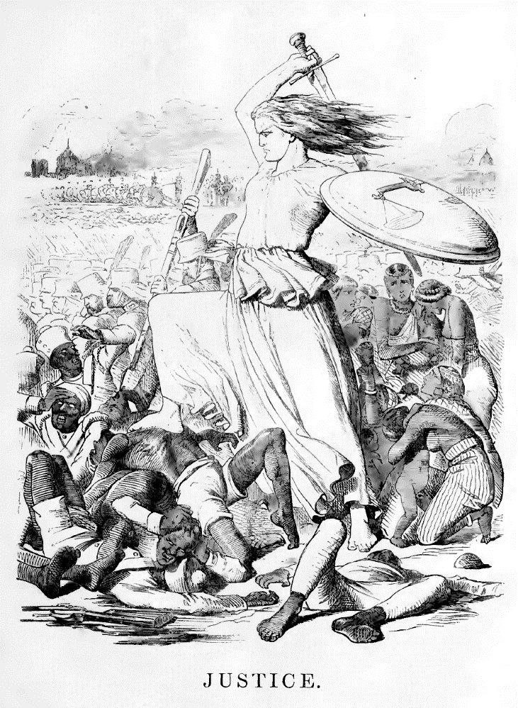
What conclusions can we make?
Take up the White Man’s burden,
Send forth the best ye breed,
Go, blind your sons to exile,
To serve your captives’ need;
To wait, in heavy harness,
On fluttered folk and wild,
Your new-caught sullen peoples,
Half devil and half child.

Slide 7
Unit 1 (Year 12)
In search of the American Dream: The USA 1917-96
30% A Level
Unit 2 (Year 12)
India 1914-47: The road to independence
20% A Level
What will I study?
Unit 3 (Year 13)
The British Experience of Warfare: 1790-1918
30% exam A Level
Unit 4 (Year 13)
Coursework
Hitler and the Nazi State
20% coursework A Level

Slide 8
Unit 1
In search of the American Dream: The USA 1917-96
Many themes are explored in this broad time period, including war, economic depression, civil rights, media and technology.
There is a separate case study about the Reagan Presidency of 1981-89 and students will analyse historians’ interpretations of Reagan as President.
Unit 2
India 1914-47: The Road to Independence
Students will study the role of India as ‘the jewel of the crown’ of the British Empire in 1914 and why this colony was so important to Britain. The role of India in both world wars is examined, along with rising nationalism and British attempts to grant reform to India. Finally, students will examine why Britain partitioned India in 1947.
Unit 3
The British Experience of Warfare: 1790-1918
Another broad time period in which students will study the British role in the French Wars, the Crimean War, the Boer War and the First World War; examining reform within the armed forces and changing attitudes to warfare at home.
Unit 4
Hitler and the Nazi State (coursework)
After studying a brief overview of Hitler’s rise to power and establishment of a dictatorship in Germany, students will research historians’ interpretations about Hitler’s role in the Nazi State; a strong or weak dictator? They will write a coursework essay of 4000 words.

