Slide 1
Business
Mrs Taylor

Slide 2
Previous student destinations
Business is a very versatile subject and here we have some examples of what our Business students have moved onto with their Business qualification;
Finance Apprenticeship
Police Degree Apprenticeship
Primary Teaching at University
Business and Finance studies at University
Accountancy at University
Sports Journalism
Photography at University
Business Apprenticeship

Slide 3
Applied General (AG) L3 Business
Business @ The Ripley Academy Sixth Form
“Applied General qualifications are rigorous, advanced (Level 3) qualifications that allow 16 to 19 year old students to develop transferable knowledge and skills” – Department for Education (DFE)
You will gain a Universally accepted qualification with UCAS points.
You will develop your skills through taking part in activities including ICT, communication, research, presentation & others.
You will participate in real business activities
e.g. setting up a Business, selecting marketing activities etc.
Your learning is directly applied to real businesses- you will study real Businesses, visit them and produce work based on them.

Slide 4
Standing out from others
Business @ The Ripley Academy Sixth Form
The key to success involves standing out from the crowd.
You all have skills and talents which make you unique. The difficulty is sometimes you don’t realise that you have them.
If you can produce the winning formula of skills and qualifications that employers/Universities are looking for, you will be successful.
KEY SKILLS
Organisation
Reliability
Communication
Innovation

Slide 5
Format for Y12 Business
There is a January exam each year, with a resit opportunity in June should you need to.
In Y12, there is one coursework piece.
In Y12, there is one piece of controlled assessment.

Slide 6
AQA Applied General Business – Year 1
Business @ The Ripley Academy Sixth Form
There are 3 Units in Year 12.
Unit 1:Financial Planning & Analysis (Exam)
Unit 2:Business Dynamics (C/W –Merlin)
Unit 3: Entrepreneurial Opportunities (C/A)

Slide 7
Profit in a Business
Revenue and Costs
Revenue-Total Costs
= PROFIT
Budgeted compared to Actual
A Business will also set themselves budgets to try and work to. For example, they may have a £10,000 budget to spend on their Total costs.
A Business can compare its budgeted costs to its actual costs to work out how well it did.

Slide 8
Unit 1 “Financial Planning and Monitoring”
10 minutes
Typical question for the Unit 3 examination.
Finance with a focus on Business.
How would we approach this question?
Work out the answer (5 mins)
Answer
Budgeted
£150,000-£90,000=£60,000
Actual
£145,000-£98,000=£47,000
Difference £60,000-£47,000= £13,000

Slide 9
AQA Applied General Business – Year 1
Business @ The Ripley Academy Sixth Form
Unit 1:Financial Planning & Analysis (Exam)
Unit 2:Business Dynamics (C/W –Merlin)
Unit 3: Entrepreneurial Opportunities (C/A)

Slide 10
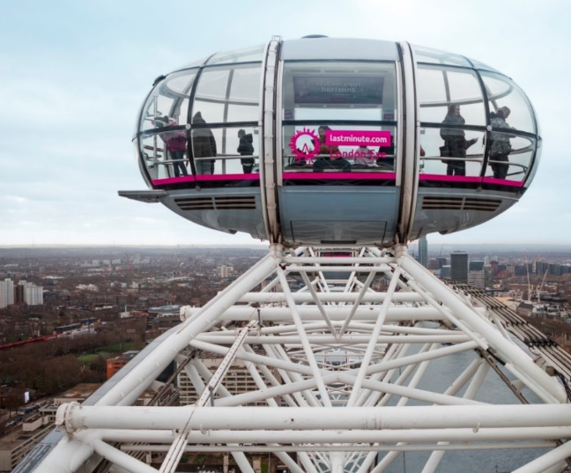
Unit 2:Business Dynamics (C/W)
Merlin Entertainments | About us
Merlin, who are now owned by Legoland are the focus of our Unit 2 coursework.
Q. Name 2 Businesses owned by Merlin?
Task 1
Find out about Merlin Entertainments and the Business that owns them.
Task 2
Find out 2 fascinating facts about Merlin that you can share with the group.
www.merlinentertanments.biz

Slide 11
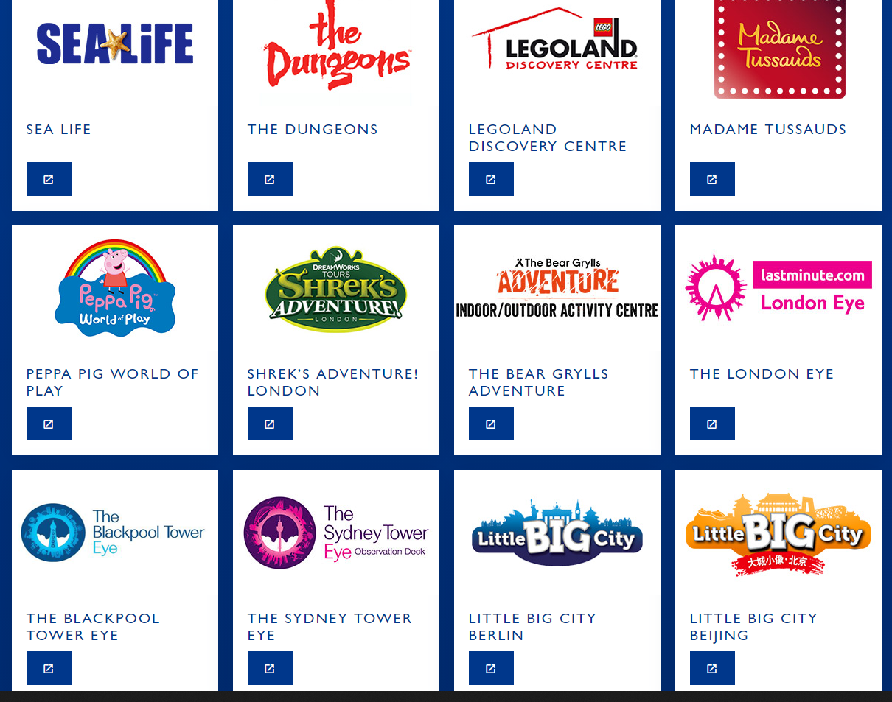
Unit 2:Business Dynamics (C/W)
Describe a market opportunity for Alton Towers or The London Eye………

Slide 12
Extended writing Task
Consolidate
Describe what has happened to Merlin plc in 2021 in terms of their ownership. What impact does this change have upon the success of the Business?

Slide 13
AQA Applied General Business – Year 1
Business @ The Ripley Academy Sixth Form
Unit 1:Financial Planning & Analysis (Exam)
Unit 2:Business Dynamics (C/W –Merlin)
Unit 3: Entrepreneurial Opportunities (C/A)

Slide 14
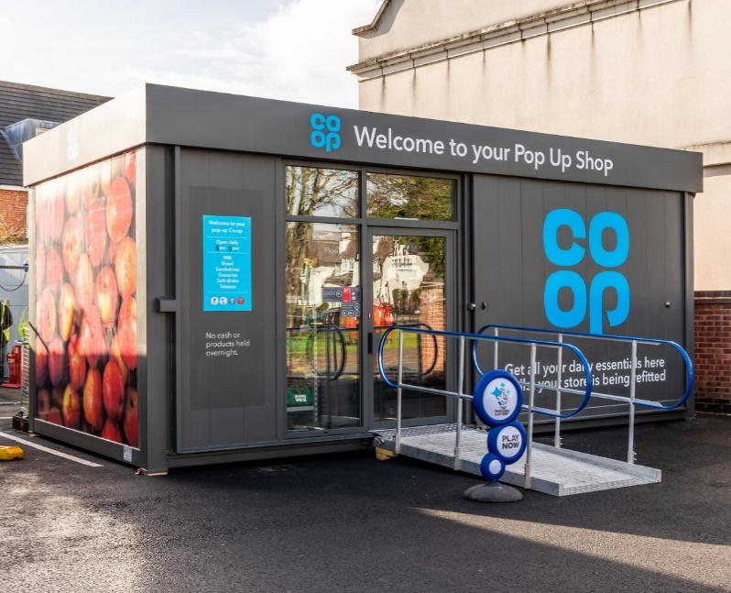
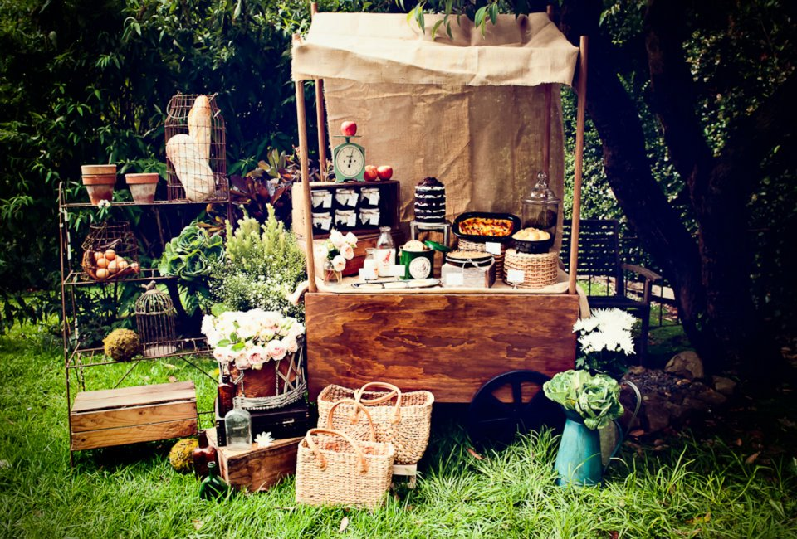
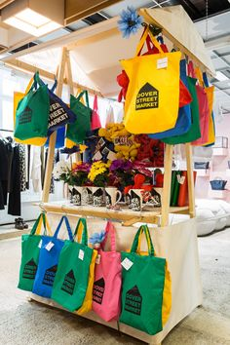
Business @ The Ripley Academy Sixth Form
Unit 3 in Business example

Slide 15
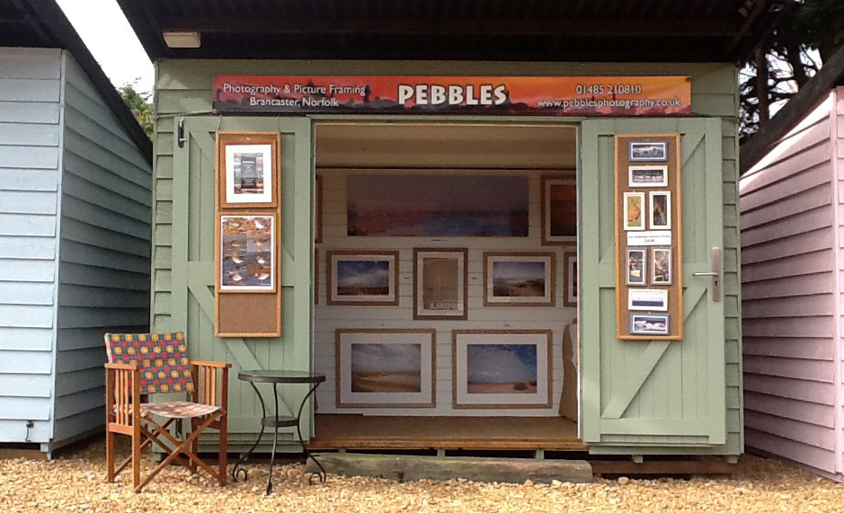
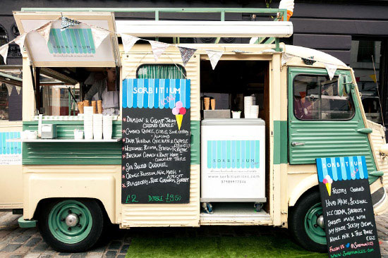
Pop up retailing
Business @ The Ripley Academy Sixth Form
DEMONSTRATE
Unit 3: Entrepreneurial Opportunities
Look at the images above
What is pop up retailing?
Q1. What are the advantages of ‘pop up’ retailing compared to a traditional shop?
Q2. WHAT ARE THE MOST POPULAR POP UP SHOPS?
Q1. Cheaper, mobile.
Q2.
1 Food
2 Drink
3 Arts and crafts

Slide 16
Thank-you for listening
Thankyou very much for listening and taking part today, I will leave you with one thought for the future.
What will your Unique Selling Point (USP) be when you are looking for a job, apprenticeship or University place?, how will you ‘stand out from the crowd’?
Any questions please email me at: etaylor@ripleyacademy.org

