Slide 1
Welcome to Alevel Philosophy and Ethics
2 Components to the course: Philosophy and Ethics, and Buddhism and Dialogues.

Slide 2
Differences between GCSE and Alevel.
You all want to be here (hopefully) so please try to fully engage with the lessons.
Anything missed will be your responsibility to catch up on (usually it will be on SMHW or you can email me)
There is a lot more opportunities for discussion and debate (you get marks for arguing in the exam)
A lot more independent work – wider research will help you get the higher grades.
Notes:
you must make sure you copy up any notes you have missed, expected to carry out extra reading around the topic.

Slide 3
Connect Activity
TASK:
On the following slides you are going to be faced with some philosophical questions.
Thumbs up/Thumbs down for each viewpoint.
Be ready to justify your answer.
By far the best way to learn philosophy is to debate it! So, with that in mind, on the following slides you are going to be faced with some philosophical questions.
Notes:
By far the best way to learn philosophy is to debate it! So, with that in mind, on the following slides you are going to be faced with some philosophical questions. Throughout this questioning it is made clear that different views are allowed in Philosophy and in fact aid learning

Slide 4
Is there life after death?
YES
NO
Notes:
By far the best way to learn philosophy is to debate it! So, with that in mind, on the following slides you are going to be faced with some philosophical questions. Throughout this questioning it is made clear that different views are allowed in Philosophy and in fact aid learning

Slide 5
Is religion compatible with science?
YES
NO
Notes:
By far the best way to learn philosophy is to debate it! So, with that in mind, on the following slides you are going to be faced with some philosophical questions. Throughout this questioning it is made clear that different views are allowed in Philosophy and in fact aid learning

Slide 6
It is acceptable to sacrifice the minority for the majority
YES
NO
Notes:
By far the best way to learn philosophy is to debate it! So, with that in mind, on the following slides you are going to be faced with some philosophical questions. Throughout this questioning it is made clear that different views are allowed in Philosophy and in fact aid learning

Slide 7
Religion should have nothing to do with making ethical decisions
YES
NO
Notes:
By far the best way to learn philosophy is to debate it! So, with that in mind, on the following slides you are going to be faced with some philosophical questions. Throughout this questioning it is made clear that different views are allowed in Philosophy and in fact aid learning

Slide 8
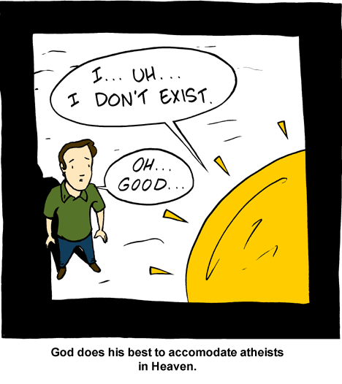
How do we argue in philosophy?
Big Picture:
To understand what is meant by philosophy.
To categorise knowledge into a priori and a posteriori.
To be able to construct simple philosophical arguments.

Slide 9
Philosophers throughout the ages

Slide 10
What is philosophy?
ACTIVATE
10 Minutes
TASK:
Read the extract from Garder’s novel ‘Sophie’s World’.
Underline/highlight as many important words/phrases as you can (minimum of 15) that explain what philosophy is.
In pairs, share your list. Reduce your list to 7 words/phrases between you.

Slide 11
What is philosophy?
PROGRESS
CHECK
5 Minutes
TASK:
As a class, decide on only 5 words and phrases.
Answer this question: ‘What is philosophy?’
Be prepared to feedback to the class.

Slide 12
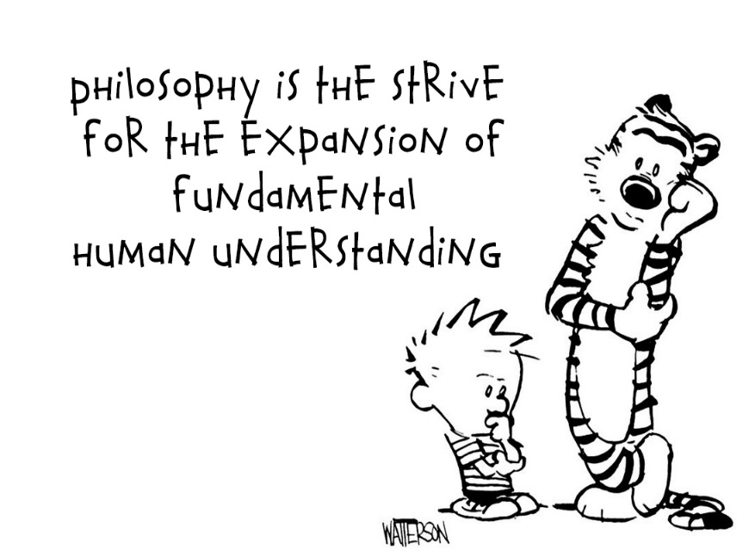
So what is philosophy?
It is the study of knowledge, existence and fundamental problems (e.g. How do we know we are real? Does God exist? Why is there evil and suffering in the world?).
Notes:
There are a set of views and theories regarding each aspect of it.

Slide 13
What is knowledge?
In philosophy knowledge can be split into two categories:
A priori knowledge – knowledge that we can have ‘prior to experience’. This can be done by applying simple reason or logic to it (e.g. 2x2=4).
A posteriori knowledge- knowledge that we can only have after certain experiences (e.g. ‘snow is white’; we can only know this by experiencing snow).
Notes:
A priori knowledge is defined as knowledge that we can have "prior to experience". We don’t need to observe how the world is to have such knowledge. Examples: "All bachelors are unmarried", "All triangles have three sides." A posteriori knowledge is knowledge that we can have only after we have certain experiences. We have to make some observations to gain such knowledge. Examples: "There is a cup on this table", "Smoking causes cancer."

Slide 14
‘A triangle has 3 sides’ – A priori or a posteriori?
Notes:
Compared to a priori knowledge, such as a mathematical equation, a posteriori knowledge is more likely to be false, since it relies on an interpretation of an experience.

Slide 15
‘The sun is orange’ – A priori or a posteriori?
Notes:
Compared to a priori knowledge, such as a mathematical equation, a posteriori knowledge is more likely to be false, since it relies on an interpretation of an experience.

Slide 16
What is knowledge?
DEMONSTRATE
15 Minutes
TASK:
Read the statements and identify them as a priori or a posteriori.
For each one, then explain your reasoning.
A priori statement- what we know by definitions or maths.
A posteriori statement- what we know through experience.
EXTENSION:
What is meant by ‘experience’?
Which type of knowledge would be more likely to be false? Why?
Notes:
Compared to a priori knowledge, such as a mathematical equation, a posteriori knowledge is more likely to be false, since it relies on an interpretation of an experience.

Slide 17
Self Assessment
The square has four sides. | A priori- the definition of the word ‘square’ includes four sides. You know the statement is true.
The square on the board is red. | A posteriori- you would have had to have seen the colour ‘red’ to know what it means.
The square has five sides. | A priori- you know the definition of ‘square’ includes four sides. You therefore know the statement is false.
The population of Ipswich is 236,502. | A posteriori- there is no way to know if this statement is true or false without having to make some (empirical) observations of the world.
TASK- Tick/correct your answers.

Slide 18
Self Assessment
David Cameron was born October 9th, 1966. | A posteriori – you cannot reasonably argue that your date of birth occurred on any particular date or time without knowledge gained empirically.
All bachelors are unmarried. | A priori- by definition you know that bachelors do not have a wife or husband.
It is raining outside. | A posteriori- you have to appeal to someone’s experience of the weather.
If George V reigned at least four days, then he reigned more than 3 days | A priori- you know that statement is true through mathematical reasoning (i.e. the order of numbers)
All tall people like baseball. | A posteriori- liking baseball is not intrinsic to being a tall person. You could only establish its truth through experience.

Slide 19
How do people argue in philosophy?
TASK- Philosophers use arguments to respond to ultimate questions about God and the universe. As you watch the Monty Python ‘Argument Clinic’ sketch consider the following:
How is an argument more than simply agreeing or disagreeing with something/one?
Notes:
Link: https://www.youtube.com/watch?v=xpAvcGcEc0k&safe=true

Slide 20
What do you think this statement means?
‘An argument is a connected series of statements to establish a proposition’

Slide 21
Two meanings to the word ‘argument’
1. An argument is just a disagreement, without any reason for their position (e.g. Carrots taste horrible!)
2. In Philosophy, an argument is a series of statements (called the premises) that support a conclusion (the claim).

Slide 22
An example of an argument
First premise (based on an observation)
All you’re doing is contradicting me.
If all you’re doing is contradicting me, then we’re not having an argument.
We’re not having an argument.
Second premise
Claim (conclusion)
TASK:
Create at least 1 philosophical argument for and against God’s existence.
Write a small paragraph for each to explain your reasoning.
15 Minutes
Notes:
Model an example with the class to help them get started. Easiest way is to start with a reason why people might think that God doesn’t exist (e.g. evil and suffering) then expand the reasoning from there.

Slide 23
Date How do we argue in philosophy?
Learning Objectives:
To understand what is meant by philosophy.
To categorise knowledge into a priori and a posteriori.
To be able to construct simple philosophical arguments.

Slide 24
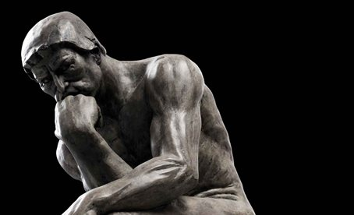
Consolidate
TASK- Answer the following questions:
What is the format for an argument in philosophy?
What is the difference between a priori and a posteriori knowledge?
Generate an example to show each type of knowledge.

Slide 25
Homework
TASK:
Complete the glossary of key terms.
Produce a title page for ‘Philosophy of Religion’. It should outline:
A definition of philosophy
Different viewpoints on its meaning
Names of famous scholars
Examples of a priori and a posteriori statements

