Slide 1
India, c1914-48
Welcome to Year 12 History Taster Session (1)
The road to independence

Slide 2
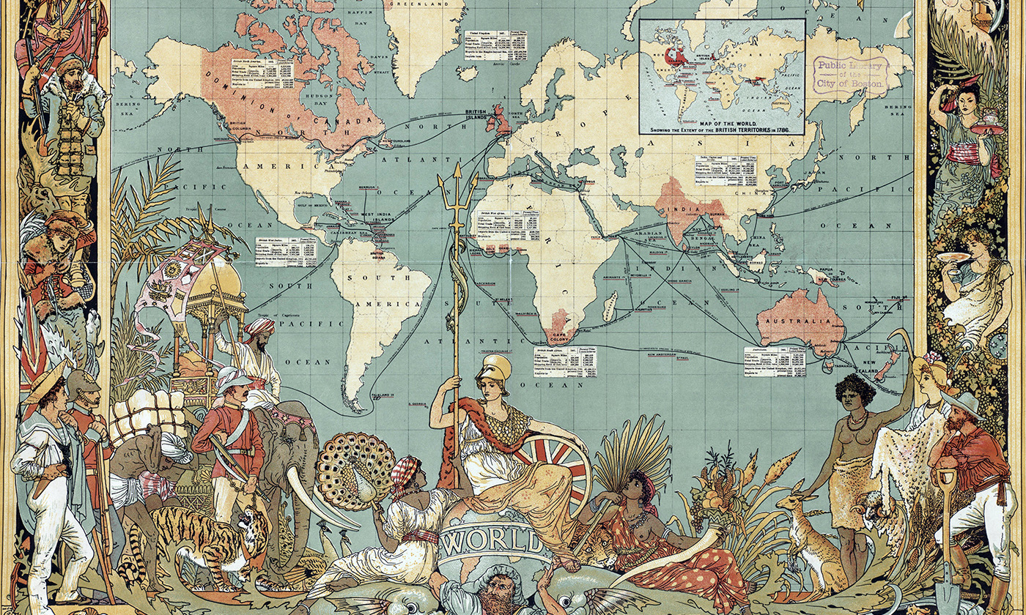
Connect
How many countries can you name that were members of the British Empire in 1900?
THINK, PAIR, SHARE
Afghanistan, Antigua and Barbuda, Australia, The Bahamas, Bahrain, Barbados, Belize, Botswana, Brunei, Canada, Cyprus, Dominica, Egypt, Fiji, The Gambia, Ghana, Grenada, India, Jamaica, Kenya, Kiribati, Lesotho, Malawi, Malaysia, Maldives, Malta, Mauritius, Myanmar (Burma), New Zealand, Nigeria, Pakistan, St Lucia, Saint Kitts and Nevis, St Vincent, Seychelles, Sierra Leonne, Solomon islands, South Africa, Sri Lanka, Sudan, Swaziland, Tanzania, Tonga, Trinidad and Tobago, Tuvalu, Uganda, United Arab Emirates, Vanuatu, Yemen, Zambia, Zimbabwe

Slide 3
An Introduction to India
Learning Objectives:
To gain an overview of India pre-1914
To infer from sources to learn about India
Big Picture

Slide 4
What will we learn in Unit 2?
You will learn how India evolved from colonial rule to independence
How India was controlled
Consequences of the First World War
The growth of Nationalism
The impact of the Second World War
Partition (independence)

Slide 5
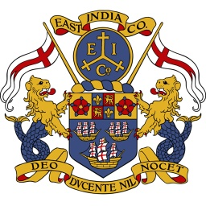
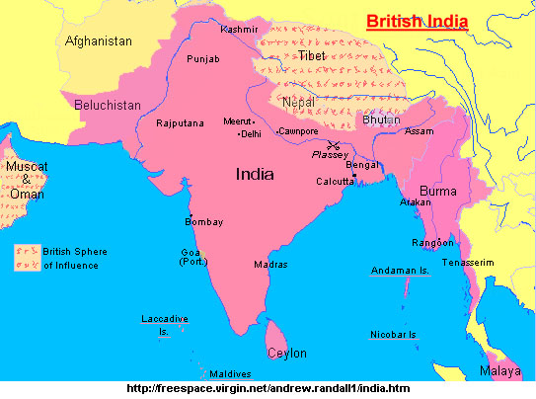
How did India become a colony?
Notes:
Elizabeth I granted a charter in 1600 to London merchants. Show clip from ‘Empire’ – from 17.15 – 21mins roughly.

Slide 6
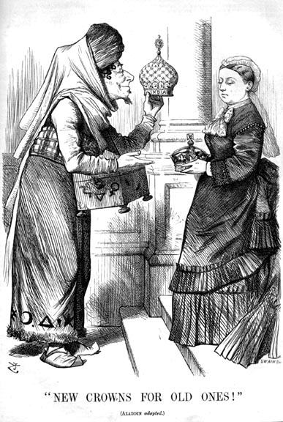
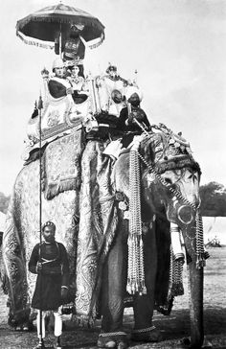
Activate
Consult the sources and answer the questions relating to each source

Slide 7
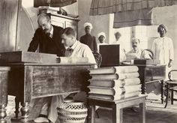
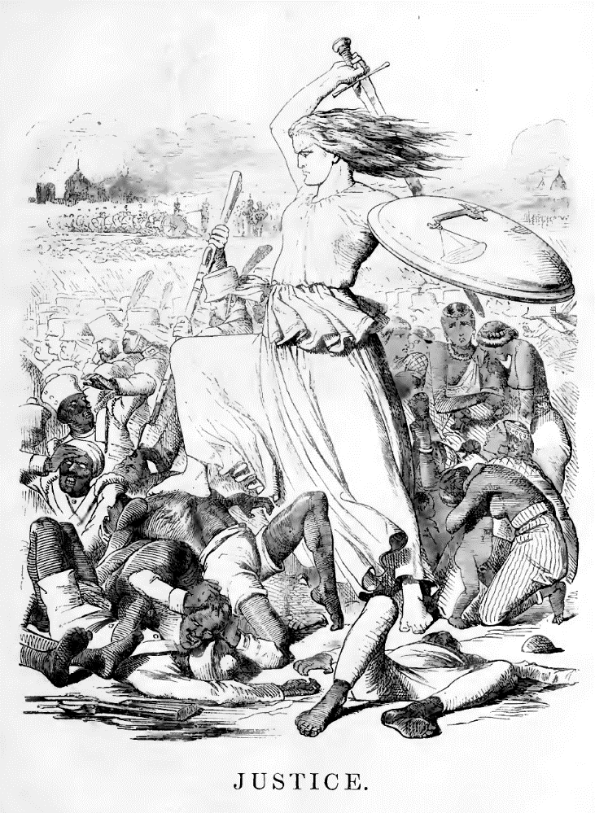
Progress Check
Take up the White Man’s burden -
Send forth the best ye breed –
Go, blind your sons to exile
To serve your captives’ need;
To wait, in heavy harness,
On fluttered folk and wild –
Your new-caught sullen peoples,
Half devil and half child.
What can we learn about the relationship Britain had with India from these sources?

Slide 8
Demonstrate
Using the knowledge you have gathered today, explain how a handful of British officials were able to rule over 350 million people in the Indian subcontinent.

Slide 9
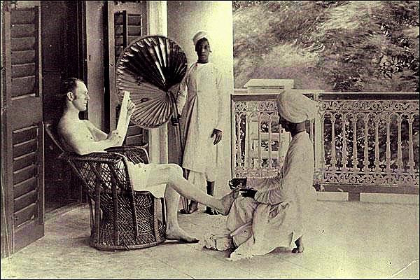
Consolidate
What do you think India was worth to Britain?
What was the relationship between British officials and the Indian people?

