Slide 1
Introduction to Health and Social Care
Keeping People Safe

Slide 2
Welcome to HSC
Y12 HSC will run primarily as a single qualification (one A level equivalence)
Impact on numbers enrolling has been massive so we are expecting larger class sizes (but this is a good thing!!!)
  Expanding enrichment and support programmes
  Increase in usable space
  Looking to increase access to subject specialist and workspaces in school

Slide 3
Welcome to HSC
Unit 1 – Human Lifespan Development
Unit 2 – Working in HSC
Unit 5 – Meeting Individual Care and Support Needs
PLUS one optional unit:

Slide 4
Keeping people safe
People who use HSC services tend to be vulnerable
Vulnerable: due to certain characteristics they may be more likely to be taken advantage of…
What characteristics may make someone vulnerable?

Slide 5
Why might people be vulnerable?
Why?
Age
Disability
Incapacity
Reliance on others
Drug / medication
Suggestable
‘Delicate’ or embarrassing situations

Slide 6
What might they be at risk of?

Slide 7
What might they be at risk of?
Neglect – Failure to provide proper care / ‘act of omission’
Physical abuse – Acts of aggression such as hitting, punching and pushing or using drugs and medication in a way that was not prescribed
Psychological abuse – behaving in a way that causes psychological trauma, helplessness, fear or distress
Sexual abuse- forcing a person into sexual behaviour against their will
Financial abuse – Stealing money or goods
Abuse by discrimination – Treating some people differently because of a protected characteristic
Domestic abuse – controlling, coercive behaviour leading to disempowerment

Slide 8
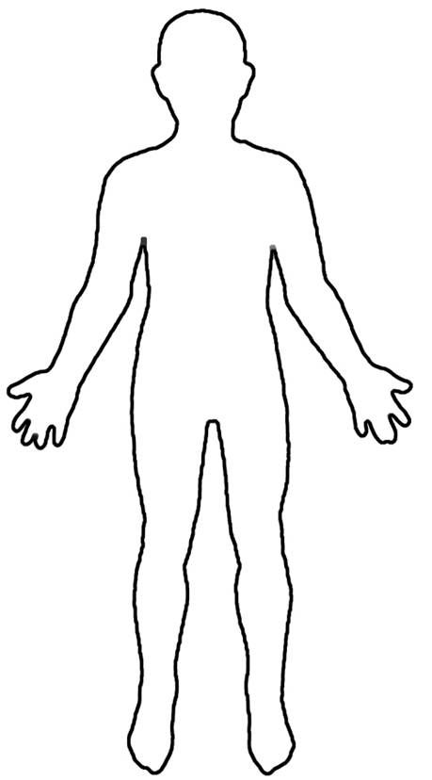
Task 1 – How would you know?
Imagine you work in a HSC setting…
Create a body template in your notes and suggest what SIGNS there may be that abuse is happening. NOTE – they won’t all be PHYSICAL

Slide 9
Task 1 – How would you know?
Imagine you work in a HSC setting…
Create a body template in your notes and suggest what SIGNS there may be that abuse is happening. NOTE – they won’t all be PHYSICAL
PHYSICAL
EMOTIONAL
BEHAVIOURAL CHANGES

Slide 10
Task 2 – Mrs Richardson

Slide 11
Task 3 – Keeping People Safe
I would like you to imagine that you are the manager of a care home.
I would like you to devise some rules for your care home that aim to protect people in your care
Your rules can target specific types of abuse, how we watch out for signs of abuse OR both!
HOWEVER – Staff must still be able to do their jobs and people being cared for MUST have their basic needs met…

Slide 12
Thank you for taking part!
Any questions?
I look forward to seeing you in September!!!

