Slide 1
Welcome to Approaches!
Connect activity – think, pair, share
Environment
What are the causes or explanations of human behaviour?

Slide 2
Big Picture
A01 – Knowledge and understanding All | To describe key early events and influences Psychology.
A02 – Application Most | To explain these events/influences with reference to what we know about psychology today.
A03 – Evaluation Some | To discuss the strengths and weaknesses of early influences in Psychology.

Slide 3
Activate
Approaches (sometimes also called perspectives) = different ways of looking at and explaining psychology phenomena
Year 1 (AS/Year 12)
Origins
Behaviourist
Social learning theory
Cognitive approach
Biopsychology (Approach and separate topic)
Year 2 (A2/Year 13)
Psychodynamic approach
Humanistic approach
Comparison of approaches

Slide 4
Activate – Origins of Psychology
Wilhelm Wundt
Introspection
Emergence of psychology as a science
Evaluation
Origin = where something begins
Key term
alert!

Slide 5
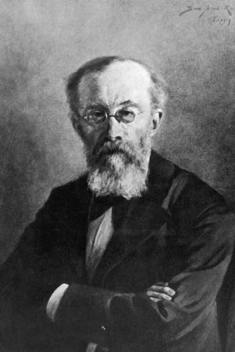
Demonstrate task
Task 1) Using the tutor2u link on SMHW – find the answers to the questions on Wundt.
Task 2) Challenge: Can you think of or identify any strengths or weaknesses of Wundt’s approach?

Slide 6
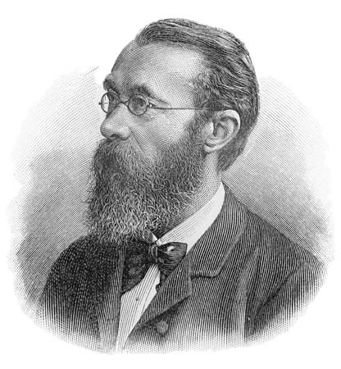
Activate Wilhelm Wundt (1832 – 1920)
Aim was to study the structure of the mind (structuralism) by breaking down behaviours such as perception and sensation
Three different methods:
Experiments
E.g. measurement of the duration of simple mental processes
Historical method
Study of mental differences between cultures (time = evolution) (space = differences in groups of people)

Slide 7
Activate: Wilhelm Wundt
Introspection
Latin for ‘looking into’
Breaking up conscious awareness into basic structures of thoughts, images and sensations
Based on belief of having conscious access to parts of mental processes
Participants would be presented with a problem to solve or something to memorise. They’d then be asked to reflect on their own cognitive processes and describe them
Notes:
Internal perception
Experimental self observation
Claimed this was a valid scientific method

Slide 8
Consolidate Introspection: your turn
Task: Write down all your conscious thoughts while you are trying to solve the problem. Do not censor any thoughts.
A man has to get a fox, a chicken, and a sack of corn across a river.
He has a rowboat, and it can only carry him and one other thing.
If the fox and the chicken are left together, the fox will eat the chicken.
If the chicken and the corn are left together, the chicken will eat the corn.

Slide 9
Consolidate – Solution
The man and the chicken cross the river, (the fox and corn are safe together), he leaves the chicken on the other side and goes back across.
The man then takes the fox across the river, and since he can't leave the fox and chicken together, he brings the chicken back.
Again, since the chicken and corn can't be left together, he leaves the chicken and he takes the corn across and leaves it with the fox.
He then returns to pick up the chicken and heads across the river one last time.

