Slide 1
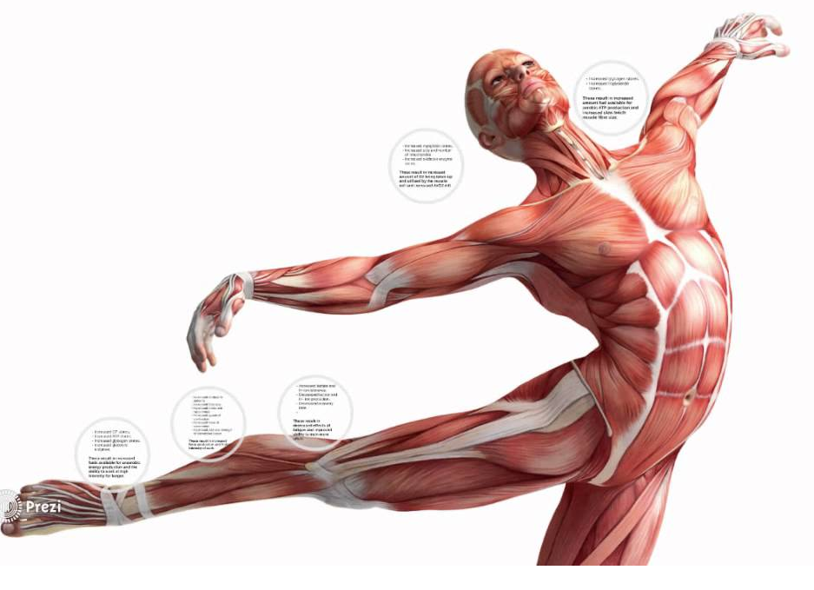
National Extended Certificate in Sport
Unit 1 Anatomy & Physiology Learning Aim B The Muscular System

Slide 2
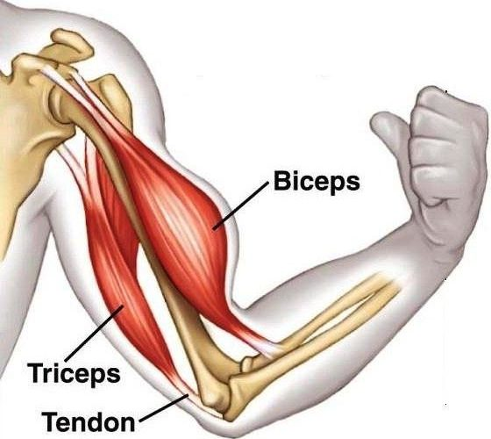
Connect
Reflect Task:
Revisit the exam questions from last lesson. Where you have dropped marks, identify why you dropped marks and then redraft your answer to gain full marks.
Connect Task:
Label the diagram to identify major muscle locations.
Deltoids, biceps, triceps, wrist flexors, wrist extensors, supinators and pronators, pectorals, abdominals, obliques, quadriceps, hip flexors, tibialis anterior, erector spinae, trapezius, latissimus dorsi, gluteals, hamstrings, gastrocnemius, soleus.
Challenge:
Create a list of muscle pairs e.g. bicep and triceps

Slide 3
Big Picture
Learning outcomes | BTEC Level
MERIT | Explain how the three types of muscles support sport and exercise performance.
PASS | Identify the characteristics of the three types of muscle.

Slide 4
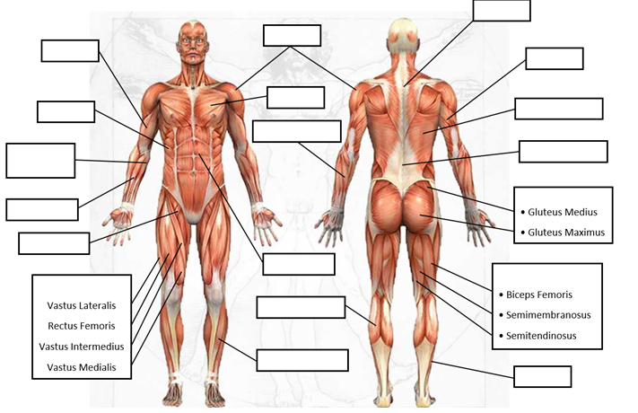
Activate
Label the diagram to identify
major muscle locations.
Deltoids, biceps, triceps, wrist flexors, wrist extensors, supinators and pronators, pectorals, abdominals, obliques, quadriceps, hip flexors, tibialis anterior, erector spinae, trapezius, latissimus dorsi, gluteals, hamstrings, gastrocnemius, soleus.
Challenge:
Create a list of muscle pairs e.g. bicep and triceps

Slide 5
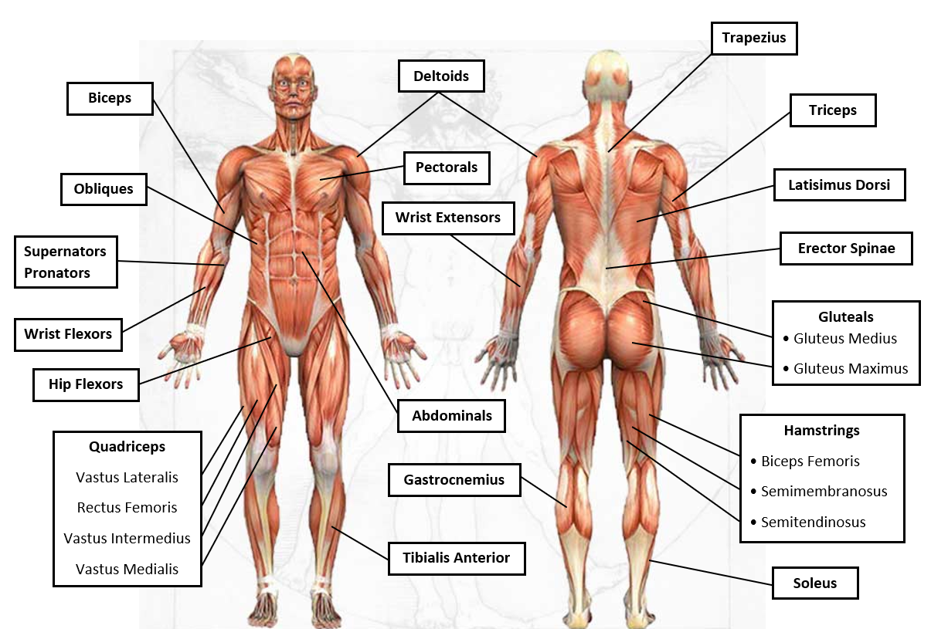

Slide 6
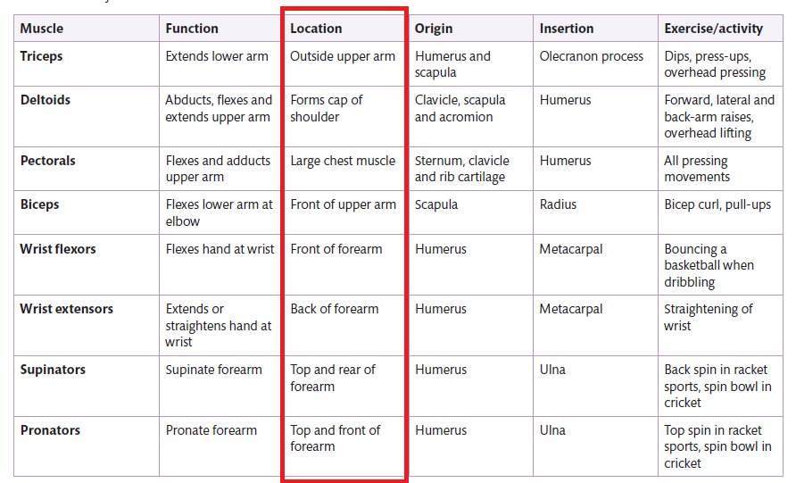

Slide 7
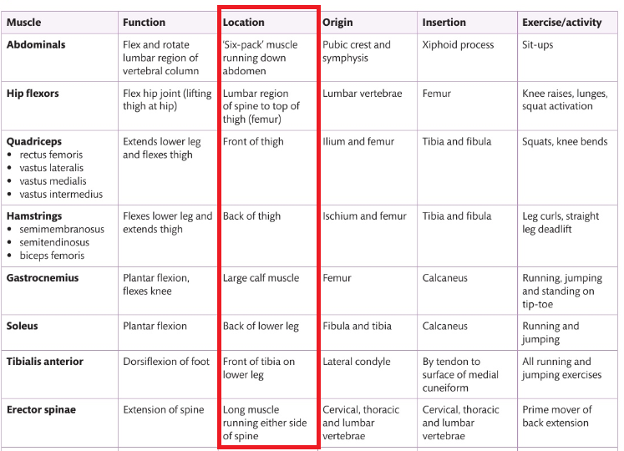

Slide 8
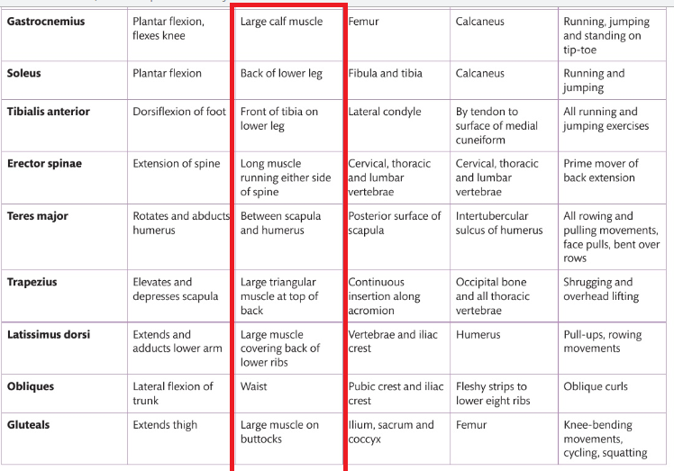

Slide 9
*
*
*
*
*
*
*
*
*
*
*
*
*
*
*
*
*
*
*

Slide 10
Within your books create your own information table identifying for each muscle its location and an example exercise or activity
Deltoids, biceps, triceps, wrist flexors, wrist extensors, supinators and pronators, pectorals, abdominals, obliques, quadriceps, hip flexors, tibialis anterior, erector spinae, trapezius, latissimus dorsi, gluteals, hamstrings, gastrocnemius, soleus.
Challenge:
Create a list of muscle pairs e.g. bicep and triceps

Slide 11
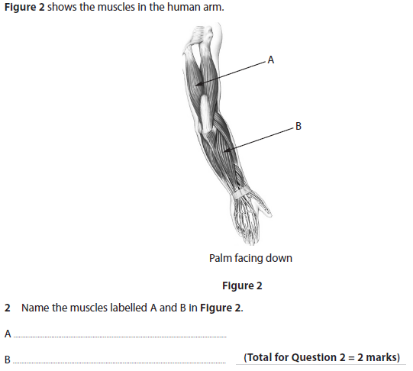
Exam Style Question
Consolidate
Planning your answer
What is the command verb?
What are the key terms?
What are you being asked to do?
Where do I get my marks?
How long should I spend answering?
Notes:
Type of joint- ball and socket
Structure- bones articulating to form joint
Shape & structure linked to full range of movement
Function- leverage, red blood cell production, protection
Links to performance of technique- movements required, problems if unable to use this range of movement.

Slide 12
Progress Check
Mark Scheme
Consolidate

Slide 13
Progress Check
Examiners
Report
Consolidate

