Slide 1
Swiss roll challenge

Slide 2
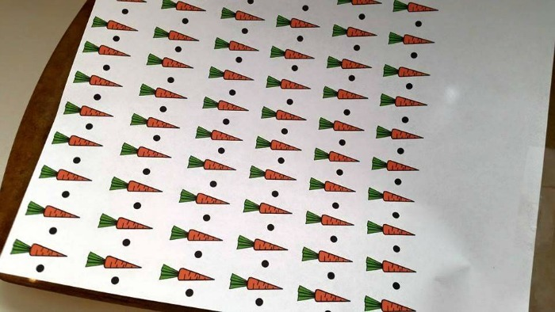
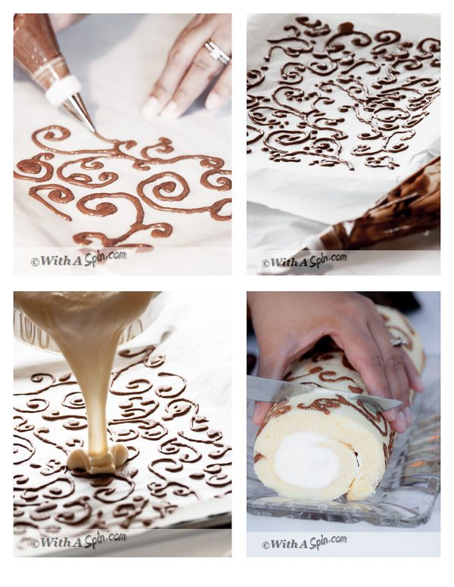
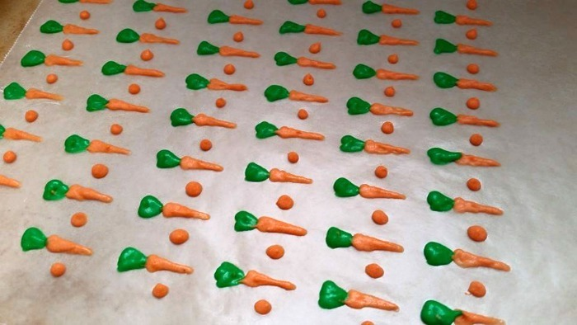
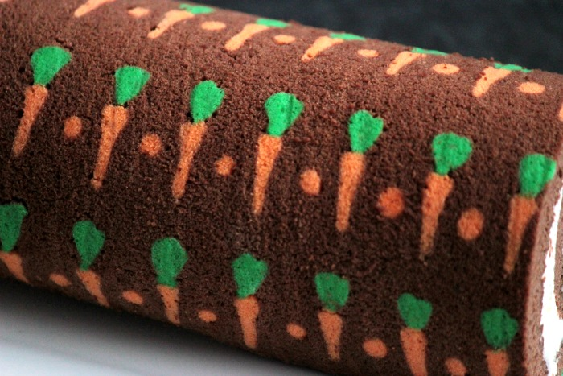
Deco Swiss Roll – Planning the pattern
Draw a pattern onto greaseproof paper
OR – Get a pattern off the internet print out and trace onto greaseproof
Roll the paper up to check how it will look
Repeat patterns will work the best
Colours we have are
Brown – Cocoa powder
Yellow
Purple
Orange
Red
Blue

Slide 3
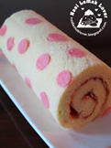
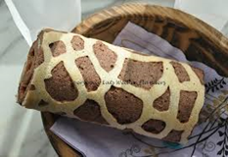
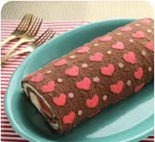
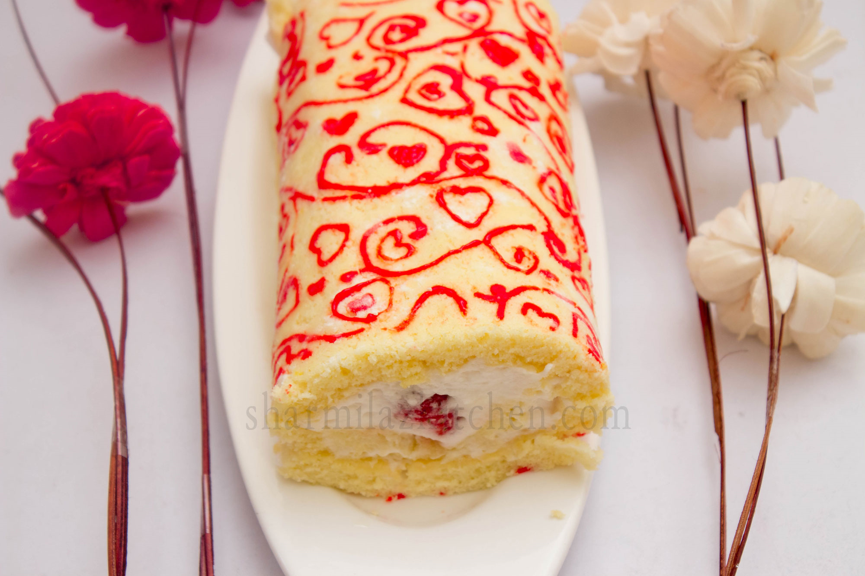
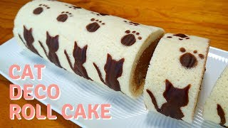
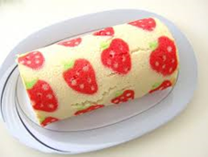
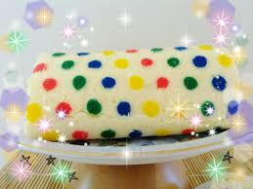
Ingredients
75g Caster Sugar
3 Large Eggs
75g Self Raising Flour (55g SR Flour & 20g Cocoa)
Method
Put oven on to gas mark 6, 200˚C
Grease and line your baking tin.
Pipe a pattern on the baking paper
Place the baking tray with your piped design into the fridge for 10 mins or blast chiller.
Caster sugar into large mixing bowl.
Adds eggs and whisk until a foam is created. It MUST be very thick.
Very gently stir in the weighed and sieved flour – Use a metal spoon for this.
Gently pour the mixture into the lined tin with your piped design on and level carefully with a palette knife.
Bake in oven for between 7-10 mins. It should be golden brown and firm to the touch.
Whilst cake is cooking sprinkle extra sugar onto a clean piece of greaseproof paper.
Soften jam in a small bowl.
Tip cake upside down onto sugared paper and peel off paper. TURN CAKE OVER
Trim cake, spread with jam and roll up.
Let the cake cool & wash up.

Slide 4
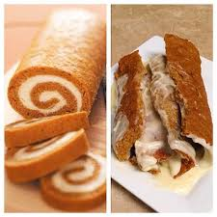
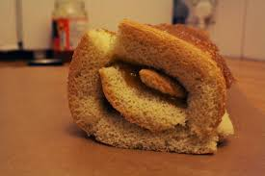
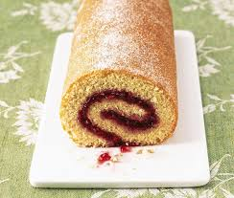
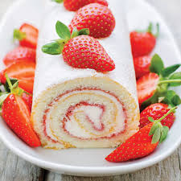
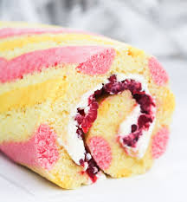
Progress check – What level am I ?
Level 1
Swiss roll made
Working with some help
Level 2
Even roll –some cracks
Working independently
Level 3
Similar size
Even colour
Even mixture
Level 4
Even roll
Even filling
Decorated design
Even mixture
Level 5
Decorated pattern design
tight roll
Level 4
All the same size
All the same colour –
golden brown
Even mixture

