Slide 1
Welcome to Y12 Sociology
What makes us who we are?

Slide 2
Quick Fire Questions… Thinking Sociologically…
What ‘rules’ govern our behaviour?
What does the word ‘normal’ mean?
Do you ever get told you are ‘just like your mum / dad / bother / sister / best friend’?
Are we really unique, or deep down, are we all the same?

Slide 3
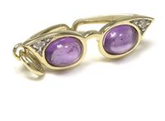
Sociology
Structural Theory
Action Theory
(Interpretivism)
Consensus
Conflict
Symbolic interactionism
Functionalism
Marxism
Feminism
Theory can be said to be like looking at society through different lenses – each give it a different perspective or appearance.
http://www.youtube.com/watch?v=v48kAslT-cY&feature=fvsr

Slide 4
Functionalism
Society is good and meets the needs of it members
Society controls us – we are like puppets
Society is the product of VALUE CONSENSUS
We co-operate and get along because we have the same core values, beliefs and ideas about how the world works
We are not EXACTLY the same, but we are similar enough to ensure that we can ‘get along’
Through SOCIALISATION we pass our values and beliefs from one generation to the next

Slide 5
TASK ONE – Identifying our ‘values’

Slide 6
However, what if the world is not all sunshine, lollypops and rainbows?

Slide 7
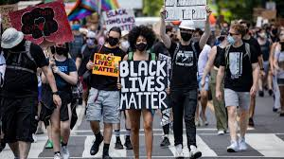

Slide 8
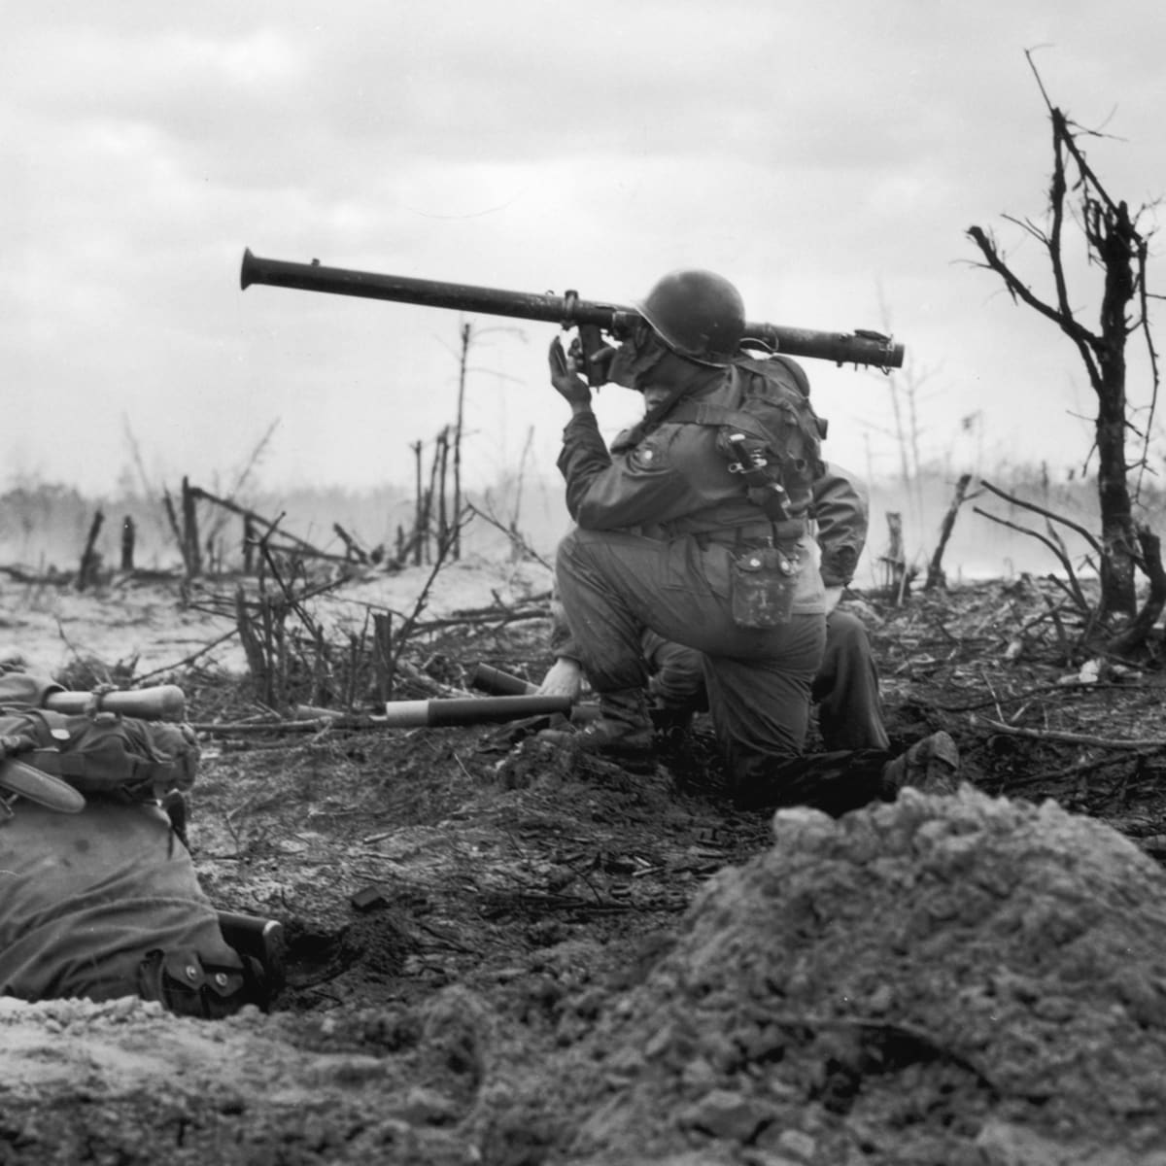

Slide 9
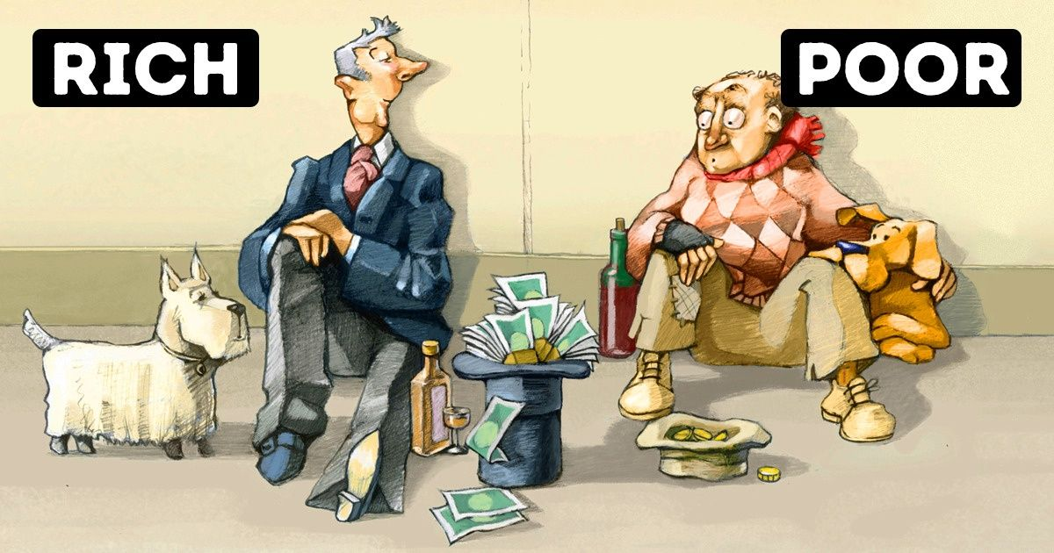

Slide 10
TASK TWO – Identifying our values
Tom works for McDonalds (other food retailers are available)
His Saturday shift is eight hours long and he is paid £8 an hour
During his shift he will serve approximately 40 customers an hour, each spending on average £5

Slide 11
TASK TWO – Identifying our values
Tom works for McDonalds (other food retailers are available)
His Saturday shift is eight hours long and he is paid £8 an hour
During his shift he will serve approximately 40 customers an hour, each spending on average £5
How much does Tom earn?
How much money does he make the McDonalds franchise that he works at?
What is Tom worth?

Slide 12
TASK TWO – Identifying our values
Tom works for McDonalds (other food retailers are available)
His Saturday shift is eight hours long and he is paid £8 an hour
During his shift he will serve approximately 40 customers an hour, each spending on average £5
How much does Tom earn?
£64
How much money does he make the McDonalds franchise that he works at?
320 customers per shift (8x40) multiplied by their average spend (5) gives a total (estimate) of £1,600
What is Tom worth?
4% of the profit

Slide 13
1% of the worlds population control 82% of the total global wealth

Slide 14
Marxism
The world is not sunshine, lollypop and rainbows for everyone
What if there ARE values and beliefs that ‘bind us together’ but instead of benefiting everyone, they only benefit a few people… specifically, the RICH…?

Slide 15
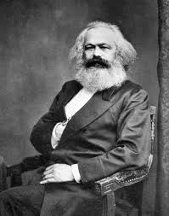
Marxism
The world is not sunshine, lollypop and rainbows for everyone
What if there are values and beliefs that ‘bind us together’ but instead of benefiting everyone, they only benefit a few people… specifically, the rich…?
Karl Marx

Slide 16
Marxism
Society as we know it is the result of CONFLICT between the rich and the poor
The rich own the ‘means of production’ and control the poor through the ‘ruling class ideology’
Who remembers being praised for things like being on time, being polite, not talking back and doing as you are told? Think CRITCALLY for a moment, who does that really benefit?

Slide 17
Marxism
Society as we know it is the result of CONFLICT between the rich and the poor
The rich own the ‘means of production’ and control the poor through the ‘ruling class ideology’
Who remembers being praised for things like being on time, being polite, not talking back and doing as you are told? Think CRITCALLY for a moment, who does that really benefit?
Your future employers, the rich!

Slide 18
The poor are not the only exploited group in our society…

Slide 19
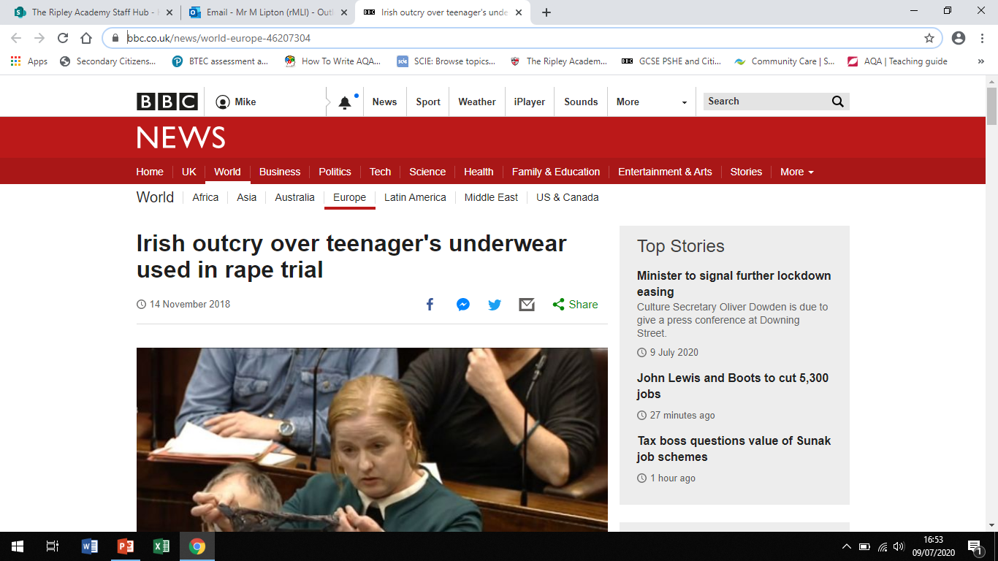
Notes:
https://www.bbc.co.uk/news/world-europe-46207304

Slide 20
Notes:
https://www.bbc.co.uk/news/world-europe-46207304

Slide 21
TASK THREE – Equality?
What stereotypical beliefs exist in society that might be seen as ‘holding women back’ and preventing equality?
Are men and women equal in society today?
The term feminism gets some bad press… Who benefits from this negative perception? Is this coincidence?

