Slide 1

If you have any questions after this session then please get in touch:
Ms. Townend – atownend@ripleyacademy.org
Mr. Prescott – mprescott@ripleyacademy.org

Slide 2
A-Level Maths Overview
Exam Board: AQA
Assessed by examination at the end of Year 13 comprised of 3 papers:
Paper 1 Pure – 2 hours
Paper 2 Pure and Mechanics – 2 hours
Paper 3 Pure and Statistics – 2 hours
Lots of trigonometry and algebra – woop woop!
Resources that we use: textbooks, exam question booklets, mymaths.com, drfrostmaths.com
What you need: A calculator (more information on the next slide), stationery (pen, pencil, ruler etc.), resilience and perseverance.

Slide 3
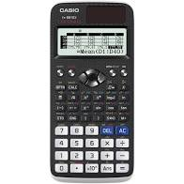
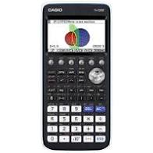
Calculators
Option 1: Casio fx - CG50 graphic calculator. All singing, all dancing - ideal if you are thinking of studying Further Maths or continuing your studies in Maths or Science at University. However, it is very expensive!
Option 2: Casio 9750GIII graphic calculator. Cheaper than the one above, will draw graphs but has some limitations in the way it displays solutions (e.g. surds).
Option 3: Casio fx - 991EX ClassWiz Advanced Scientific calculator. A cheaper alternative to a graphic calculator.

Slide 4
A bit more about the course…
What is Mechanics?
Mechanics – modelling the physics of the world around us
e.g. at what angle should a cricketer
aim to hit the ball in order to
maximise the distance the ball
will travel?
Students planning careers in physics
or engineering would find mechanics
particularly useful.

Slide 5
A bit more about the course…
What is Statistics?
Statistics – collecting and analysing data and using this to make predictions about future events.
e.g. actuaries study statistical information to calculate the risk of a driver of a certain age having a car accident. This information would be used by insurers in establishing the cost of the annual premiums.
An actuary evaluates, manages and advises on financial risks. They use their knowledge of business and economics, together with their understanding of probability theory, statistics and investment theory, to provide strategic, commercial and financial advice.

Slide 6
Let’s do some maths!
Go to drfrost.com/join and type in the code: _______
Now let’s learn something new…
Notes:
DFM – atownend worksheets – Y12 induction
This could be played on their phones.

Slide 7
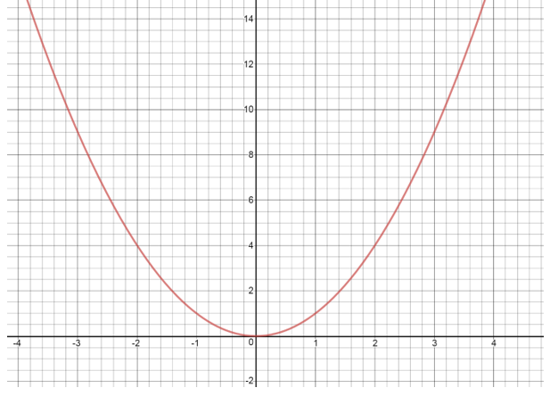
This is the graph of y = x²
Find the gradient of the tangent at x = 2.5.
Gradient = change in y
change in x
(3.2, 9.5)
Gradient = 9.5 – 1
3.2 – 1.4
(2.5, 6.25)
x
Gradient = 8.5
1.8
Gradient = 4.72
What is the problem with this?
(1.4, 1)
It is only an estimate!

Slide 8
This is the graph of y = x²
Find the gradient of the tangent at x = 2.5
From drawing a tangent we’ve worked out that an estimate of the gradient is 4.72.
(3.2, 9.5)
(2.5, 6.25)
x
The actual gradient when x = 2.5 is 5… but how can we work this out exactly?
(1.4, 1)

Slide 9
Lets look at smaller and smaller tangents…
x
(3.5, 12.25)
TANGENT 1…
Gradient = change in y
change in x
Gradient = 12.25 – 6.25
3.5 – 2.5
(2.5, 6.25)
x
Gradient = 6
1
Gradient = 6

Slide 10
Lets look at smaller and smaller tangents…
TANGENT 2…
(3, 9)
x
Gradient = change in y
change in x
Gradient = 9 – 6.25
3 – 2.5
(2.5, 6.25)
x
Gradient = 2.75
0.5
Gradient = 5.5

Slide 11
Lets look at smaller and smaller tangents…
TANGENT 3…
Gradient = change in y
change in x
(2.7, 7.29)
x
Gradient = 7.29 – 6.25
2.7 – 2.5
x
(2.5, 6.25)
Gradient = 1.04
0.2
Gradient = 5.2

Slide 12
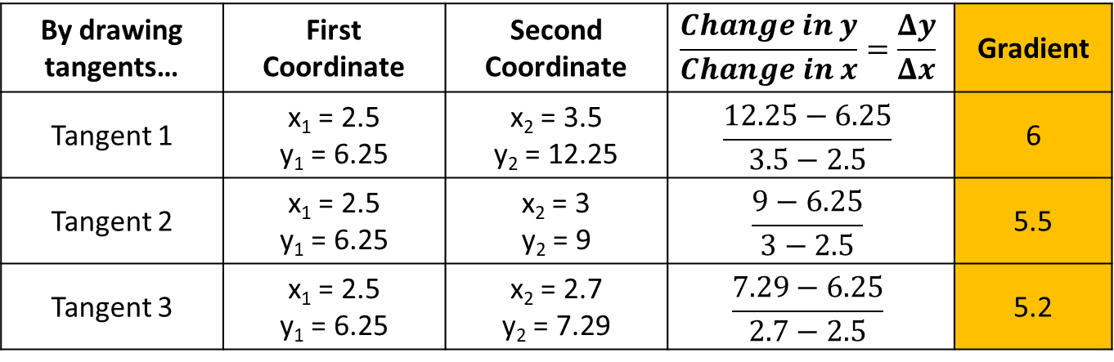
To summarise so far…
By drawing tangents… | First Coordinate | Second Coordinate | $$\frac{Change in y}{Change in x}=\frac{Δy}{Δx}$$ | Gradient
Tangent 1 | x₁ = 2.5 y₁ = 6.25 | x₂ = 3.5 y₂ = 12.25 | $$\frac{12.25−6.25}{3.5−2.5}$$ | 6
Tangent 2 | x₁ = 2.5 y₁ = 6.25 | x₂ = 3 y₂ = 9 | $$\frac{9−6.25}{3−2.5}$$ | 5.5
Tangent 3 | x₁ = 2.5 y₁ = 6.25 | x₂ = 2.7 y₂ = 7.29 | $$\frac{7.29−6.25}{2.7−2.5}$$ | 5.2
The gradient is getting closer and closer to 5
Now lets think more generally…

Slide 13
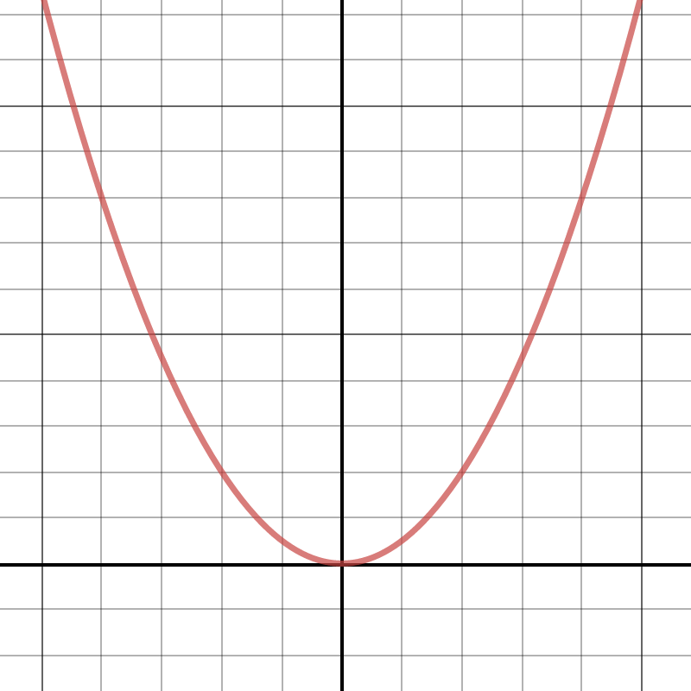






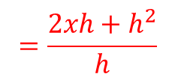

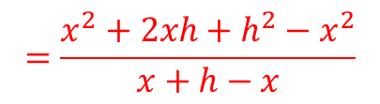
Now lets think more generally…
Pick any point the curve y = x².
It will have coordinates ( , )
Go a bit further along the curve and plot a second point.
It will have the coordinates ( , )
So the gradient will be:
(x+h, (x+h)²)
$$x$$
$$x^{2}$$
x
$$x+h$$
$${(x+h)}^{2}$$
$$\frac{Δy}{Δx}=$$
$$\frac{{(x+h)}^{2}−x^{2}}{x+h−x}$$
(x, x²)
x
h
$$=\frac{x^{2}+2xh+h^{2}−x^{2}}{x+h−x}$$
$$=\frac{2xh+h^{2}}{h}$$
$$=2x+h$$

Slide 14

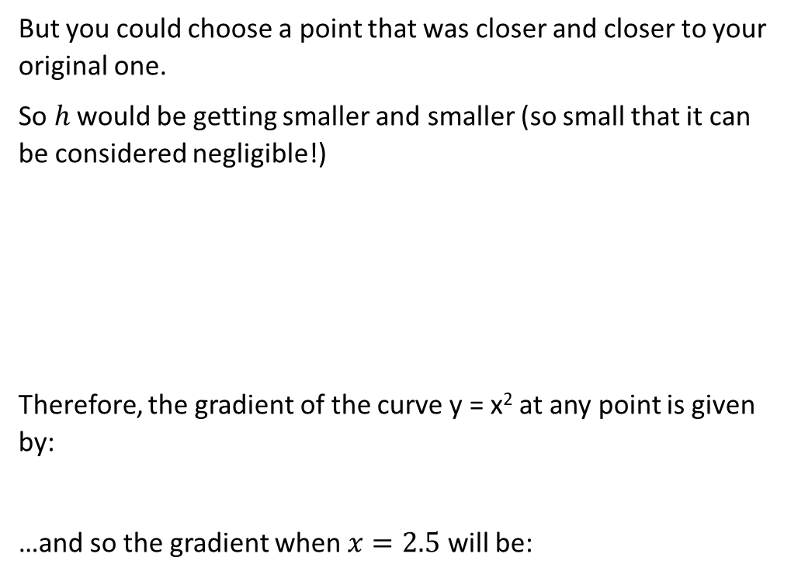




Now lets think more generally…
But you could choose a point that was closer and closer to your original one.
So $h$ would be getting smaller and smaller (so small that it can be considered negligible!)
Therefore, the gradient of the curve y = x² at any point is given by:
…and so the gradient when $x=2.5$ will be:
(x+h, (x+h)²)
x
So… $\lim_{h→0}{ 2x+h=2x}$
This means “the limit as h approaches 0”
(x, x²)
x
h
$$2x$$
$$2×2.5=5$$
What would the gradient be if: $x=3$? $x=−4$? $x=5.2$?
$$6$$
$$−8$$
10.4

Slide 15


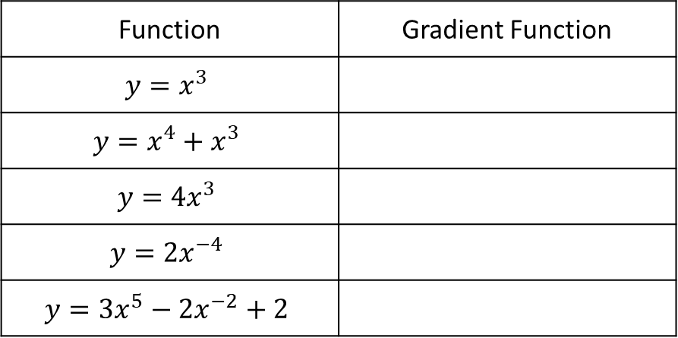



Now lets generalise further…
Function | Gradient Function
$$y=x^{3}$$
$$y=x^{4}+x^{3}$$
$$y={4x}^{3}$$
$$y={2x}^{−4}$$
$$y={3x}^{5}−2x^{−2}+2$$
$$y=3x^{2}$$
$$y=4x^{3}+3x^{2}$$
$$y=12x^{2}$$
$$y=−8x^{−5}$$
$$y=15x^{4}+4x^{−3}$$
Can anyone spot what’s happening?
So to find a gradient function you…
bring the power down
subtract one away from the power
This is called… DIFFERENTIATION

Slide 16
Multiple Choice Questions:
Don’t worry about getting it wrong… Just have a go!

Slide 17
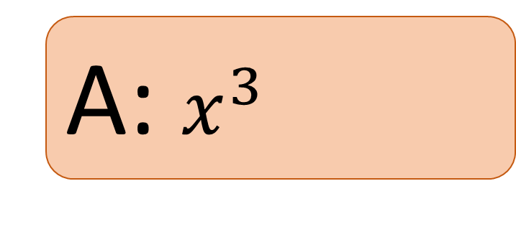

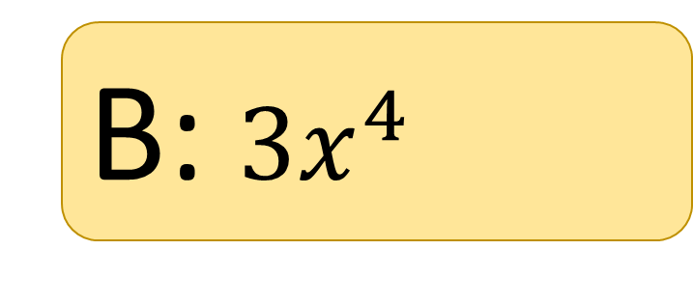
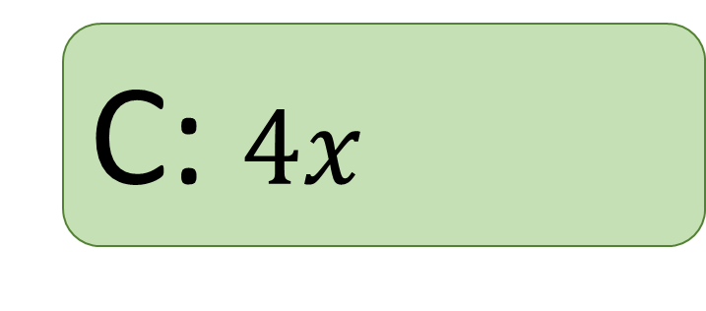
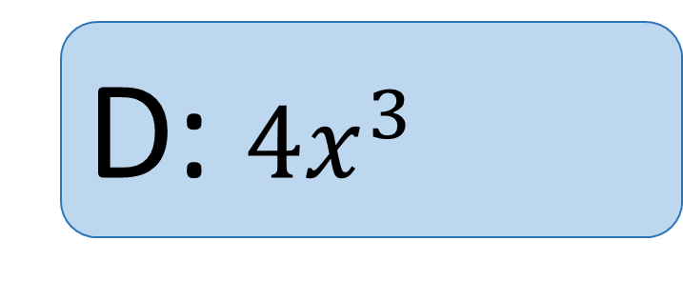
Differentiate…
A: $x^{3}$
$$y=x^{4}$$
B: ${3x}^{4}$
C: $4x$
D: $4x^{3}$

Slide 18
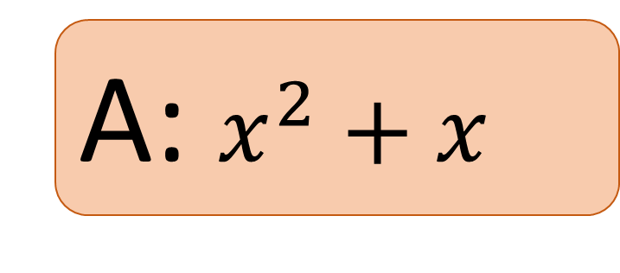

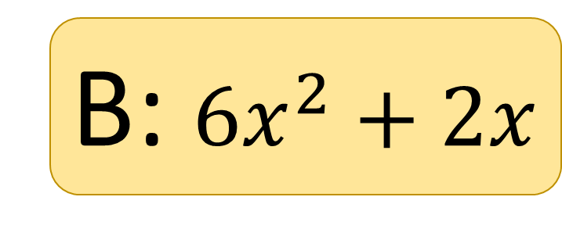
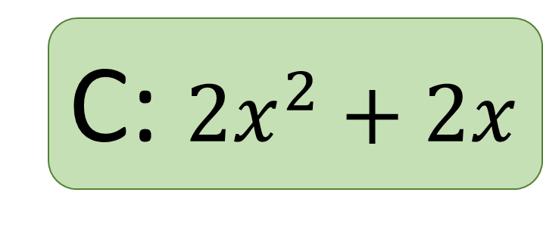
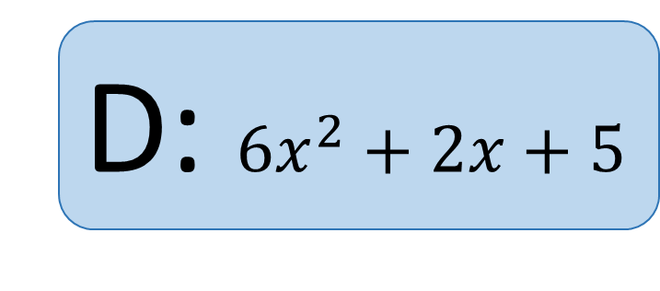
Differentiate…
A: $x^{2}+x$
$$y=2x^{3}+x^{2}+5$$
B: $6x^{2}+2x$
C: $2x^{2}+2x$
D: $6x^{2}+2x+5$

Slide 19
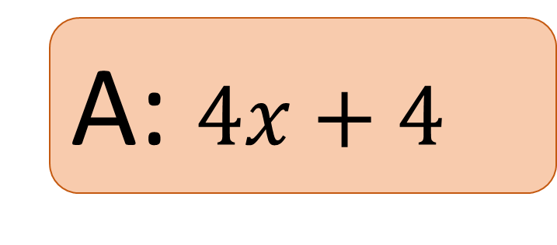


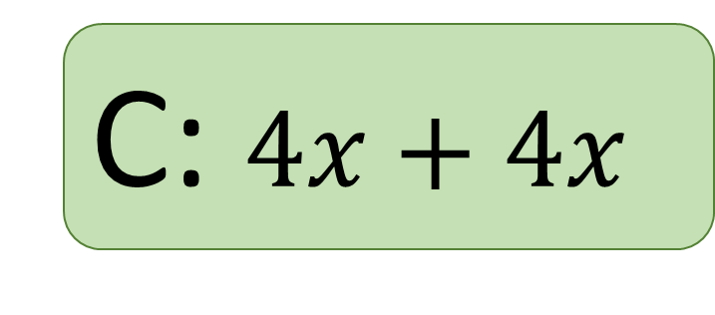
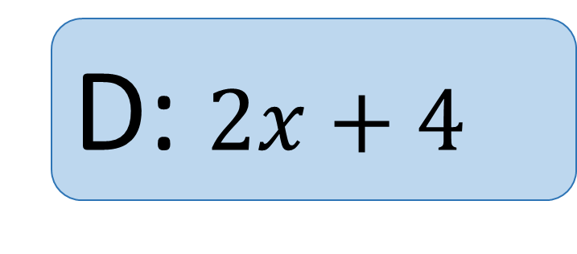
Differentiate…
A: $4x+4$
$$y=2x^{2}+4x$$
B: $4x^{2}+4$
C: $4x+4x$
D: $2x+4$

Slide 20
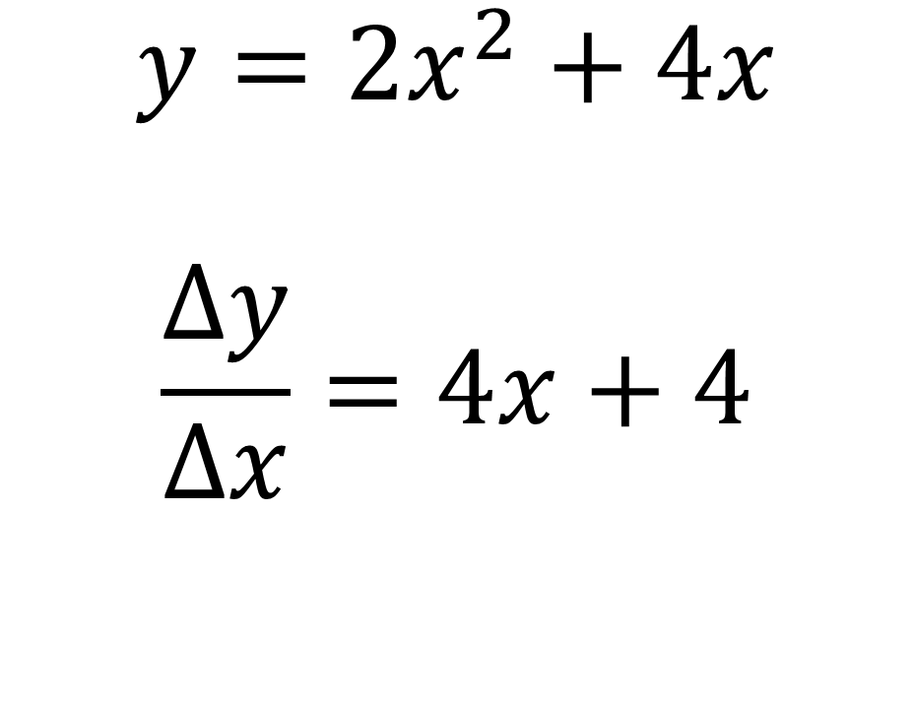
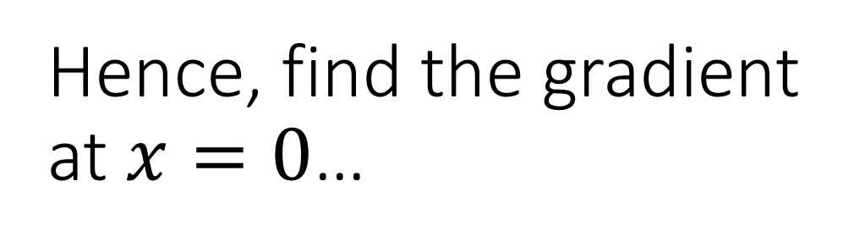
Hence, find the gradient at $x=0$…
A: 0
$$y=2x^{2}+4x$$
$$\frac{Δy}{Δx}=4x+4$$
B: 8
C: 4
D: 6

Slide 21
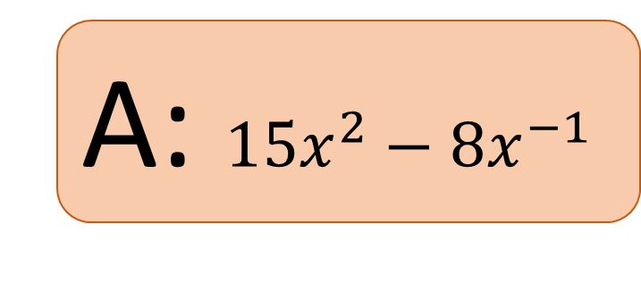

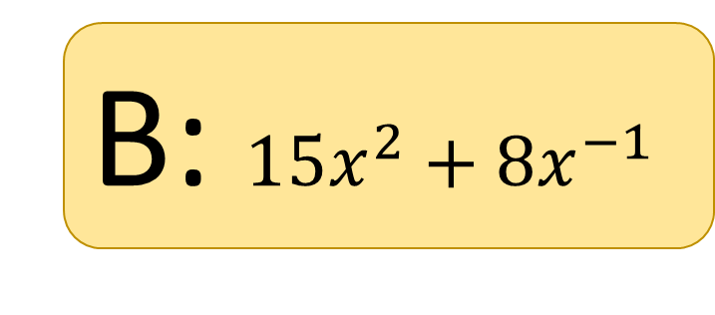
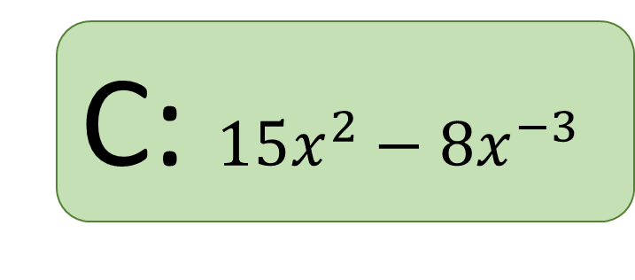
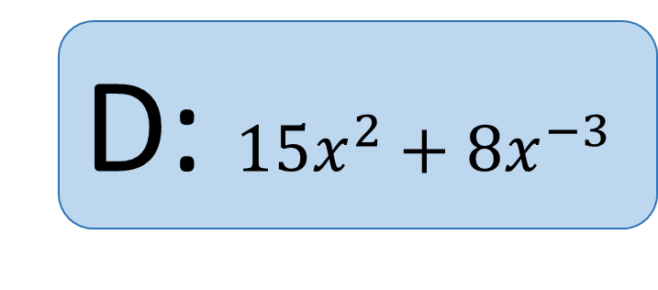
Differentiate…
A: $15x^{2}−8x^{−1}$
$$y=5x^{3}−4x^{−2}$$
B: $15x^{2}+8x^{−1}$
C: $15x^{2}−8x^{−3}$
D: $15x^{2}+8x^{−3}$

Slide 22

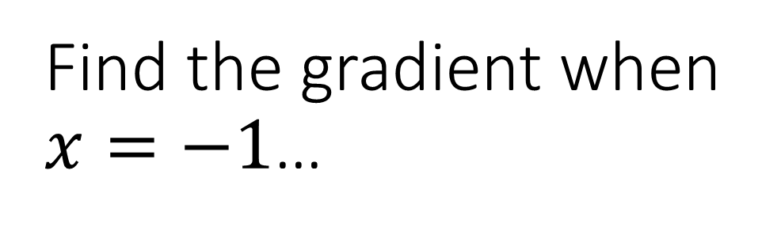
Find the gradient when $x=−1$…
A: 3
$$y=x^{3}$$
HINT: think about what you might need to do first?
B: -3
C: 1
D: -1

Slide 23
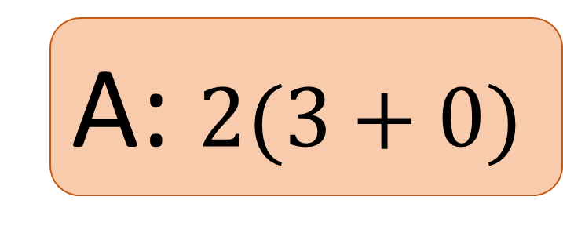

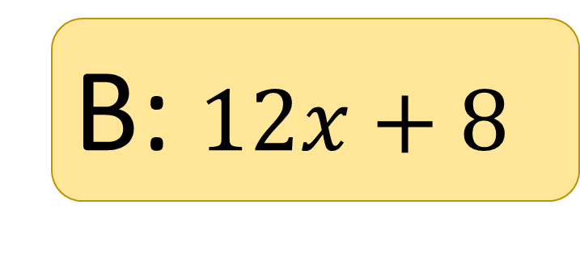
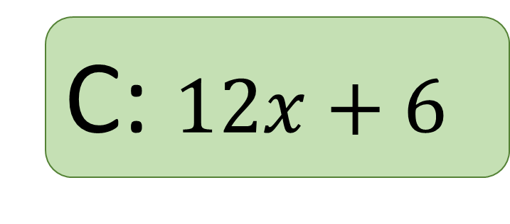
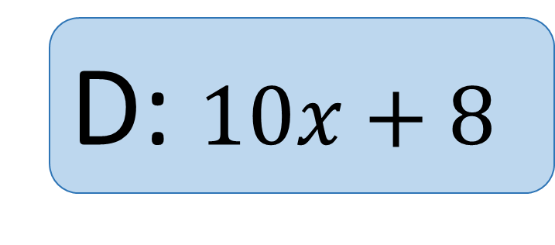
Differentiate…
A: $2(3+0)$
$$y=2x\left(3x+4\right)$$
HINT: think about what you might need to do first?
B: $12x+8$
C: $12x+6$
D: $10x+8$

Slide 24
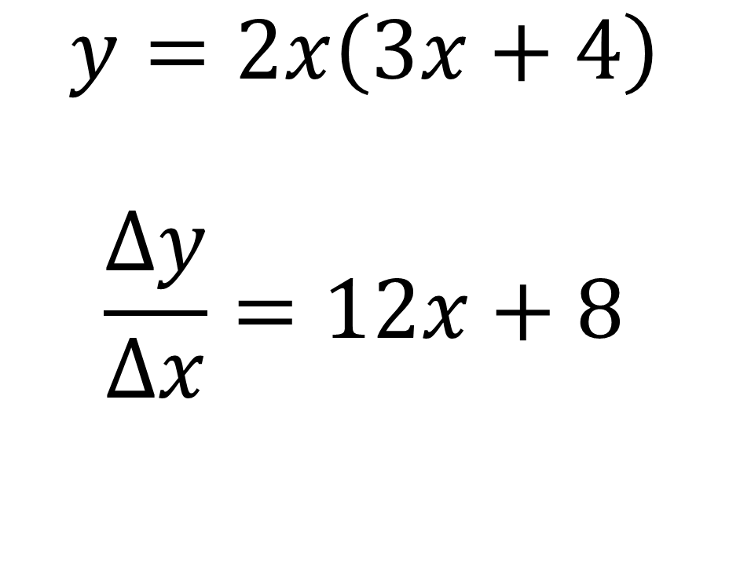
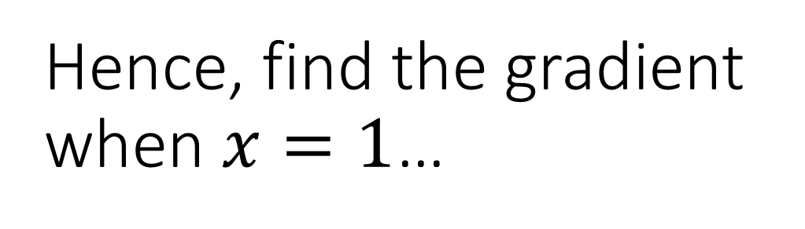
Hence, find the gradient when $x=1$…
A: 8
$$y=2x\left(3x+4\right)$$
$$\frac{Δy}{Δx}=12x+8$$
B: 12
C: 20
D: 14

Slide 25

EXAM-STYLE QUESTION:
The points $A$ and $B$ lie on the curve$y={2x}^{3}+x^{2}−18x+2$
The gradient at both $A$ and $B$ is 2.
Find the coordinates of $A$ and $B$.
(6 marks)

Slide 26
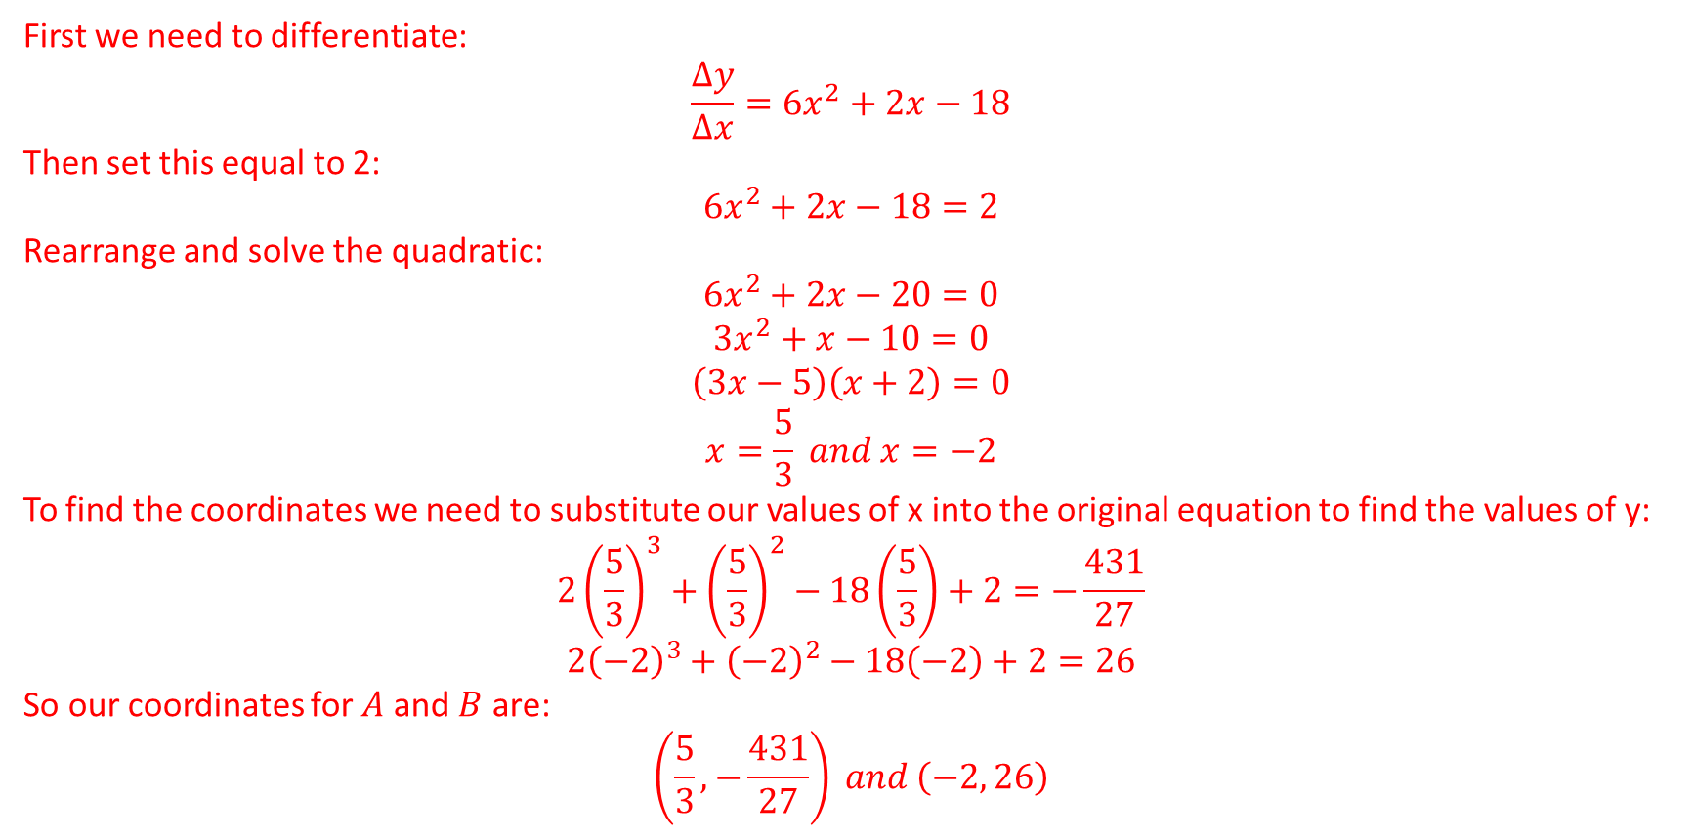
EXAM-STYLE QUESTION: SOLUTION
The points $A$ and $B$ lie on the curve$y={2x}^{3}+x^{2}−18x+2$
The gradient at both $A$ and $B$ is 2. Find the coordinates of $A$ and $B$. (6 marks)
First we need to differentiate:
$$\frac{Δy}{Δx}=6x^{2}+2x−18$$
Then set this equal to 2:
$$6x^{2}+2x−18=2$$
Rearrange and solve the quadratic:
$$6x^{2}+2x−20=0$$
$$3x^{2}+x−10=0$$
$$\left(3x−5\right)\left(x+2\right)=0$$
$$x=\frac{5}{3} and x=−2$$
To find the coordinates we need to substitute our values of x into the original equation to find the values of y:
$${2\left(\frac{5}{3}\right)}^{3}+{\left(\frac{5}{3}\right)}^{2}−18\left(\frac{5}{3}\right)+2=−\frac{431}{27}$$
$${2\left(−2\right)}^{3}+{\left(−2\right)}^{2}−18\left(−2\right)+2=26$$
So our coordinates for $A$ and $B$ are:
$$\left(\frac{5}{3},−\frac{431}{27}\right) and \left(−2, 26\right)$$

Slide 27
Any questions?

