Slide 1
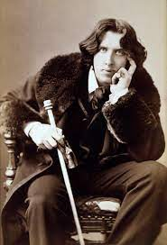
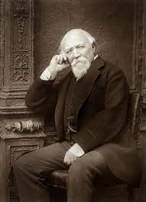
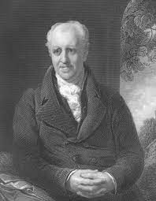
‘As a shut bud that holds a bee I warily oped her lids’
Connect
‘He is sure to remember her dying face!’
‘And her breast and her arms and her hands, should drop dead!’
‘Paint Must never hope to reproduce the faint Half-flush that dies along her throat’
‘He wanted some obedient boy to stand and bear the blow of his outrageous hand’.
What do these quotes suggest about crime?
B/A: Analyse thematically and discuss complexity/simplicity of crime
‘Each man kills the thing he loves.’

Slide 2
Learning Outcomes:
Big Picture
To develop our knowledge of crime within poetry.
To apply our knowledge of crime to an unseen poem.
All of you will consider the conventions of crime writing and apply this knowledge to an analysis of language and structure. (Grade C)
Most of you will provide a thoughtful analysis of crime writing with developing coherency and flashes of perceptiveness. (Grade B)
Some of you will consider the complexity of crime when exploring the representation of it across texts and apply this knowledge to a perceptive analysis of language and structure. (Grade A)

Slide 3
In the case of Elements of crime writing, many of the texts pre-date the crime fiction genre that emerged as a recognisable literary genre in the mid-19th century and with academic recognition in the 20th century. However, in all the texts a significant crime drives the narrative and the execution and consequences of the crime are fundamentally important to the way the text is structured.
All set texts are narratives which focus on transgressions against established order and the specific breaking of either national, social, religious or moral laws. The focus in this component must be on ‘Elements’ and students need to consider the elements that exist in each of their texts.
Activate
Oliver Twist
Crabbe, Browning and Wilde poetry
When Will There Be Good News?
Let’s read and annotate ‘The Laboratory’.
Focus: Presentation of crime
B/A: Complexity of crime and gender

Slide 4
Progress Check
The AABB Anapaestic metre (2 non-stressed syllables and 1 stressed syllable) creates the juxtaposition between the simple rhyme scheme and the driving language that creates an excited voice. Browning’s use of an irregular metre and enjambment enforces the speaker’s uncontrollable desire to kill, making us complicit in the speaker’s actions.
C: Using your analyses, provide an analysis of language that supports this assertion.
B/A: Can you extend the analysis to cover another interpretation of metre?

Slide 5
Demonstrate
Group writing:
‘In “The Laboratory”, the motive is more interesting than the murder’.
To what extent do you think that the poem supports this view?
Remember to include in your answer relevant detailed exploration of the poet’s authorial methods
C: Explore aspects of crime through close analysis of language and structure.
B: Consider a narrow argument; explore a concept in close detail.
A: Can you allude to anapaestic metre and other structural devices in your response as well as other famous Browning texts (MLD)?

Slide 6
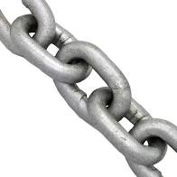
Chain of intellect: Elect one person from your table to verbalise a word or phrase relating to the extract studied today. Beginning clockwise, each person must say an additional word/phrase which relates to the word spoken by the previous person. Which table can achieve the longest ‘chain’ of knowledge? Additional challenge: your response to the previous person can only be a word or phrase which contrasts/undermines theirs
Consolidate

