Slide 1

Define denotation and connotation.
Connect
Grade C:
Choose four aspects of this gaming cover. Analyse the denotations and connotations of each.
Grade B:
Complete C, explaining how the denotative/connotative readings create audience appeal.
Grade A:
Complete B before explaining the pros and cons of connotative readings of the media.
EXAMPLE:
Denotation of fire suggests action, connotes rebellion suggestive of violence and uprising.

Slide 2
Learning Outcomes:
The Big Picture
To experience an A level Media Studies lesson.
To begin analysing media products.
All of you will have an introduction to media theory and will be able to make some comments on this in an academic written response.
Most of you will use media language analysis in relation to a media product alongside some media terminology to develop a confident written response.
Some of you will be critical and evaluative within your analysis, using it as a lens to consider a media text.

Slide 3
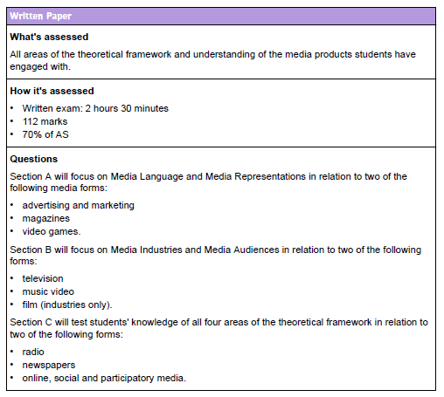
Assessment Breakdown:
Written exam x1: 2hr 30, 70% of AS
Tested on: adverts, magazines, video games,
TV, music videos, film, newspapers, radio, online media
Activate

Slide 4
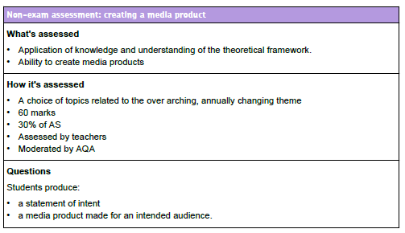
Assessment Breakdown:
Activate
The other 30% of marks: NEA
Your chance to produce a media product e.g.:
Magazine
Advert
Newspaper
Short film
Video game cover
Radio broadcast

Slide 5
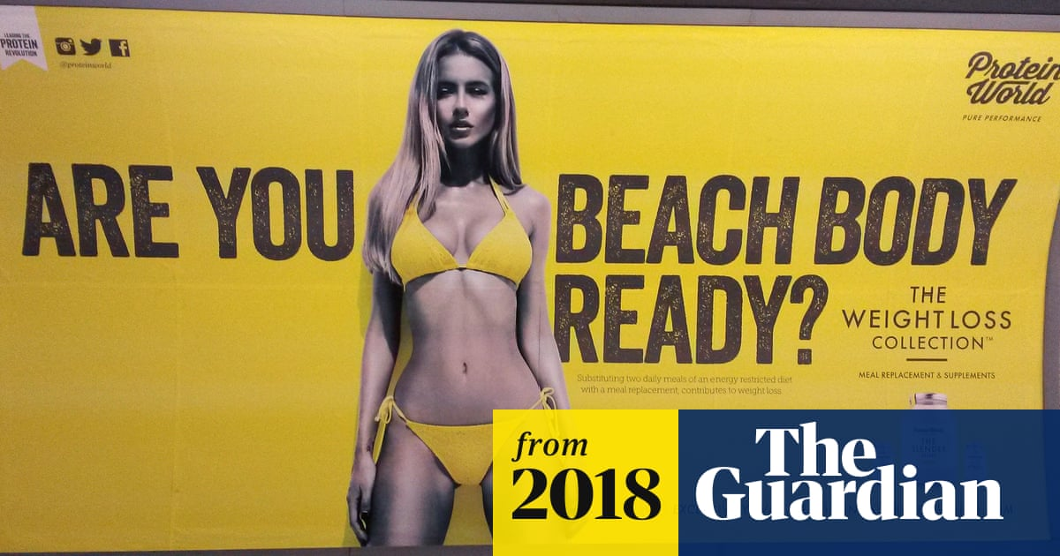

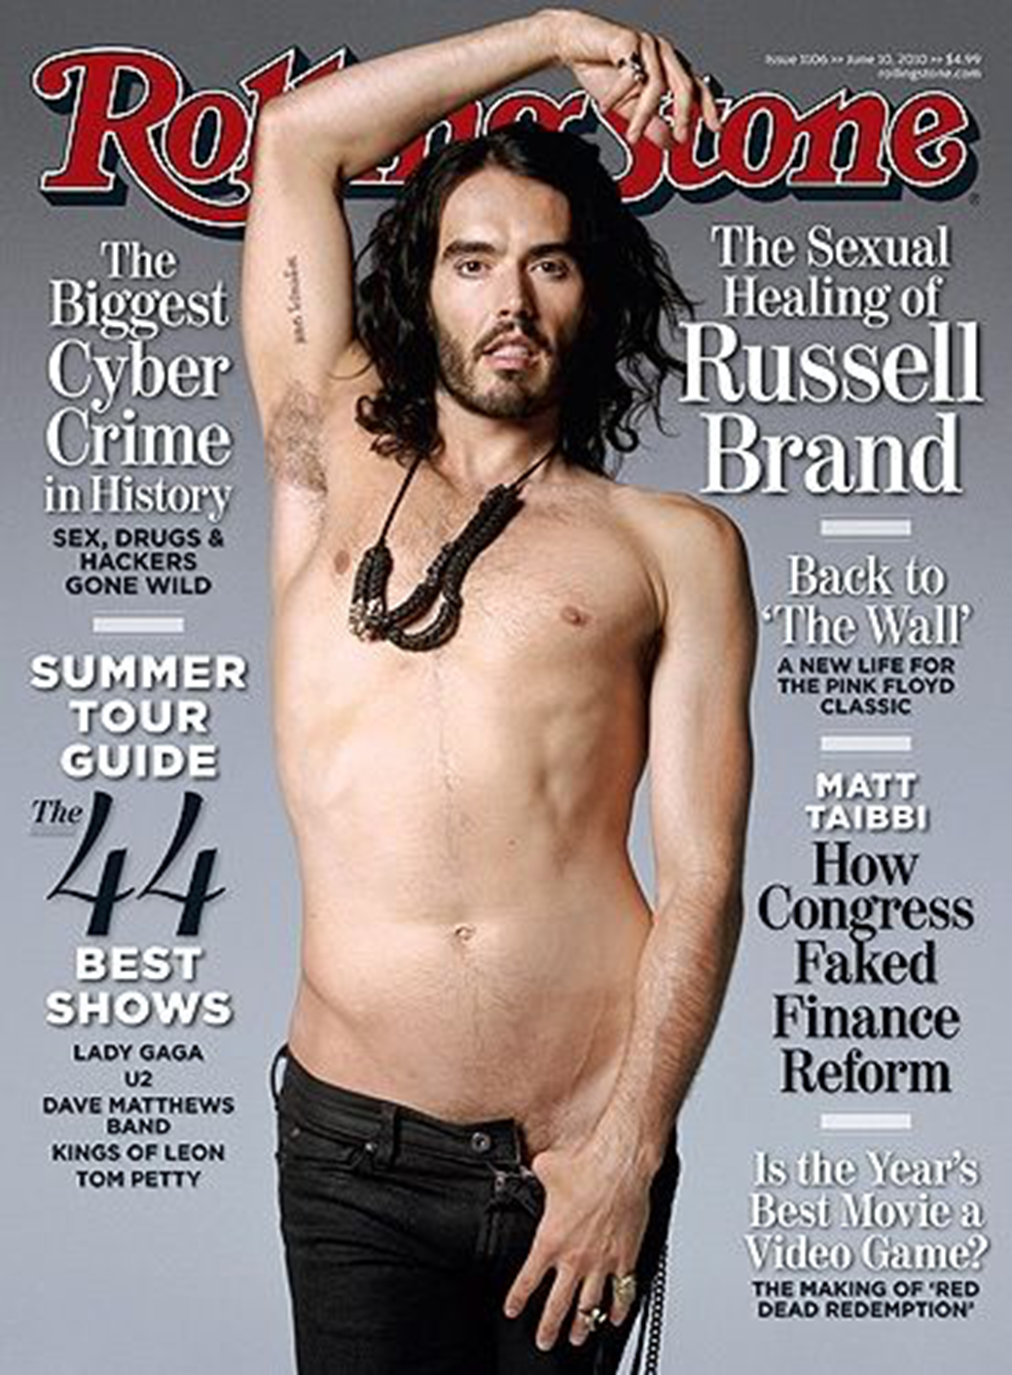

Barthes’ Myth: Dominant Ideology
Activate
Attitudes, beliefs, values and morals shared by the majority of people within a society
Suggests cultural myths are one way in which we share ideas about ourselves in society – they can also be restrictive and reductive by simplifying concepts
Influential on how the majority thinks about the nature of society and their place within it
Serves the interests of those in power
C: What dominant ideologies are being suggested within these adverts?
B/A: How far do these ideologies rely on social and cultural expectations? Why?

Slide 6
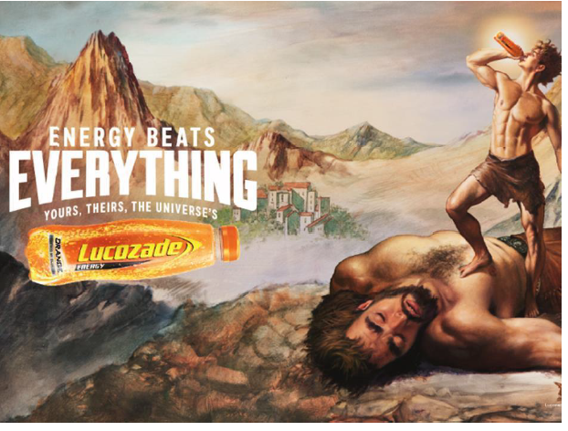
‘The diversity of media forms in modern society means that there are multiple ways to interpret media products which can be highly damaging for audiences and producers.’
To what extent do you agree?
Progress Check

Slide 7
Conduct various points of analysis of the adverts given to you. Focus on:
Connotation/denotation
Dominant ideologies
B/A: How could audiences interpret the media products in different ways depending on social, cultural and historical contexts?
Demonstrate

Slide 8
B/A
What conventional myth within society is being alluded to? How do you know?
What does the gun denote and connote? How does this relate to the myth that is drawn upon?
What connotations and denotations can be drawn from the primary image?
What type of audience is positioned by the cover? How does the game aim to appeal to their societal, cultural and personal morals/values?
What does ‘infinite’ connote? How does this hint at the type of game this is?
How might this aircraft in the background and the male figure be connected? What ideas about men, society and job roles can be connoted? How does this link to the potential audience?
What does the flag connote? How does this link to the target audience and the content of the game?
What does fire and sparks connote? How does this add to your impression of the game?
C:
What myth surrounding gender is drawn upon? How do you know?
What does the gun denote and connote? How does this relate to the myth that is drawn upon?
What denotations can be drawn from the primary (main) image?
Who do you think the target audience is? Why? What personality/morality myths are being drawn upon?
What does the flag connote? How does this link to the target audience and the potential content of the game?
What does fire and sparks connote? How does this add to your impression of the game?

Slide 9
The Lucozade advert relies on modern audiences’ desires for convenience food and drink and combines this with a traditional religious narrative of David and Goliath to convey ideologies of strength and piousness. In this way, the advert almost seems to have a moral function: it is almost as though drinking the product leads to a more morally correct lifestyle which works to position the consumer as wholly good and superior to those who do not consume it. This moral function makes audiences feel they need the product due to its positive ideologies…
Let’s write! ☺
Analyse one advert of your choice using the following semiotic ideas:
Denotation
Connotation
Myth (dominant ideology)
[9 marks]
Consolidate

