Slide 1

Jayne Scattergood – Deputy Headteacher and
Scott Kingsland – Associate Assistant Headteacher
Welcome to the Emotional Health and Wellbeing workshop
What would your top tips for managing exams and the associated stress that comes with them?
Write your ideas onto the whiteboards please

Slide 2
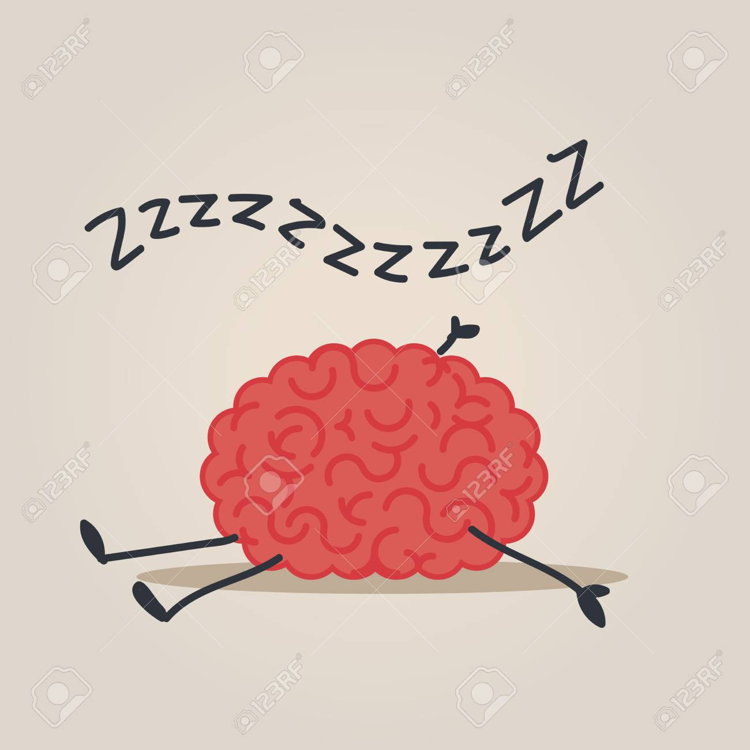
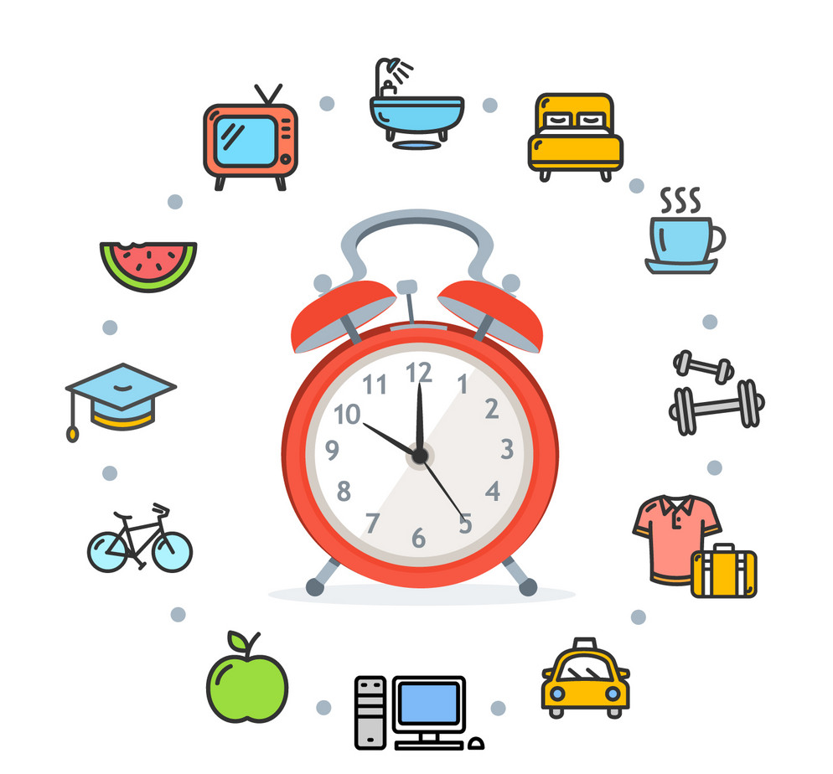
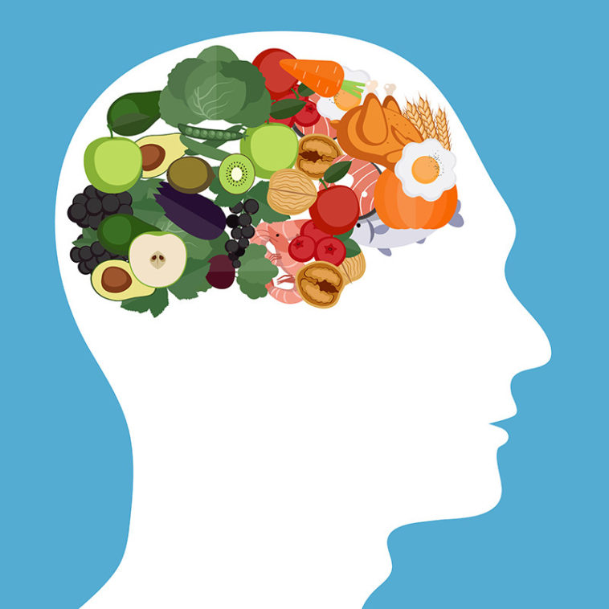




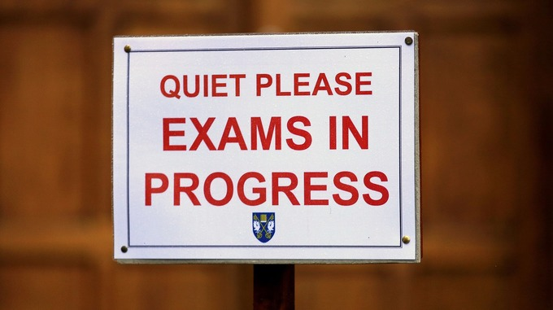
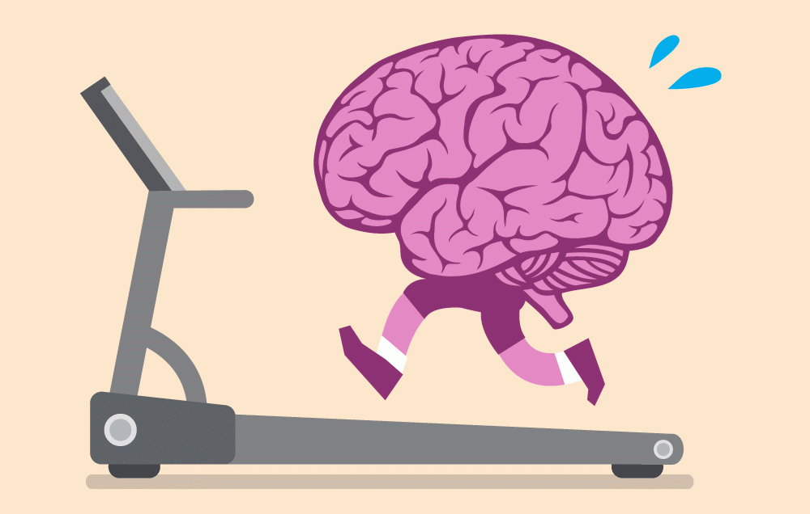

1
2
3
4
5
Emotional Health and Wellbeing
6
7
8
9
10
Notes:
I’m Jayne Scattergood Deputy Headteacher and this is Scott Kingsland, HOY 9. We aren’t medical professionals, we’re not paediatricians, we’re not emotional health counsellors but we are experienced in teaching and dealing with pastoral issues, we’ve seen over 40 Year 11 groups come through between us and we care. So we volunteered to do the session in the hope that we can help your sons and daughters look after themselves over the next few months.

Slide 3

Top tip #1 watch your sleep
Routine here helps
Recommendation is 8-10 hours’ sleep (recent study 15%!)
Reduce screen time before bed
Do something relaxing instead – reading, bath, music
Avoid going to sleep watching television
Use an alarm clock rather than your phone, to reduce temptation to sit and scroll in the morning
change your bedsheets regularly

Slide 4
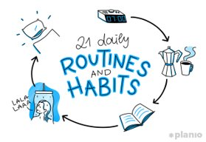
Top tip #2 get into a routine
bedtime routines, eating routines – plan it and stick to it
Getting organised is really important! It allows you to minimise time worrying about what you need to do
Being well prepared for your exams is the best way to overcome stress and anxiety, and gives you the best chance of getting good grades

Slide 5
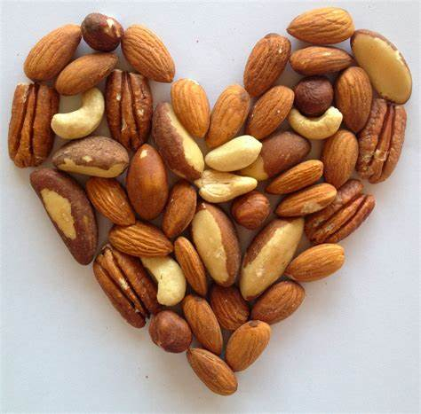


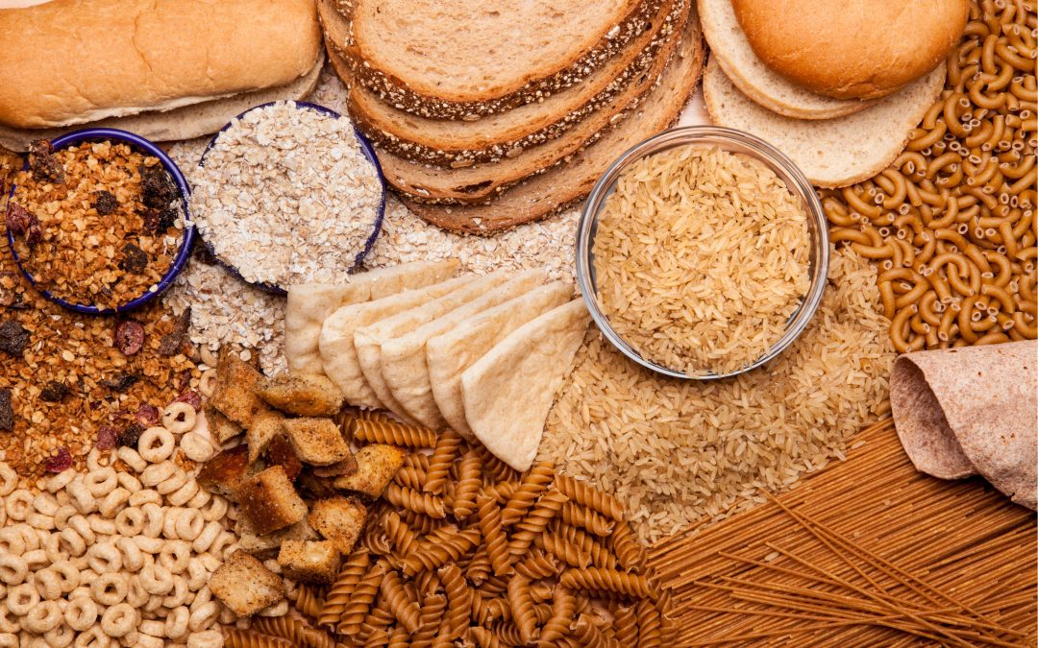


Top tip #3 nutrition is key!
Less caffeine
Veg-load!
Healthy fats
Whole grains
Less sugars
How many of these would you answer yes to?
I often skip breakfast because I’m not hungry
I sometimes forget to drink water during the day
I try to control my weight through no carbs diets/ketones diet/1200 calorie a day diets
I don’t allow myself treats because they’re bad for you
I eat some fruit but I don’t eat vegetables really

Slide 6

Top tip #4 EAT THE FROG
I can’t do this!
I don’t have time to do that!
Don’t put things off! It’ll only increase the fear around doing certain tasks or revising certain topics.
Instead:
Use the eat the frog analogy!
As Mark Twain once said “If it's your job to eat a frog, it's best to do it first thing in the morning. And if it's your job to eat two frogs, it's best to eat the biggest one first.” ... Eating the frog means to just do it, otherwise the frog will eat you meaning that you'll end up procrastinating it the whole day.

Slide 7

Top tip #5 DECLUTTER YOUR MIND
Declutter your bedroom, declutter your mind
Notepad by the BED: Write down to-dos and worries before bed so it’s easier to switch off
GET YOURSELF ORGANISED
Studying for hours and hours in one go is ineffective and will often lead you to feel more stressed and overwhelmed with a cluttered mind.
I need to spend all my time revising
Instead:
Break down topics & split up your time
Create a revision timetable and plan in fun activities to break up your revision
Remember the importance of sleep and regular physical activity to help aid your overall wellbeing

Slide 8
Top tip #6 think about your environment
Going for a jog
Walking the dog
Spending time with family
Having a bath
Cooking a meal
Happy spaces
Happy places
Happy people
During stressful times we often put off or stop doing things that we enjoy. Problem is this makes studying even harder and can mean your ability to focus declines!
I can’t fit everything in so I need to stop my hobby
Listening to some music
Instead:
Create a revision plan which allows you to keep up your hobbies
Don’t underestimate the importance of effective breaks in revision and carrying on when you can’t take any more
Use this time to clear your head

Slide 9
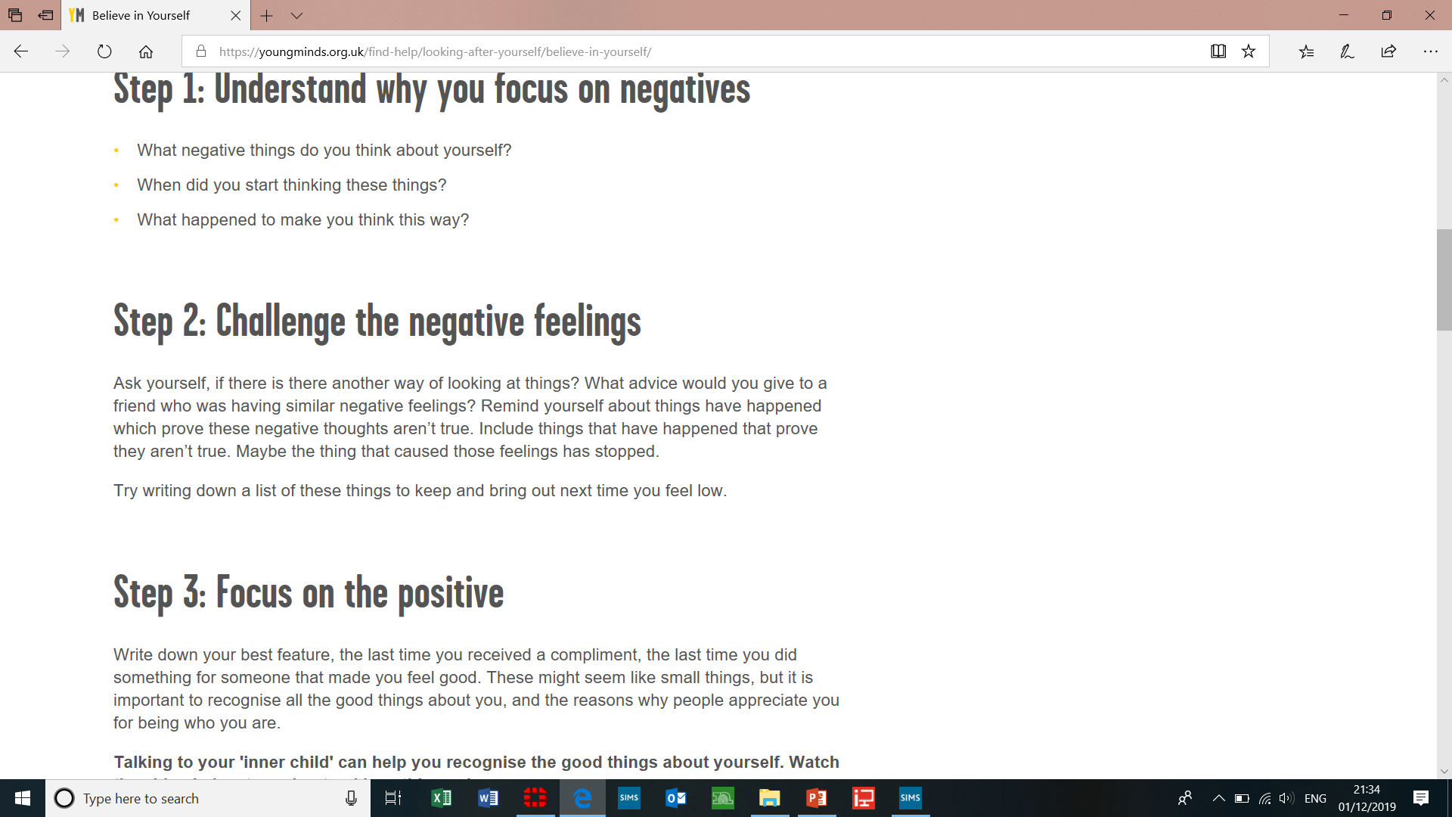
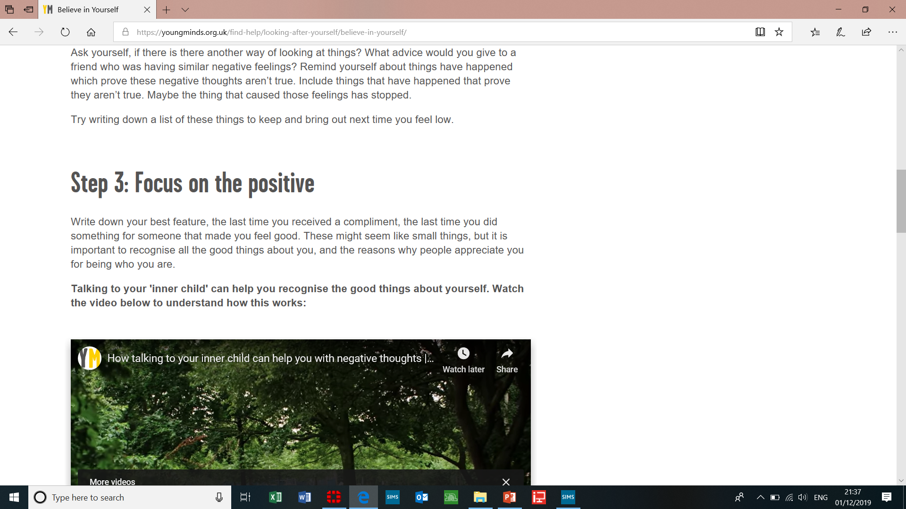
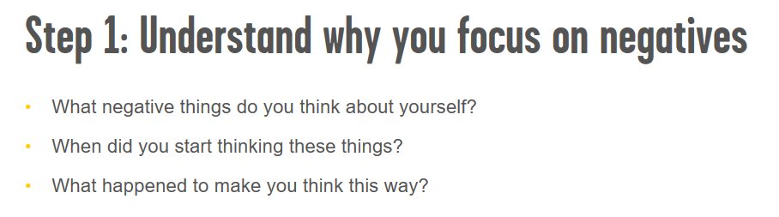
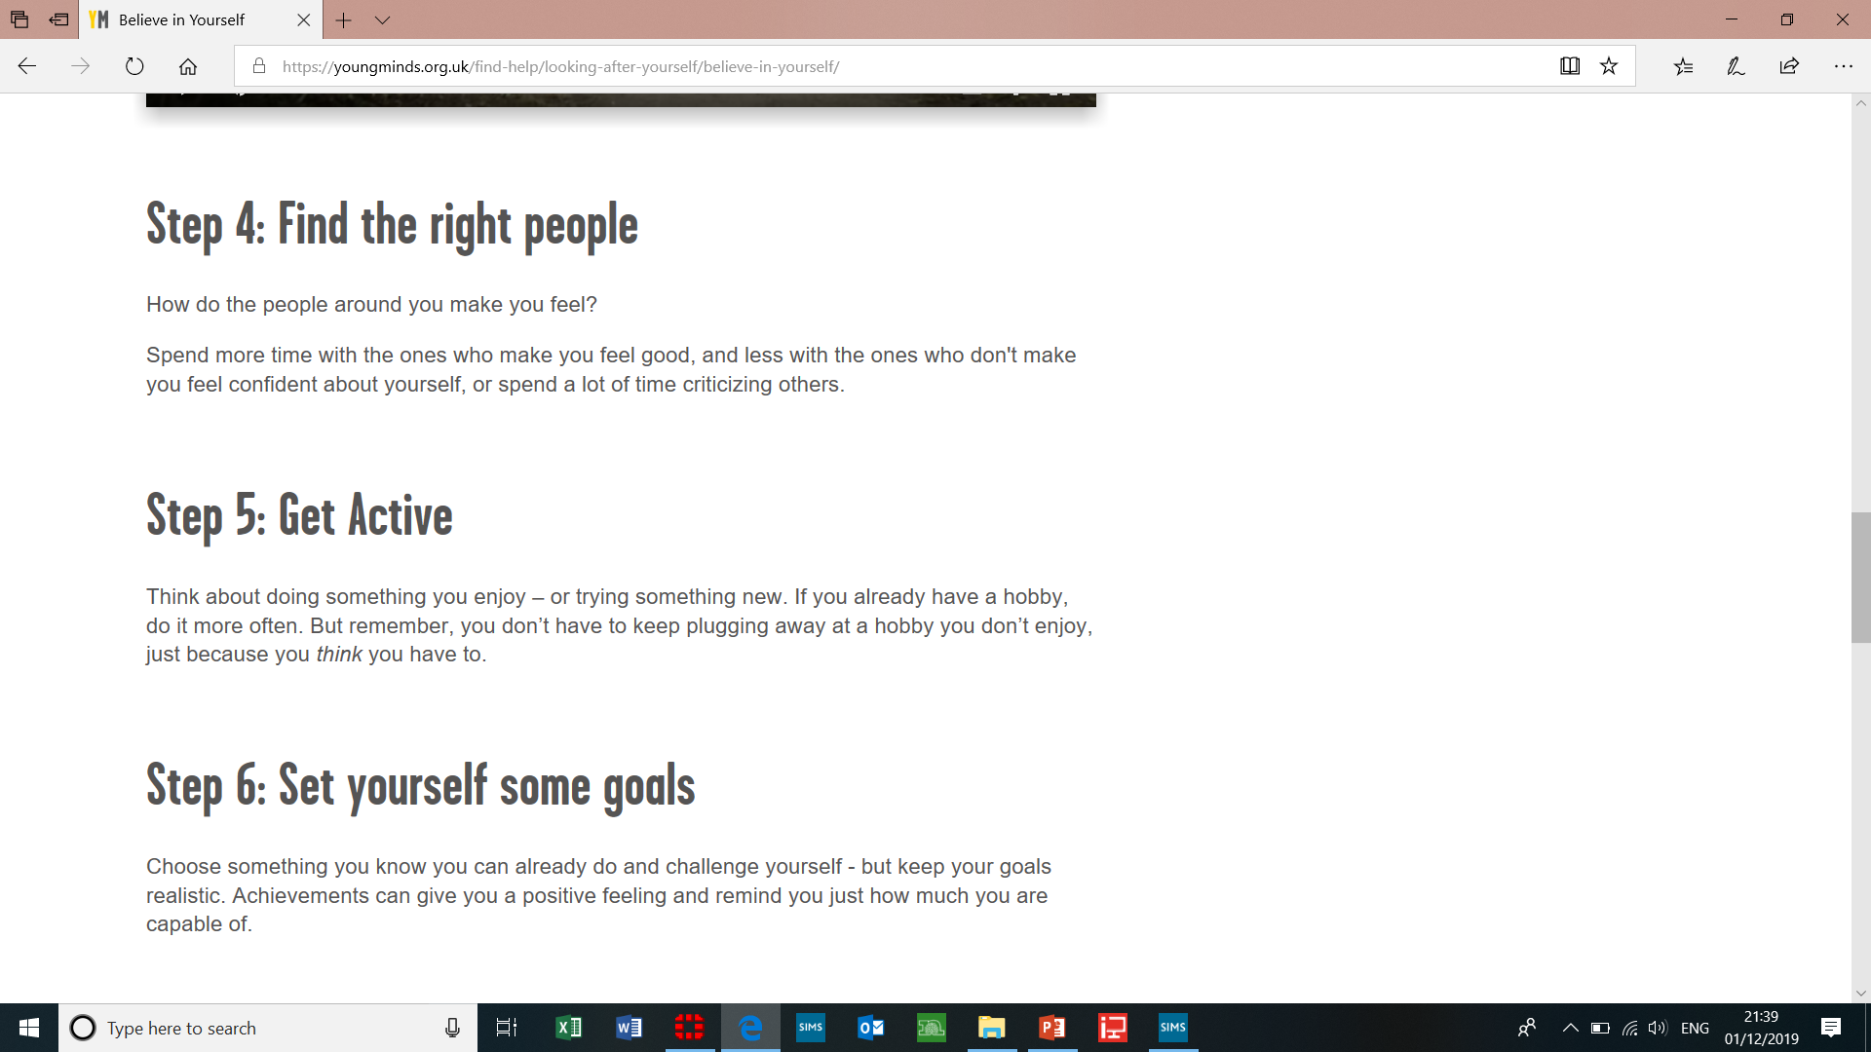

Top tip #7 challenging negativity
No one gets what I am going through
I can’t do this!
During times of stress we often overthink things and go over them in our head thinking of the worst case scenarios and making ourselves feel worse. Remember lots of people are going through what you are and lots of people around you have.

Slide 10
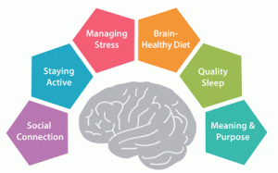
Top tip #8 self awareness on exam/ASSESSMENT day
Anxious feelings during exam season is completely normal
For most of you this will be the most stressful thing you’ve ever been through
Everyone handles stressful situations different so remember what works for you might not work for those around you
Be prepared. Start the day with a good breakfast, and give yourself plenty of time to get to the exam hall. Remember to take everything you need, including pencils, pens and a calculator. A bottle of water and some tissues are also useful.
Set up a routine. Where to go on the day and what you can do as you go into the exam to help relieve your nervousness.
Take a few minutes to read the instructions and questions. Then you'll know exactly what's expected of you. Ask an exam supervisor if anything is unclear – they're there to help you.
Focus on small things. Look for something in the room to keep you focused. If you feel worried focus on one thing in the room and just focus on your breathing. Give yourself 30 seconds of doing this to clear your mind before going back to the exam.
Once the exam is finished, forget about it. Don't spend too much time going over it in your head or comparing answers with your friends. Just focus on the next exam instead.

Slide 11




Top tip #9 keep active and fit
60 minutes exercise a day now recommended
Spend time with friends or family keeping fit
Make time for some exercise
Skipping, jogging, star jumps to get your heart rate up
Zumba track!
Brisk walk to school/the shops
Kick about, shooting hoops
Take the dog a walk
Half an hour swim
5k run
Notes:
Children and young people need to do 2 types of physical activity each week:
aerobic exercise and then exercises to strengthen their muscles and bones
aim for an average of at least 60 minutes of moderate intensity physical activity a day across the week
take part in a variety of types and intensities of physical activity across the week to develop movement skills, muscles and bones
reduce the time spent sitting or lying down and break up long periods of not moving with some activity. Aim to spread activity throughout the day. All activities should make you breathe faster and feel warmer

Slide 12



Top tip #10 talk and share problems
In school: your tutor, MR EVANS or MRS MORTON.
Outside of school: if you have concerns about your wellbeing, you can contact your GP for advice and support. Sometimes this is a faster route to go down.
School nurse offers help to young people experiencing physical health related issues as well as low mood.
COMPASS: CHANGING Lives offers intervention to young people (up to 17 years) who are experiencing mild to moderate mental health problems.
Kooth.com free, safe and anonymous online support for young people.
There is also lots of information available online at:
www.nhs.co.uk www.youngminds.org.uk www.mind.org.uk

Slide 13






Helpful websites and apps…
Twilight
Filters the flux of blue light emitted by your phone or tablet which can cause sleep problems.
Hydro Coach
Helps you to keep tabs on how much you are drinking throughout the day.
Happy Healthy
Allows you to rate yourself on Lifestyle, Exercise, Nutrition Sleep and Happiness, showing you what may affect your mood.
Self Control for Study
Lets you block certain apps and websites during times you’d like to focus on study.
WellMind
Designed to help you with stress, anxiety and depression. It includes advice, tips and tools to improve your mental health and wellbeing.
Noom Walk
Keeps track of how many steps you take a day.

