Slide 1


Welcome
Apps for Learning | Mr Hudson
Text here

Slide 2
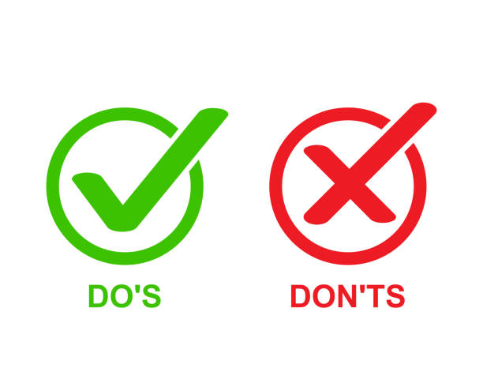

Slide 3



Slide 4

Don’t Waste Time!

Slide 5
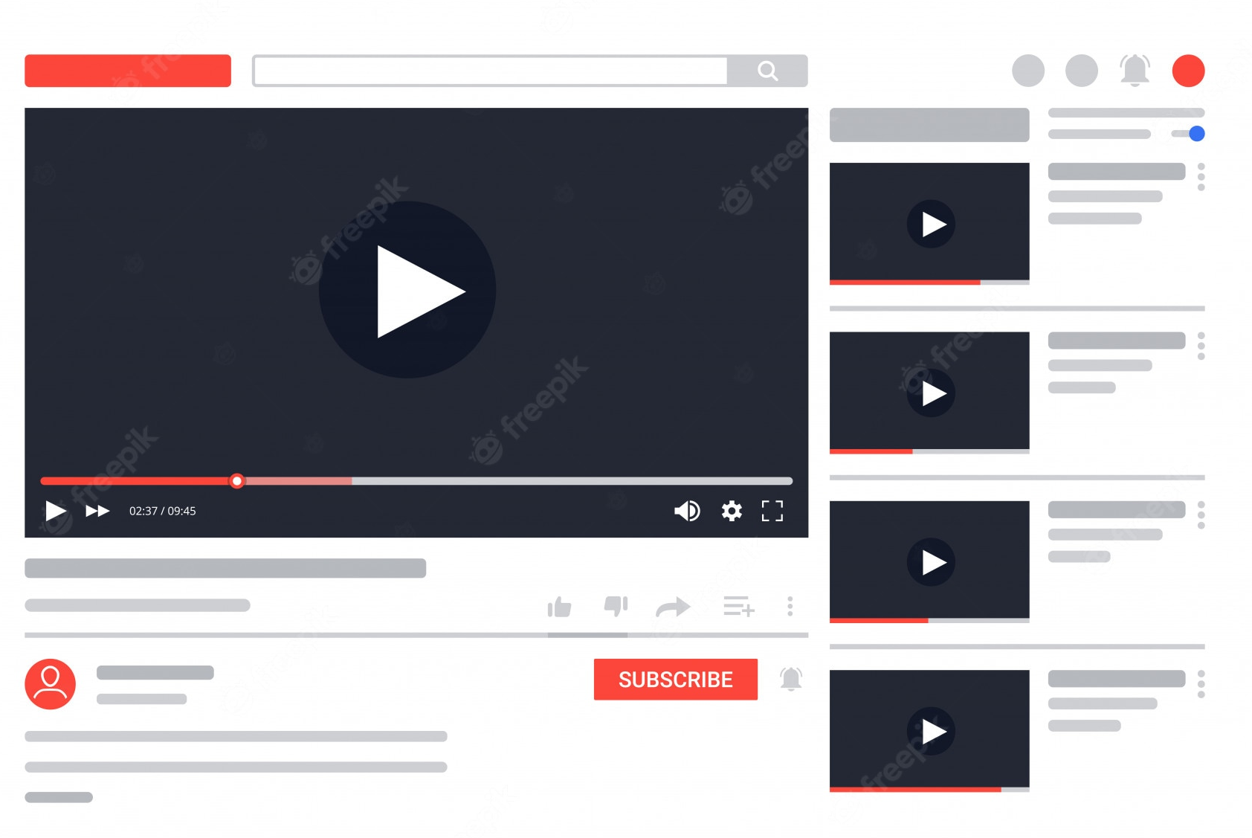

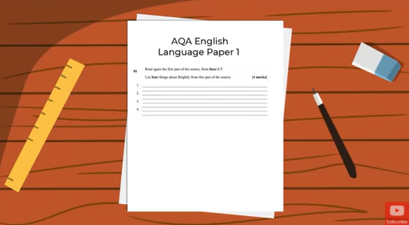
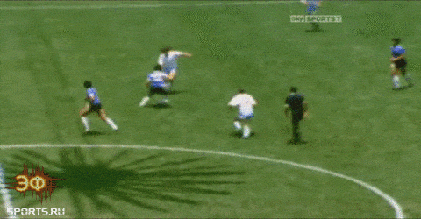

If you know you will get distracted, stay away!

Slide 6



English
Photography
Art
Maths
Computer Science
Technology
PE
Drama

Slide 7








Subject Specific Apps
Science
Maths
MFL

Slide 8





Generic Revision Apps

Slide 9
Generic Revision Apps

Slide 10
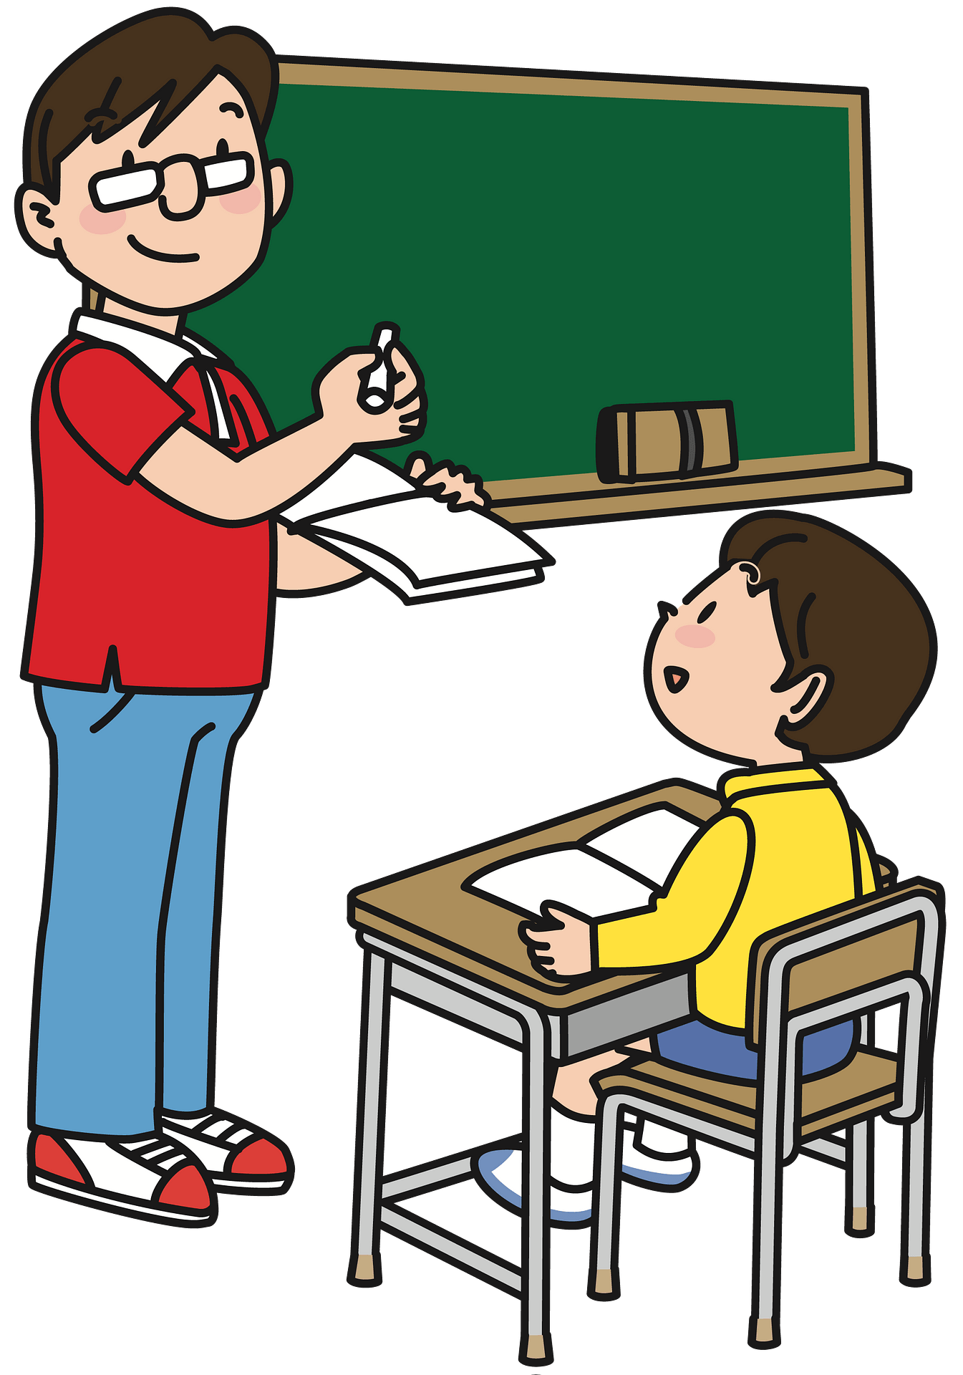

Slide 11
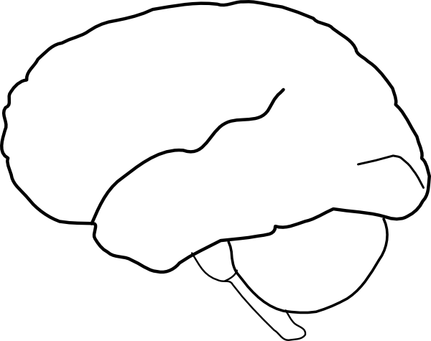

Slide 13


Slide 14


Slide 15


Slide 18
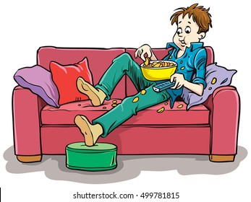

Slide 23


Application that personalise it to you
If it requires an account, create an account!!

Slide 24


Slide 25
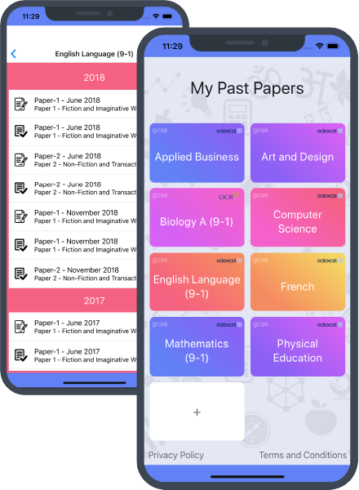
Where can I get Past Papers?
More than 7000 papers available for free!
OCR | Edexcel | AQA | WJECT | and more…

Slide 26

Which course am I studying?
Make sure you know your exam board.
Ask your teacher for each subject if you don’t!

Slide 27
Steps for Success
Find useful pages, apps and accounts for revision
Use a mixture of the above as well as ‘hard copy’ resources
Set yourself time slots for the use of all revision resources
Check the material with your teachers
Don’t use pages/applications which you’ll find distracting, keep them as a treat, for your non-revision time
Don’t lie to yourself. If you’re revising, great, if you’re having down time also great, but find a balance
Don’t lie to yourself. Revise the content you need to revise!

