Slide 1

Year 11:
Revision Guidance

Slide 2

Advice

Slide 3

What is your motivation?
There are two types of motivation, intrinsic and extrinsic motivation.
Extrinsic motivation is when motivation comes from "external" factors that are given or controlled by others. Money or praise are good examples. This type of motivation is everywhere and frequently used within society.
Intrinsic motivation is when motivation comes from "internal" factors to meet personal needs. We do things we do because we enjoy them and can see their value, not because we have to. Intrinsic means internal or inside of yourself.

Slide 4
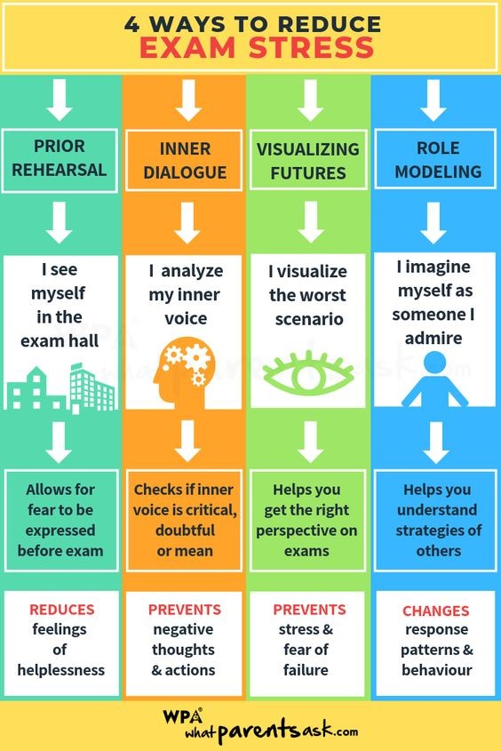
Psychological intrinsic ‘training’
Helps you to combat overwhelming and unexpected feelings
Allows you to rationalise scenarios, feelings and thoughts
Contributes to encouraging a calm and purposeful mindset which is exam ready!

Slide 5
What Motivates You in Year 11?
Achieving High Grades:
Striving for excellent grades to reflect their hard work and understanding of the material.
The sense of accomplishment and recognition that comes with good academic performance.
Positive Feedback:
Receiving praise and constructive feedback from teachers and peers.
The boost in confidence and encouragement that positive feedback provides.
Future Career Aspirations:
Connecting schoolwork to future career goals and ambitions.
The motivation to pursue a particular profession or field of interest.
Sixth-Form, College or University Acceptance:
The goal of gaining admission to a desired sixth-form, college or university.
The academic achievements and extracurricular involvement required for acceptance.
Parental Approval and Support:
Seeking approval and encouragement from parents or guardians.
The desire to make family members proud of their academic accomplishments.
Personal Growth and Self-Improvement:
The intrinsic satisfaction of learning new things and improving skills.
The motivation to challenge oneself and achieve personal goals.

Slide 6




Generic Advice Prior to Exams
Practise Core Skills
Have an Effective Plan
Redraft Classwork
Use Exam/Assessment Feedback
Use Online Revision Tools
Use the Experts!

Slide 7




Generic Advice
Read the sources and/or questions multiple times
Each time, focus your attention on a specific element or skill
Plan a response, where necessary, before you begin to write
Re-read and revisit your responses!

Slide 8

Why Set Targets?
It is important for all students to know what they would like to achieve. That may be six months from now, the end of the school year or five years time and so on
Setting targets will help you understand exactly what you need to do to achieve those targets, work on weaknesses and give you a much better chance of getting where you want to be!

Slide 9


Benefits of Setting Targets
Setting targets is more than just deciding what you want to achieve; it's about creating a roadmap to success. Here are some key benefits:
Sense of Achievement:
Reaching your targets provides a sense of accomplishment and boosts your self-confidence. Each small success builds your confidence and encourages you to set and achieve even more ambitious goals.
Improved Performance:
Targets push you to perform at your best and strive for excellence. By setting high standards for yourself, you can continually improve your skills and knowledge.

Slide 10



Benefits of Setting Targets
Increased Motivation:
Setting targets gives you something concrete to strive for, which can boost your motivation and drive. When you have a clear goal in mind, you're more likely to put in the effort needed to achieve it.
Enhanced Focus:
Targets help you concentrate your efforts on specific tasks, reducing distractions and improving efficiency. When you know exactly what you're working towards, you can prioritise your activities accordingly.
Better Time Management:
Setting targets allows you to plan your time effectively, ensuring that you allocate sufficient time for each task. This can help you avoid last-minute rushes and reduce stress.

Slide 11
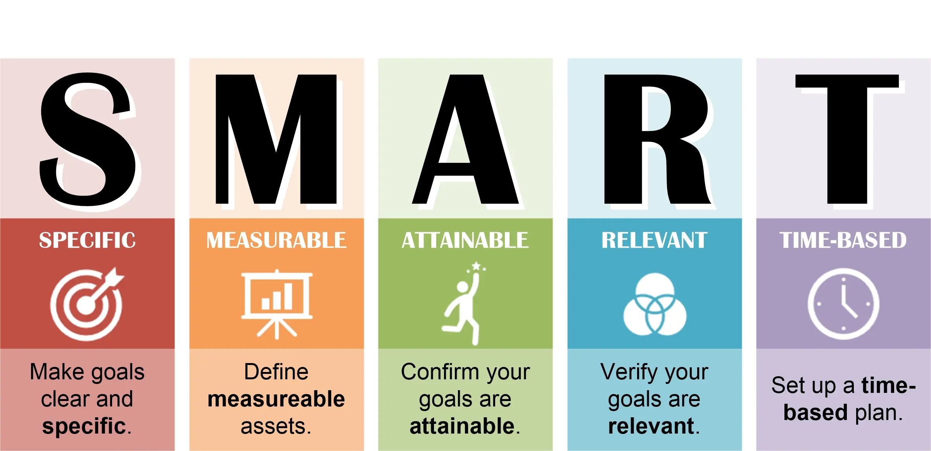
SMART Targets
The SMART goals framework is a powerful tool that helps in setting well-defined and attainable targets. SMART stands for Specific, Measurable, Achievable, Relevant, and Time-bound.

