Slide 1




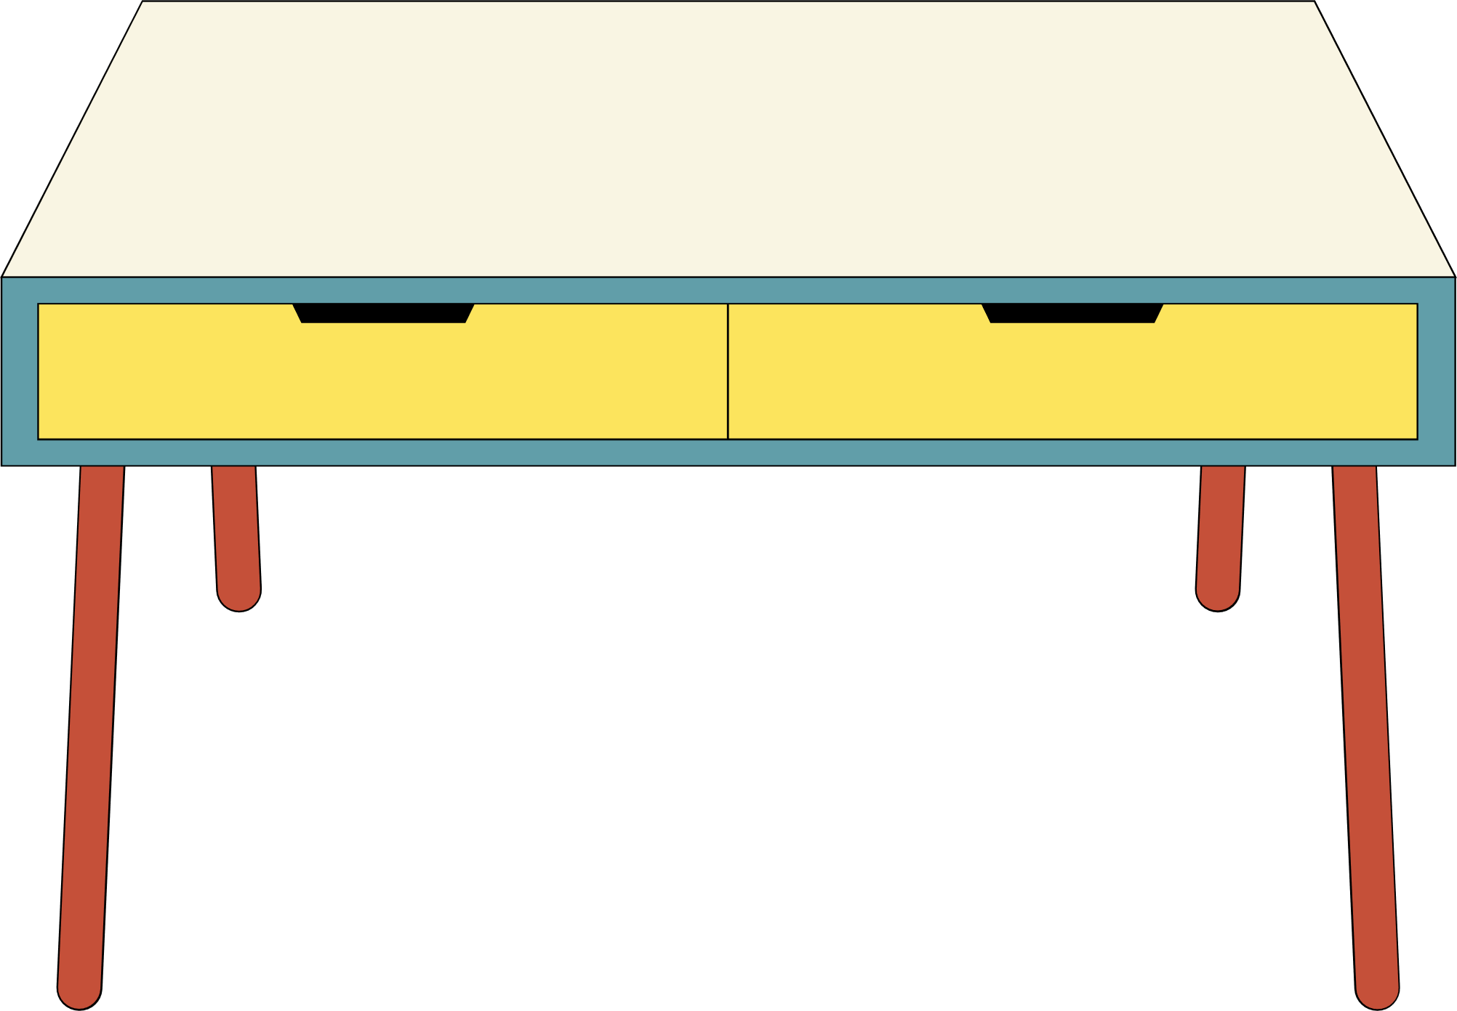
Year 11
Revising
How To Guide

Slide 2



I KNOW I NEED TO REVISE…
BUT WHY?
To secure content knowledge
To practise core skills
To be regularly exposed to exam-style questions and content
To enable yourself to have the confidence and resilience needed to succeed
To avoid ‘exam panic’ and allow yourself to focus on the task at hand more effectively

Slide 3
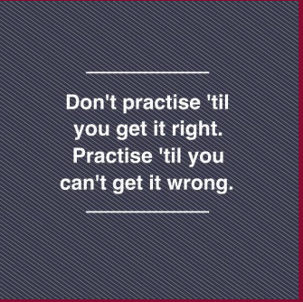




Slide 4
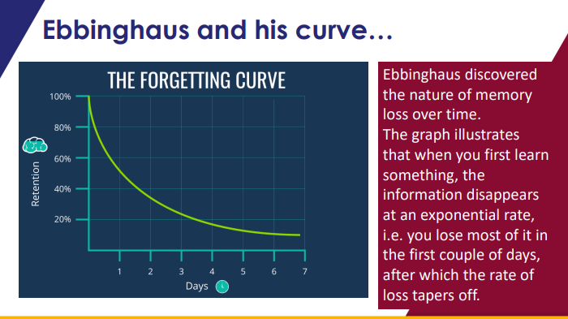

Slide 5
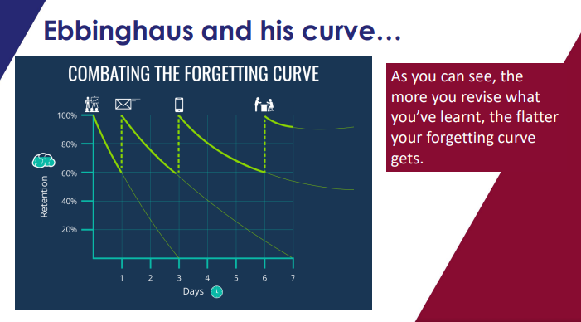
When you learn something, a group of neurons in the brain activate in the hippocampus, like a pattern of lightbulbs turning on.
Pathways to and between neurons can be strengthened over time.

Slide 6


ADVICE
PREPARATION
TECHNIQUES

Slide 7
I KNOW I NEED TO REVISE…
BUT WHAT DO I DO?
‘Revision’ can be a daunting prospect if you are unequipped with the knowledge and skillset required to effectively conduct it.
Here’s some advice…

Slide 8


ADVICE

Slide 9
MAKE IT
MEANINGFUL
v

Slide 10

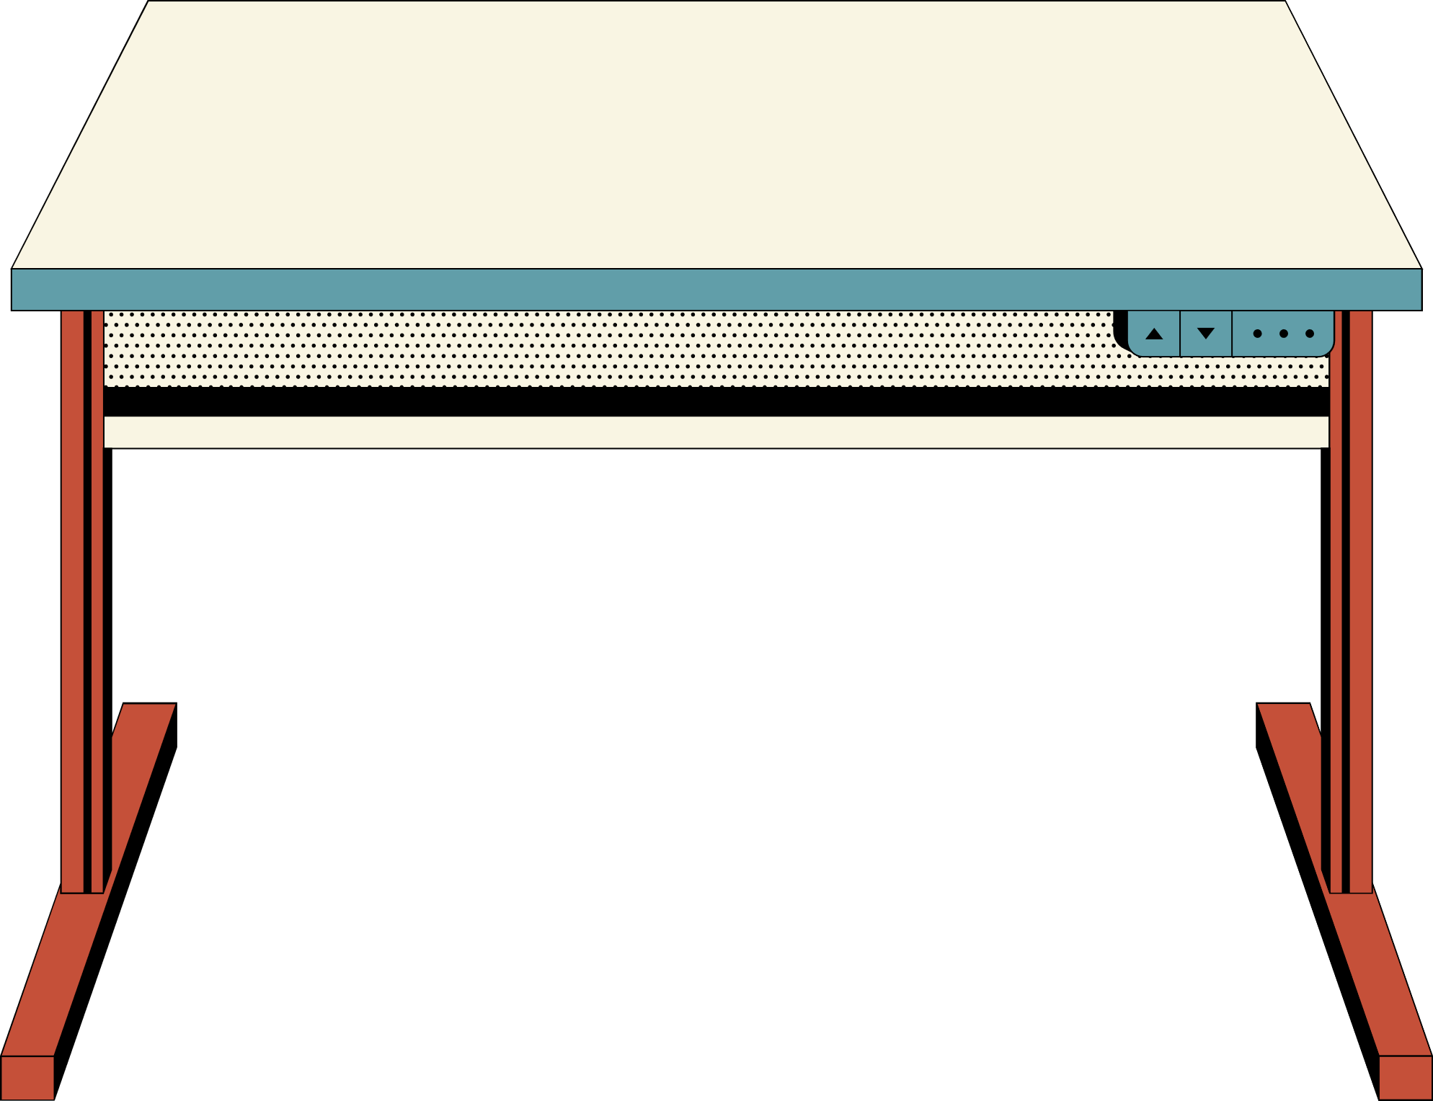

Cramming content doesn’t work!
The forgetting curve is at its steepest early on, which means that if you cram in your revision the day before the test, your recall of this will be more likely to unsuccessful.

Slide 11
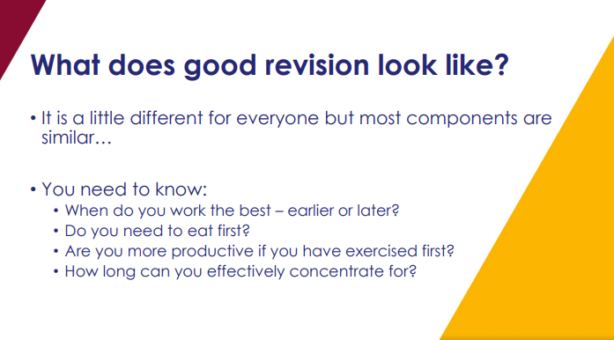

Slide 12
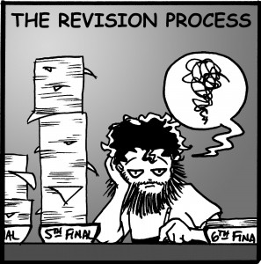
The 50/10 Rule
Keep revision sessions short and meaningful
50 minutes of revision followed by a 10 minute break is more than sufficient
The brain can recall material from the start and end of revision sessions more successfully that that in the middle – breaks are key!
- A break should not be something that will distract you completely so that you don’t stick to your timings e.g. Television or mobile phones.

Slide 13
WORK SMARTER, NOT HARDER
v

Slide 14

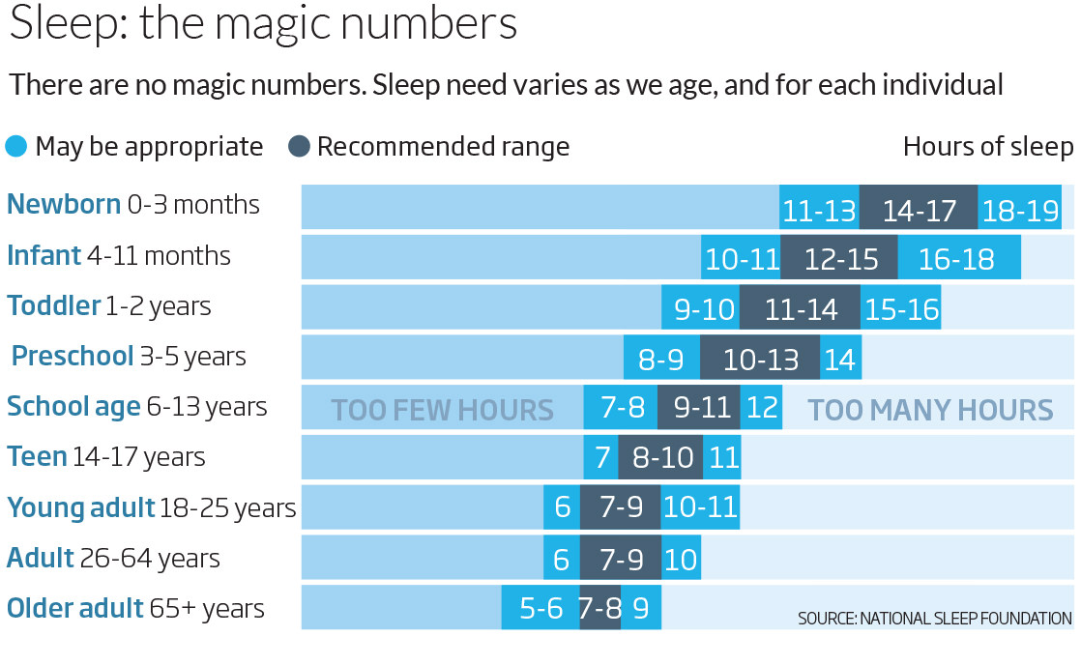

Keep your energy levels high
A lack of sleep or oversleeping will cause a loss in concentration and thus you will be working harder, not smarter!

Slide 15


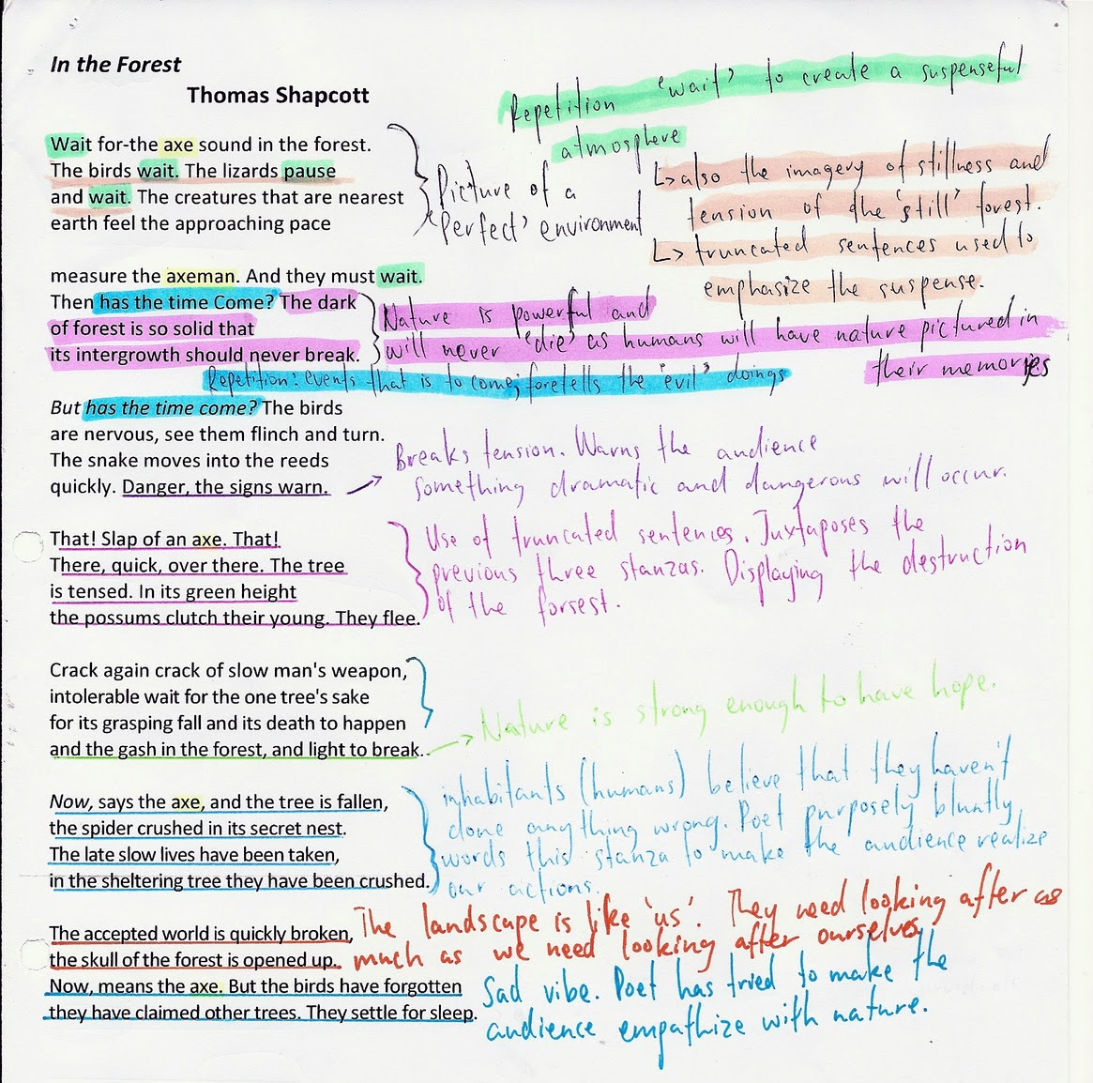

Know your revision!
Avoid ‘revision for revision’s sake’: ensure that you understand what to revise and why you are revising that content.

Slide 16
ADVICE
PREPARATION
TECHNIQUES

Slide 17
PREPARATION

Slide 18
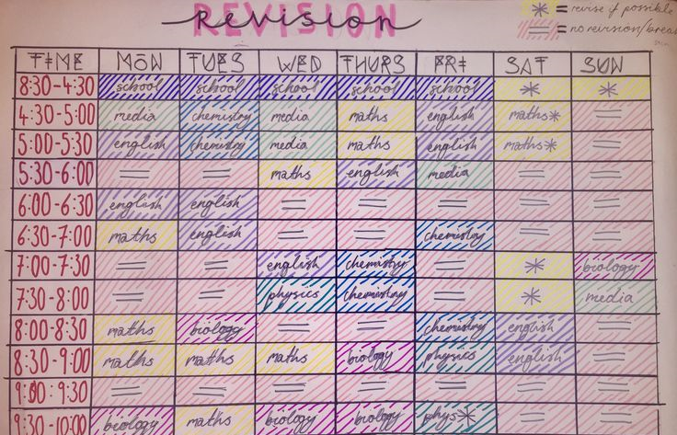
Organise your time
You could:
Colour code what subject to revise when you definitely know you can revise
Colour coded when you are definitely unable to revise
Colour code where you might be able to revise
Teachers are realistic that you have other commitments (as do we) but as long as you work around them correctly then revision can still easily take place effectively.

Slide 19
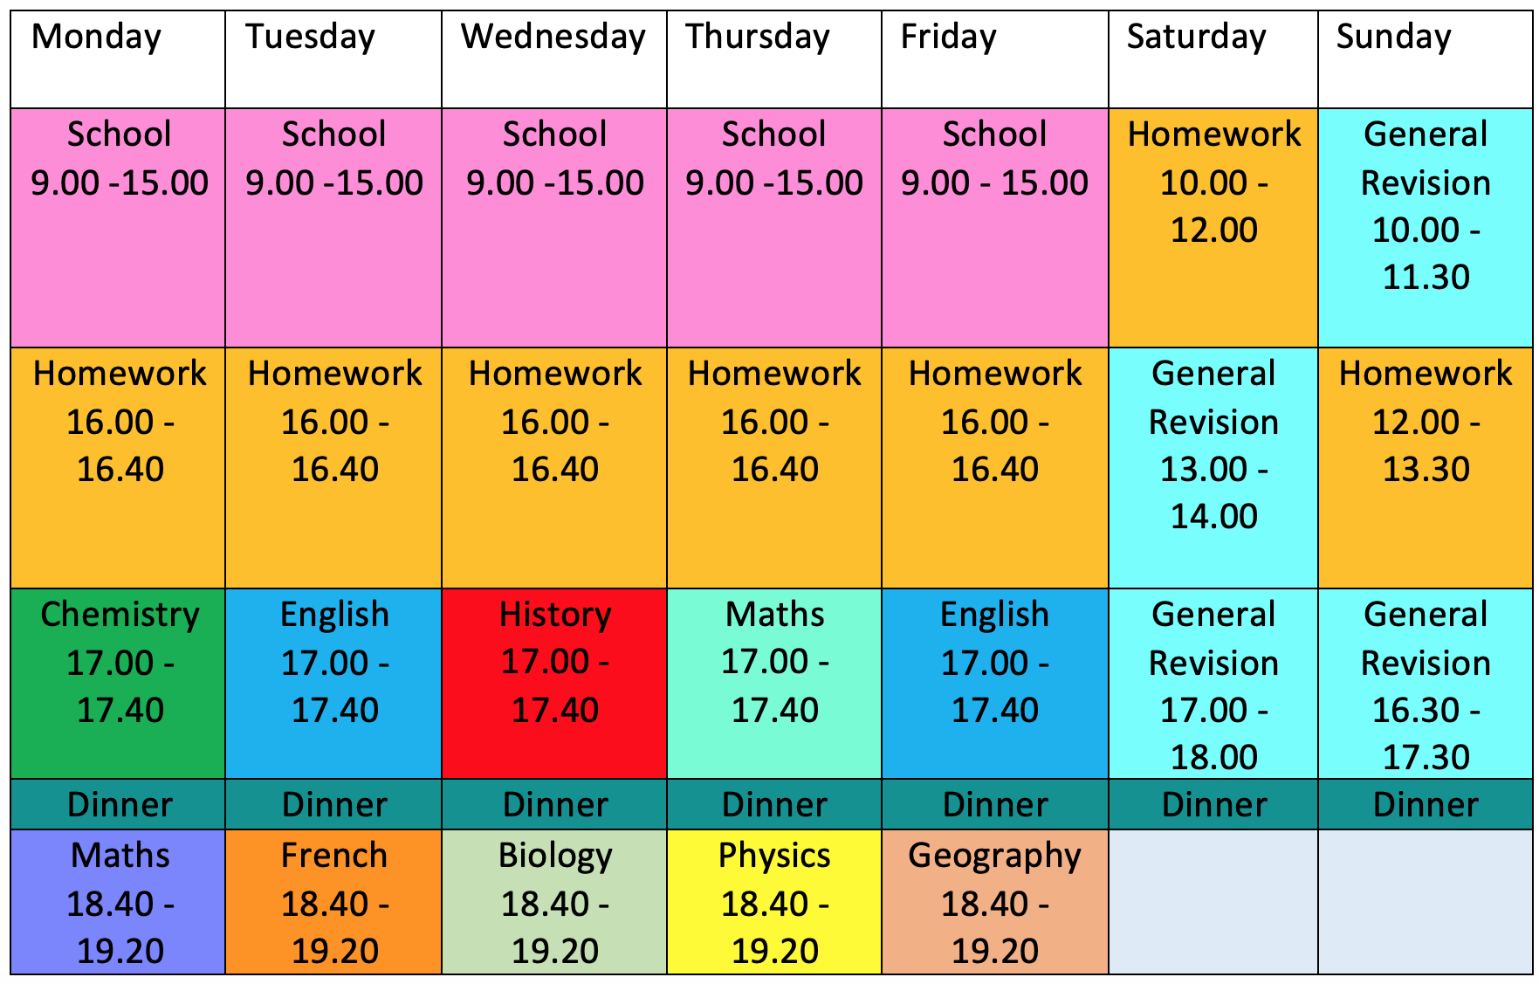
Organise your time

Slide 20
How to make a revision timetable:
know your content!
English Literature: 5 topics
Macbeth
A Christmas Carol
Power and Conflict Poetry
An Inspector Calls
Unseen poetry
It sounds obvious, but writing a list of the topics you need to cover for each subject will help to focus your revision and allow you to break down your revision into manageable sections:

Slide 21
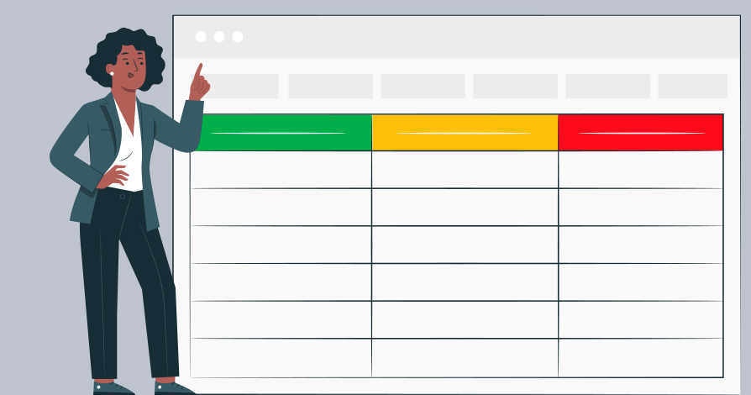
How to make a revision timetable:
prioritise your content
Order your list of topics from those you’re least to most confident with; when it comes to constructing your timetable, schedule your hardest topics for sooner rather than later.
Allow yourself more time to get to grips with your worst subjects − but don’t neglect the ones you’re strongest in. For example, you might decide to complete two hours on a tricky unit for every hour you spend on a more familiar one.

Slide 22
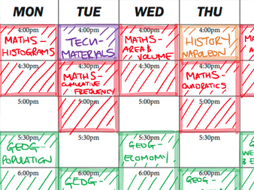
How to make a revision timetable:
compiling the table
For each subject, divide however many days you have until your first exam (minus any days you won’t be studying) by the number of topics you need to revise. This will tell you how many topics you need to revise each day. For example, if you have 60 topics and 30 days, you will need to cover two topics per day.

Slide 23
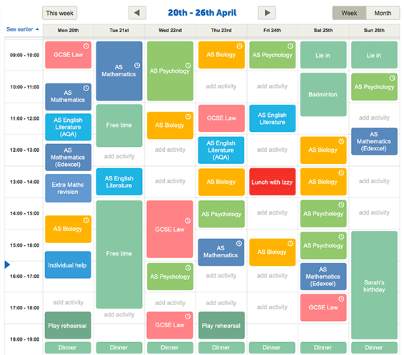
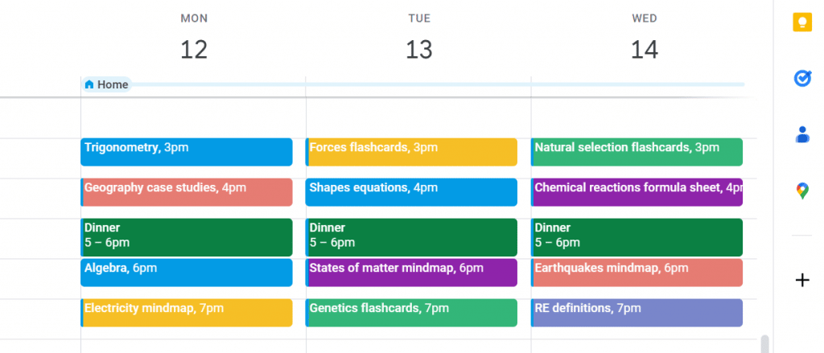
How to make a revision timetable:
compiling the table
Getrevising.co.uk
Google calendar

Slide 24
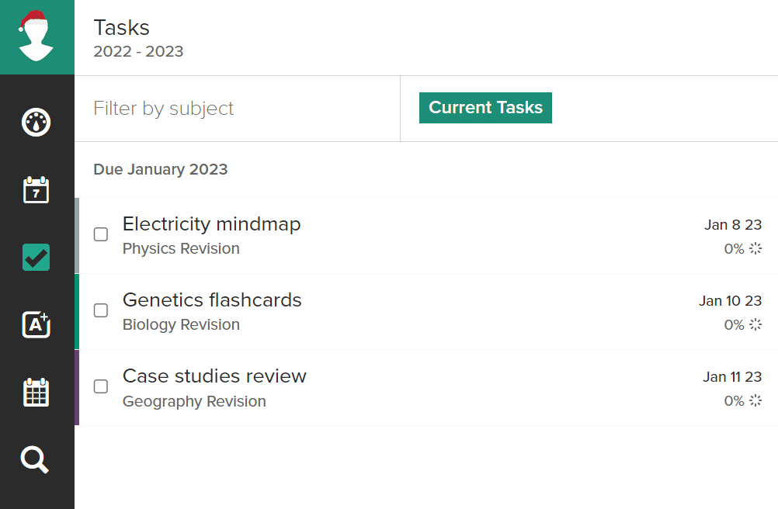
How to make a revision timetable:
compiling the table
Mystudylife.com
Don’t overthink your revision timetable: there’s no exact science to it. Ultimately, putting the work in is what really counts.
Planning is definitely important, just don’t spend so much time making the ideal calendar that you never get round to revising!

Slide 25
ADVICE
PREPARATION
TECHNIQUES

Slide 26
TECHNIQUES

Slide 27
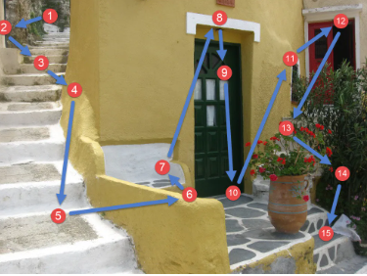
MEMORY JOURNEYS
Pick a well-known journey that you can visualise
Choose and write down the landmarks or key stages within that journey that you intend to use/notice
Place at least one item that you wish to remember at each landmark or key stage of the journey
Run through the journey, including the items, over and over again (it should almost feel like a story)

Slide 28

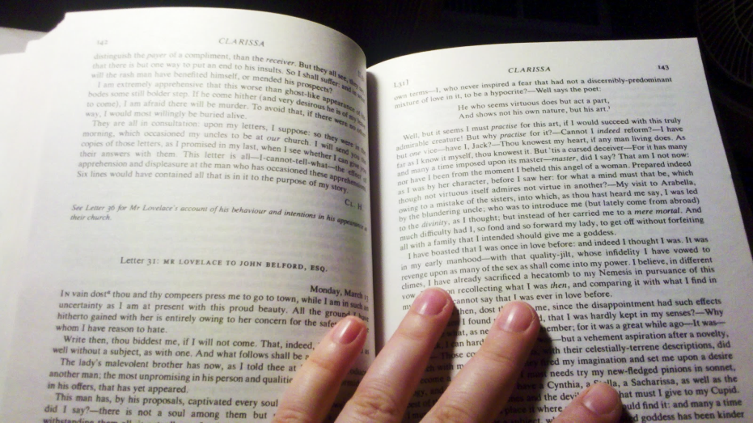

MIND MAPPING
Mind-maps were invented by Tony Buzan who said…
Although we read and write like this…
We think more
like this…

Slide 29
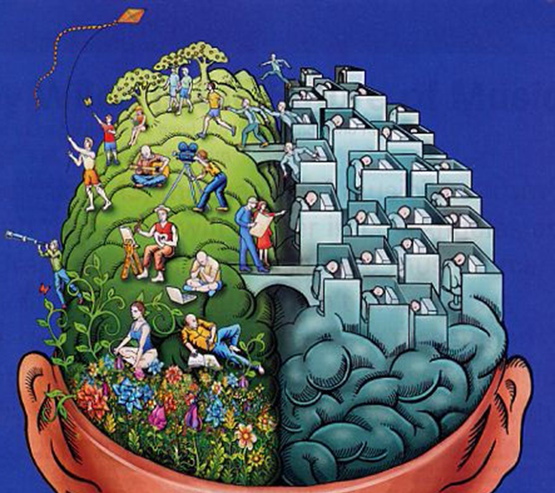
Which side of your brain is most dominant?
Remembering events in words – what was said
Prefer working alone
Good at spelling
Good at thinking logically
Likes to read
Will make a step-by-step plan before getting on with a task
Remembering events in pictures – what you saw
Prefer working with other people
Good at thinking up imaginary narratives
Enjoys art and creativity
Likes to listen to music
Will think more about the final product of the task – not how to get there!
L
R

Slide 30

Which way does the dancer turn?
anti-clockwise
clockwise
=
=
‘left dominant’ brain
‘right dominant’
brain

Slide 31
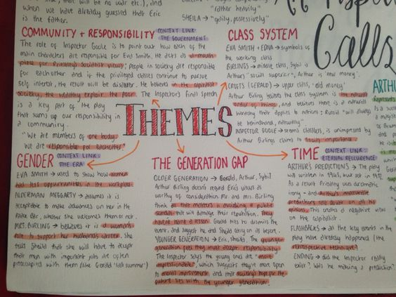
An Inspector Calls by J.B. Priestley explores several key themes, notably social responsibility, class inequality, and the consequences of actions. The play critiques the selfishness and moral complacency of the upper class, highlighting how the wealthy often fail to consider the impact of their actions on others, particularly those less fortunate. Through the character of Inspector Goole, Priestley emphasises the importance of collective responsibility, suggesting that everyone in society is interconnected, and the mistreatment of one individual affects the whole. Another central theme is guilt and morality, as the characters are forced to confront their roles in the tragic downfall of Eva Smith, a working-class woman. Priestley also critiques the arrogance and rigidity of capitalist ideology, advocating for a more empathetic and socially just society.

Slide 32


