Slide 1

Year 11:
Subject Exam Preparation Guidance

Slide 2




Generic Advice Prior to Exams
Practise Core Skills
Have an Effective Plan
Redraft Classwork
Use Exam/Assessment Feedback
Use Online Revision Tools
Use the Experts!

Slide 3




How to Prepare and Succeed: English Language
Question 2: Summary, 8 marks
Question 3: Language Analysis, 12 marks
SUMMARISE key differences/similarities using SQUID
Use quotations
Make inferences – don’t zoom into language!
COMPARE to second source
Don’t mention the reader!
An extended version of LP1, Q2
Only refer to the section you’re asked to explore
Include a range of embedded quotations
Spotlight key words, methods, phrases used and ‘squeeze’ the effect from them!
Question 4: Comparing Writer’s Viewpoints, 16 marks
Question 5: Discursive Writing, 40 marks
Focus on the thoughts/feelings of the WRITER
Use MAPT: identify the methods used, the attitudes, the purpose and the tone and compare in each
Spotlight key words, methods, phrases – just remember to focus on what they imply about the WRITER’S feelings!
Use RASOR
Identify the PAF prior to writing
Decide on your viewpoint and express this cleverly and passionately using a variety of methods
Use a range of punctuation, paragraphing and sentence forms
Plan, plan plan!

Slide 4





Read each source again with each question focus in mind, practicing the skills required for each
How to Prepare and Succeed: English Language
Consider your work on past sources provided to you in lessons and on ClassCharts
Answer each question using the skills taught in lessons and the model answers on ClassCharts
Consider your wider study of news articles which both explore similar/the same topics and ideas – these are your sources!
For question 5, consider our work on a variety of articles, speeches, blogs, letters to ensure you are familiar with their conventions – practise writing each form using RASOR
Practise reading both sources, initially identifying the overall purpose, audience and form

Slide 5
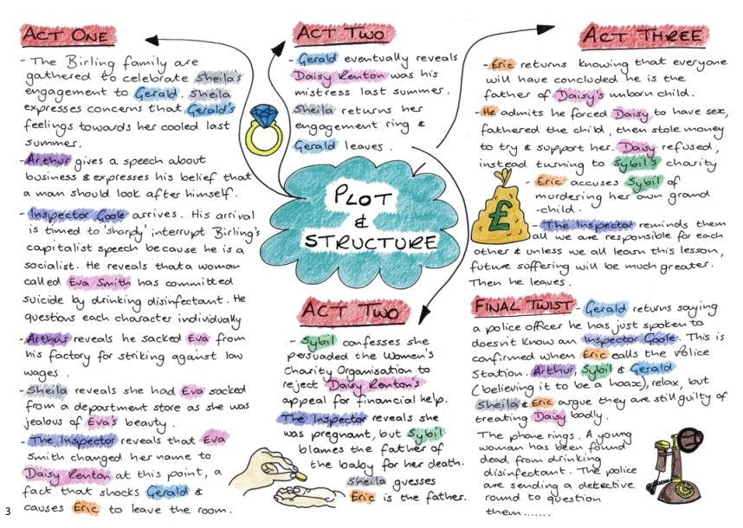


How to Prepare and Succeed: English Literature
An Inspector Calls
34 marks, 45 mins
Power and Conflict Poetry 30 marks, 45 mins
Unseen Poetry – 24 marks and 8 marks, 30 mins
Revise key scenes, quotations characters and themes using your flashcards to support
Access the Mr Bruff YouTube channel for helpful analytical, plot and contextual knowledge
Practise past exam questions
Upgrade your in-lesson responses
Use feedback from your previous Literature exam as a focal point when writing here
Re-read the poems
Summarise each poem and reduce to 5 main quotations – use your flashcards
Conduct ECLIPS plans and responses
Use your skills from the Power and Conflict question to help you with unseen poetry – source poems online and practice an ELIPS annotation and response

Slide 6
How to Prepare and Succeed: Maths
Foundation Tier
Higher Tier
Paper 1 – Calculator, 1 hour 30 minutes, 100 marks
Paper 2 – Non-calculator, 1 hour 30 minutes, 100 marks
Paper 3 – Calculator, 1 hour 30 minutes, 100 marks
Paper 4 – Calculator, 1 hour 30 minutes, 100 marks
Paper 5 – Non-calculator, 1 hour 30 minutes, 100 marks
Paper 6 – Calculator, 1 hour 30 minutes, 100 marks
Any of the content can be assessed in any of the three papers.
To help you prepare – start with your purple Routes to Remarkable booklet. This has suggested websites to use, a list of topics from your mock that you need to improve on and an overview of the entire course.
You also have your Pinpoint Learning booklets (which are personalised) and the past papers that your class teacher has been handing out in lessons.
Top exam tip: complete the questions in the order you can do them, skip them if you're not immediately sure. Then work through them again slowly once you've done all the questions you're confident on. This will make the best use of the time in the exam.

Slide 7



How to Prepare and Succeed:
Spanish and French.
SPEAKING
WRITING
HIGHER
WRITING
FOUNDATION
Use purple and black revision books
Prepare speaking cards
Revise all of PALM-W for photo card
Practice photo cards and role plays at the back of the speaking booklet
HIGHER
Practice 150 word answers using the support sheets and the language ladders to assess your grade
FOUNDATION
Practice the photo card and 40 word answers
FOUNDATION AND HIGHER
Practice 90 words answers using the support sheets and the language ladders to assess your grade
Practice translation in the back of your Grammar and Translation orange book. Self-assess the translation with the marking booklet.
LISTENING AND READING
Check the Active Learn Library is all gold or green
Revise using your purple and black revision book
Carry out the practice exam questions in your purple and black revision booklet

Slide 8
How to Prepare and Succeed: Drama
Section A
45 marks
Section B
15 marks
1 hour 15 minutes
30 minutes
Revise key scenes in DNA – how would you direct and design that scene?
Revise key terminology in drama – both acting and design
Use Anna Starbuck videos for access to GCSE support
Practice past exam questions
Upgrade your in-lesson responses
Use feedback from your previous Literature exam as a focal point when writing here
Make notes on 3 key scenes in 'Life of Pi' or 'Feel Me' - what happened?
For each scene, write down how the actors used their bodies, stage space and voices
For each scene, write down how the lighting/sound/set/stage furniture and props/costume were used in this scene
Revise key terminology in drama – both acting and design

Slide 9
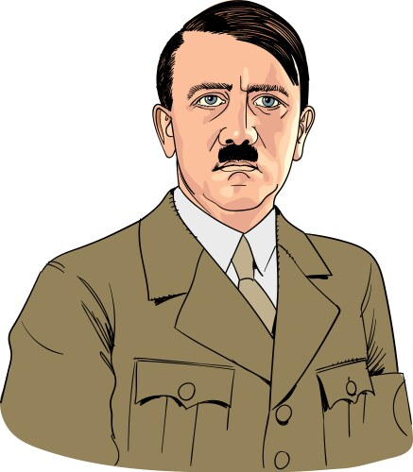

How to Prepare and Succeed:
History
The creation of a dictatorship – 12 marks
Paper 3 – Weimar & Nazi Germany
1 hour 30 minutes
The Reichstag Fire and the impact
The Enabling Law
The creation of a 'one party state'
The Night of the Long Knives
Why was Hitler appointed Chancellor?
36 marks
Impact of the Depression on votes for the Nazi Party
Who voted for the Nazi Party
Why President Hindenburg appointed Hitler as Chancellor
This is a SKILLS paper!
Refer to past retrieval tests and upgraded work.
BUG exam questions.
Use GCSE Pod & the ‘ Clear Revise’ revision guide
Attend intervention on Wednesdays.
Almost half the marks you can gain without any own knowledge
This paper is testing your ability to infer from sources and evaluate interpretations (different views)

Slide 10



How to Prepare and Succeed:
Geography
Tip – Remember to use your case studies checklist and key term glossaries! Both are available on ClassCharts.
Paper One – Physical Geography
1 hour 30 minutes
The Living World - 25 marks
Ensure you know your case study/named examples for the Thar Desert and Malaysia rainforest.
Use your locational knowledge to explain different climates and ecosystems
For different ecosystems how have plants and vegetation adapted? Challenges and opportunities for each environment.
Challenge of Natural Hazards -
33 marks
Plate tectonic boundaries.
Know causes, effects and responses about named earthquakes Chile and Nepal.
Explain the formation, effects and responses to Tropical Storm Haiyan.
Physical landscapes in the UK -
30 marks
Remember we do the Rivers and Coasts sections – NOT glaciers!
Refer to past tests and upgraded work.
Re-do past questions.
BUG exam questions/ METAL skills questions.
Use GCSE Pod/ ‘Clear Revise’ revision guides and resources provided on Class Charts.
Attend intervention on Tuesdays.
Ensure use of tier 3 specialist terminology.
Refer to erosional, transportation and depositional processes.
Landforms and explanations of how they are formed.
Practice use of OS maps and interpreting landforms.
Describe/explain management of rivers and coasts.
Named examples of River Tees and Holderness coast.

Slide 11
How to Prepare and Succeed:
MUSIC
'MAD T-SHIRT'
AoS 2.3.4.5
(Areas of study)
Listening exam
1.5 hours. Total of 80 Marks. 40% of your final grade.
Remember to use 'MAD T-SHIRT' to help you reference the elements of music for each question in your exam.
You need to know what 'MAD T-SHIRT' stands for and how to pick out these elements in the music.
Refer to the revision video links that are on class charts.
You need to know the key features of each area of study.
Remember to read the questions carefully, which elements do you need to focus on?
You need to know the correct terminology for each area of study.

Slide 12
How to Prepare and Succeed: Design and Technology
Exam - 2 hours
Section A – Core Technical Principles 20 marks.
10 multiply choice questions and 5 short 2-mark questions.
Section B – Speicalist Technical Principles 30 marks.
Various question around 2-5 marks. This section includes an extended writing question worth 8 marks and some maths questions.
Section C – Designing and Making Principles 50 Marks
Various question about designing and making, inlcuding 6-mark answers. Maths and drawing questions included.
.
Use you Collins revision books and the practice questions.
Search topics on GCSE Pod to check you knowlodge.
Think about the retreival questions completed in the being of the lessons and link these to any answers.
Write the extended writing questions as a PEE response.
Use a range of technical language, avoid words like 'strong' and 'cheap' unless it’s a comparison to another product or material

Slide 13
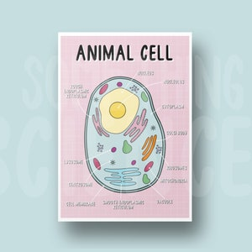
How to Prepare and Succeed: Science
Paper 2 Topics
Top Tips
Biology: Homeostasis and response; Inheritance, variation and evolution; and Ecology.
Chemistry: The rate and extent of chemical change; Organic chemistry; Chemical analysis; Chemistry of the atmosphere; and Using resources
Physics: Forces; Waves; Magnetism and electromagnetism; and Space (SepSci only)
Use your revision guides to make notes and complete the practice exam questions that are in them.
Use GCSE Pod and Seneca learning as excellent online revision tools.
Speak to your science teachers about some past paper questions for practice, they will provide you with some.

Slide 14
How to Prepare and Succeed: Food Preparation and Nutrition.
Food Science: Understand chemical reactions in food preparation (e.g. emulsification, caramelisation).
Nutrition: Be able to explain the functions of nutrients, the dietary needs of different groups, and how to analyse nutritional content.
Food Safety: Know food hygiene principles, temperature control, and preventing foodborne illness.
Food Provenance: Understand where food comes from, its journey, and sustainability issues.
Use you Collins revision books and the practice questions.
Search topics on GCSE Pod to check you knowlodge.
Think about the retreival questions completed in the being of the lessons and link these to any answers.
Write the extended writing questions as a PEE response.
Use a range of technical language, avoid words like 'Obesity' and 'positive energy balance' rather than "fat or gaining weight.

Slide 15


Refer to past retrieval tests.
Re-do past questions.
Use revision guides and E-Revision.
Attend intervention on Mondays.
How to Prepare and Succeed: PE
Paper 1 =78 marks 75 minutes
Paper 2 = 78 marks 75 minutes
Anatomy and physiology – types of exercise, effects of exercise, cardio-respiratory system, musculoskeletal system.
Movement analysis – levers system, planes and axes
Physical training – components of fitness and principles of training.
All of paper 2 was taught in Y10.
Psychology – classification of skills, goalsetting, information processing, guidance, feeedback, arousal, aggression, personality and motivation.
Health and wellbeing – fitness, sedentary lifestyles, somatotypes, diet

Slide 16
How to Prepare and Succeed:
Art and Photography
Final Outcome Planning
Component 1, AO4
5 hours
Success criteria
Review your project so far and reflect on what has been successful, and what has worked well.
What media/technique do you like working in and why?
What will be the subject of your final outcome/outcomes?
How will you present your final piece?
Which artists does your final piece link to?
How does your final piece idea link to your theme?
Your final piece should link to the rest of your project.
Be ambitious! Do not settle for the easy option.
Discuss your idea with your teacher before the exam.
Research potential ideas online to see how other artists have approached the subject.

Slide 17
How to Prepare and Succeed:
Art, Craft and Design
Final Outcome Planning
Component 1, AO4
5 hours
Success criteria
Review your project so far and reflect on what has been successful, and what has worked well.
What media/technique do you like working in and why?
What will be the subject of your final outcome/outcomes?
How will you present your final piece?
Which artists does your final piece link to?
How does your final piece idea link to your theme?
Your final piece should link to the rest of your project.
Be ambitious! Do not settle for the easy option.
Discuss your idea with your teacher before the exam.
Research potential ideas online to see how other artists have approached the subject.

Slide 18
How to Prepare and Succeed: Religious studies
Paper 1: 1 hour 45 minutes. 100 marks
Paper 2: 1 hour 45 minutes 100 marks
Marks/time
Use the topic list on classcharts – which areas do need to work on?
Use your revision guides to go over Buddhist and Christian beliefs and practices
Complete seneca quizes online/ create flashcards to check your understanding of key terms
Use the quotes booklet to create a bank of useful sources of authority (see MEA if you don't have one of these)
Only 2 themes in this Mock (A: Relationships and Families, D: Peace and conflict).
Use the topic list on classcharts to narrow down your revision
Use your revision guides to complete practice 12 mark questions
Use the quotes booklet to create a bank of useful sources of authority
Don't miss questions out – if you usually run out of time start with the 12-mark questions
Read the questions properly!
Read through the feedback in your books from previous assessments

Slide 19
How to Prepare and Succeed: Computer Science
Paper 1 – Computer Systems (1hr 30min)
Paper 2 – Algorithms (1hr 30
Use GCSE Pod to revise the basic components of the computer
Ensure you revise how data such as images, text, and sound are stored in a computer.
Recap the Networking Exam which we only recently completed in prep for this mock.
Ensure you use Grok learning to practice programming from home.
Ensure you know how to input and store data in a variable.

